Slide 1
Site Reuse Initiative
Gordon Conwell Theological
Seminary

Slide 2
Presentation General Contents
Historic Opportunity
Goals
Code Options
Conventional Zoning
Coding for Special Situations
Coding Emphasizing Design
Site Assessment Informs Code
Becoming Familiar With Design-Based Codes
Notes:
This presentation will look at a few alternative methods of land development coding that will guide the Seminary’s built future as a community – what are its regulating mechanisms and its shortcomings, and we will ask whether we will get the results intended by using these instruments.
We will talk about Conventional and Special Situation Coding and a “new, “old”, idea” – Emphasizing Design as an option to create a physical environment residents would like to have and how to implement that.
Finally, we will look a few Case Studies and Model Bylaws created by the Commonwealth of Massachusetts for more clarity.

Slide 3
Presentation General Content
Historic Opportunity
Goals
Code Options
Conventional Zoning
Use-Based Coding
Coding for Special Situations
Coding Emphasizing Design
Site Assessment Informs Code
Becoming Familiar With Design-Based Codes

Slide 4
Presentation General Content
Historic Opportunity
Goals
Code Options
Conventional Zoning
Coding for Special Situations
Overlay Districts
Planned Unit Developments
Coding Emphasizing Design
Site Assessment Informs Code
Becoming Familiar With Design-Based Codes

Slide 5
Presentation General Content
Historic Opportunity
Goals
Code Options
Conventional Zoning
Coding for Special Situations
Coding Emphasizing Design
Prescriptive vs Proscriptive
Organizing Principles
Pictures Not Words
The Official Map
Site Assessment Informs Code
Becoming Familiar With Design-Based Codes

Slide 6
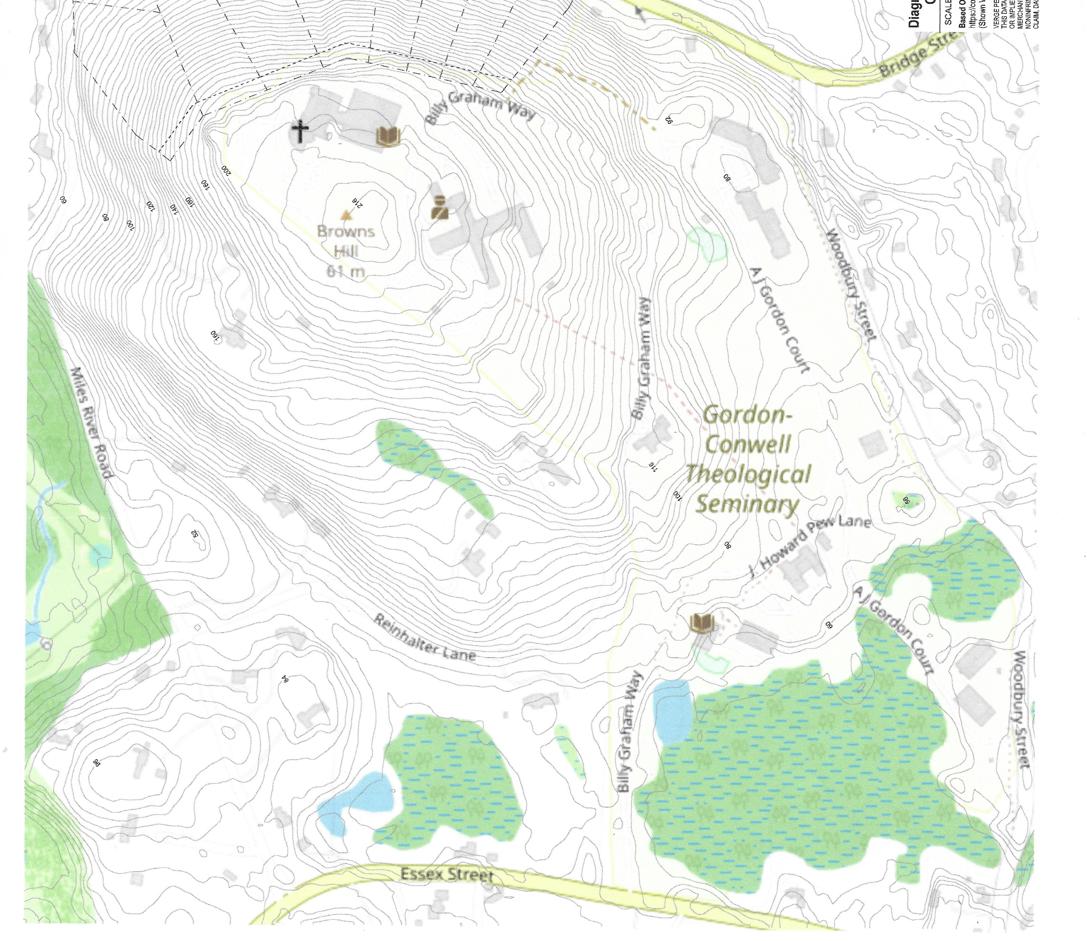
Historic Opportunity
Historic Partnership Between the Town, Its Residents & a 50+ Year Neighbor - The Seminary
Historic Opportunity For All to Create a Code That Will Produce Intended Results

Slide 7
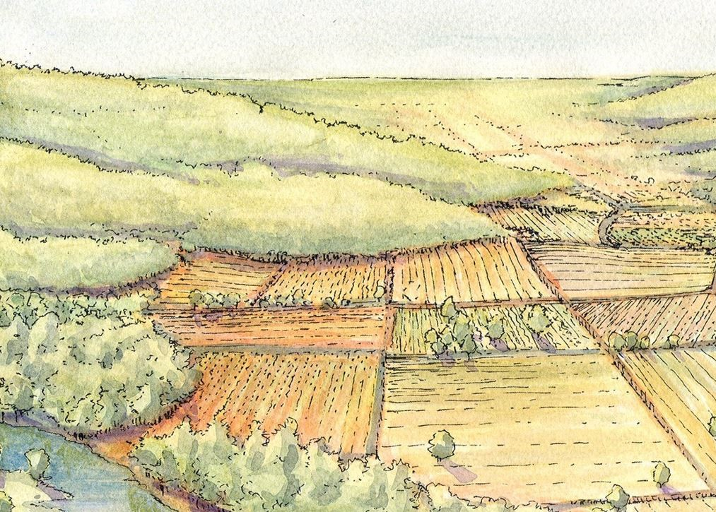
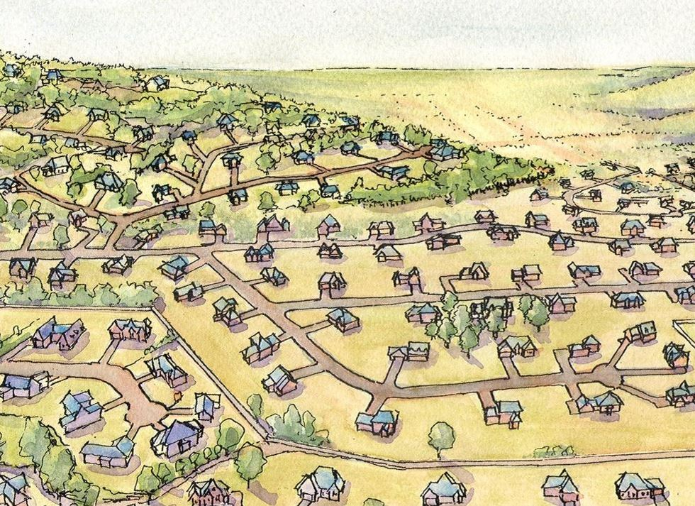
Conventional
Pre-Development
Illustrative
Development Examples
Conventional
Creative
Creative

Slide 8
Overall Context
Adjacent Zoning
Northerly
Bridge St– R-1A
Easterly
Woodbury St – R-1A
Southerly
Essex St – R-1A & RA
Westerly
Residential – R-1B

Slide 9
Campus Areas
Upper Campus
Res
Distinct Areas
Upper Campus
Middle Campus
Lower Campus
Field
Residential (Res)
Each has identifiable & definable characteristics to be evaluated
Middle Campus
Field
Lower Campus
Res
Res

Slide 10
Area Characteristics
Hilltop Prominence
Expansive Vistas
Major Structures for Repurposing
Level Open Space
Area Privacy Through Separation & Elevation
Experiential Value
Upper Campus
Enlarged Site Areas

Slide 11
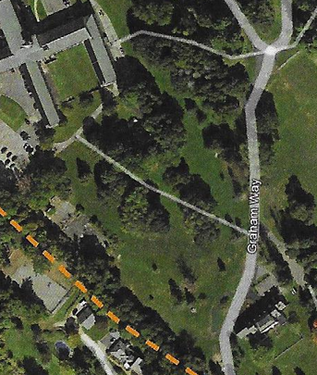
Area Characteristics
Heritage Landscape Surrounding The Retreat Building
Scenic Views
Sweeping Lawns
Walking Paths
Mature Tree Cover
Meaningful Open Space
Middle Campus
Enlarged Site Areas

Slide 12
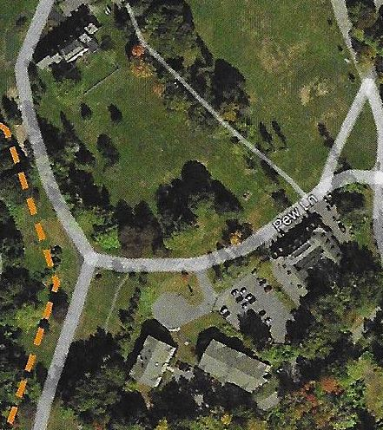
Area Characteristics
Historic Architecture
Heritage Landscape Surrounding The Retreat
Sweeping Lawns
Mature Tree Cover
Gateway Potential
Meaningful Open Space
Residential Buildings
Abuts Pond & Wetlands
Lower Campus
Enlarged Site Areas

Slide 13
Area Characteristics
Level & Gently Sloping Terrain
Mature Tree Buffer
Gateway Potential
Residential Buildings
Ease of Site Entering / Exiting
Suitable for Interior Development
Fields
Enlarged Site Areas

Slide 14
Site Scale
Approx. Size of Winthrop School Site
Relative Scale for a Village Settlement

Slide 15
Goals
Goals of Balanced Planning and Regulation-Making
Process:
Institute a public procedure for decision-making that is thorough and fair to all concerned over time
Results:
Make choices that will cause the actual place to get better rather than worse as it changes
Create a place through visioning & codify the plan for predictability

Slide 16
Code Options
Use-Based Zoning
Overlay Districts
Planned Unit Development
Form-Based Codes
Traditional Neighborhood Development
Village Center District

Slide 17
Use-Based Zoning
What Hamilton Has Now
Disadvantages:
Re-Active, Not Pro-Active
Mapped Districts With Single Uses Assigned
Revisions Are Difficult, Frequent & Time Consuming
Results Rarely Predictable
Does It Work as Intended? Probably Not
Advantages:
Easiest to Implement Because It Is Familiar
Conventional Zoning

Slide 18
Special Situations
Overlay Districts
ODs are used where particular site characteristics require special considerations
Disadvantages:
Proscriptive – Prohibits vs Promotes
Requires more consensus building
Reactive, Not Proactive Process
Advantages:
Minimal Effort to Write & Enact

Slide 19
Special Situations
Planned Unit Developments (PUD)
Use-Based Code that opens the door Primarily to Mixed-Use But Remains Proscriptive
More Palatable Than Variances
Requires a Master Plan
Disadvantages:
Has All Disadvantages of Overlay Districts & Conventional Codes
Requires Experienced Elected Officials and Staff to Evaluate Project Quality
Advantages:
Easy to Write & Implement
Flexible
Limits Upfront Invest By Developer

Slide 20
Emphasizing Design
Form-Based Codes
FBCs May Not Be the Best Application Here Because of The Unknowns & Variables
Traditional Neighborhood Development (TND)
Recommended For Additional Study
Village Center District
Recommended For Additional Study
Notes:
This presentation will look at the instruments that will guide our built future as a community – what are its regulating mechanisms and its shortcomings and we will ask whether we are getting the results intended at this point in time.
We will talk about a “new, “old”, idea” – Form-Based Coding as an option to create a physical environment residents would like to have and how to implement that.
Finally we will look a few Case Studies in which I was closely involved.

Slide 21
Emphasizing Design
Traditional Neighborhood Development
TND is an Update to the PUD
May Be Applied In a Number of Places Tailored To Individual Conditions
Requires a Master Plan
Village Center District
Supplements the TND Model
Helps to Zone for a More Gradual or Piecemeal Revitalization of Existing Sites with No Mixed-Use
Language for These Guidelines Must Emerge from a Community Outreach Process to Identify the Appropriate Permitting Vehicle

Slide 22
Specific Content
Disadvantages:
Must be carefully crafted to avoid creating too much density and traffic
Advantages:
Can guide new development patterns that are civic-oriented, pedestrian-friendly, economically vibrant, environmentally sustainable, and evoke a sense of place

Slide 23
Site Assessment Informs Code
Checklist of Site Data
Physical Data
Cultural Data
Data Correlation

Slide 24
Physical Data
Water
Existing water bodies – variation & purity
Natural & man-made drainage channels
Topography
Patterns of landform
Contours
Slope analysis
Visibility analysis
Circulation analysis
Unique features
Ecology
Map of general plant cover, including wooded areas
Specimen trees to remain
Man-Made Structures
Existing buildings
Circulation
Utilities
Checklist of Site Data

Slide 25
Experiential Qualities
Character & relationships of visual spaces
Viewpoints, vistas, & visual focal points
Quality & variation of light, sound, and other senses
Cultural Data
Past & Future
Site History & Traces
Data Correlation
Classification of site by areas of similar structure, quality, and problems
Identification of key points, lines, and areas
Analysis of current and likely future changes
Identification of significant problems and possibilities
Checklist of Site Data

Slide 26
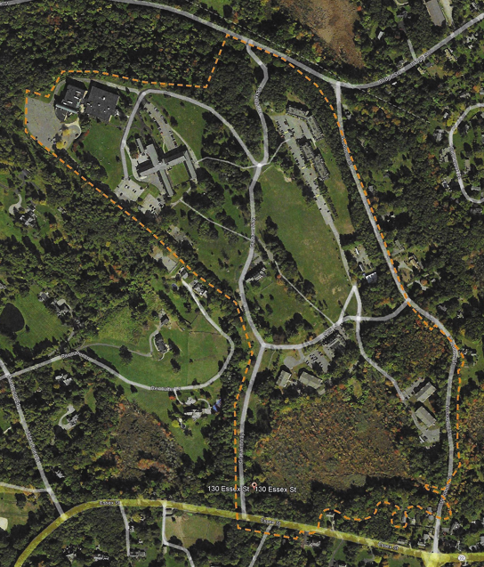
Site Map

Slide 27
Topography
Notes:
This presentation will look at the instruments that will guide our built future as a community – what are its regulating mechanisms and its shortcomings and we will ask whether we are getting the results intended at this point in time.
We will talk about a “new, “old”, idea” – Form-Based Coding as an option to create a physical environment residents would like to have and how to implement that.
Finally we will look a few Case Studies in which I was closely involved.

Slide 28
Natural Features
Notes:
This presentation will look at the instruments that will guide our built future as a community – what are its regulating mechanisms and its shortcomings and we will ask whether we are getting the results intended at this point in time.
We will talk about a “new, “old”, idea” – Form-Based Coding as an option to create a physical environment residents would like to have and how to implement that.
Finally we will look a few Case Studies in which I was closely involved.

Slide 29
Existing Street Network

Slide 30
Becoming Familiar With
Design-Based Codes
The Following Section Has Information Pertinent to the Two Design-Based Codes from the Mass.Gov Website:
A Model Ordinance for a Traditional Neighborhood Development
The Village Center Overlay District Model By-Law

Slide 31
Emphasizing Design
Organizing Principles
By Type:
Street
Building
Location
Select One & Diagram Plan
Pictures Not Words
Graphic Codes
The Official Map
The Regulating Plan
Notes:
This presentation will look at the instruments that will guide our built future as a community – what are its regulating mechanisms and its shortcomings and we will ask whether we are getting the results intended at this point in time.
We will talk about a “new, “old”, idea” – Form-Based Coding as an option to create a physical environment residents would like to have and how to implement that.
Finally we will look a few Case Studies in which I was closely involved.

Slide 32
By Street Type
Boulevard
Main Street & Squares
Secondary Downtown Streets
Residential Streets
Alleys
Organizing Principles

Slide 34
By Building Type
Shopfront / Mixed-Use
Commercial & Workshops
Apartments, Inns & Hotels
Rowhouses
Cottages, Bungalows and Front-Porch Houses
Large Houses and Duplexes
Outbuildings and Accessory Apartments
Organizing
Principles

Slide 36
Organizing Principles
By Location
Natural
Fringe
General
Center
Special District

Slide 37
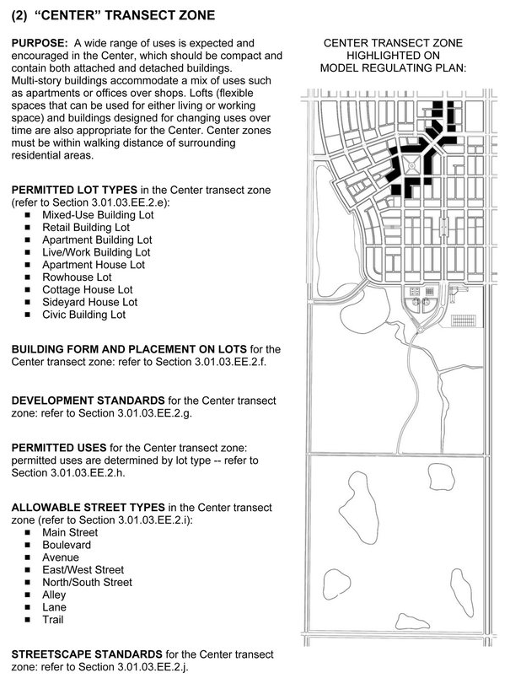
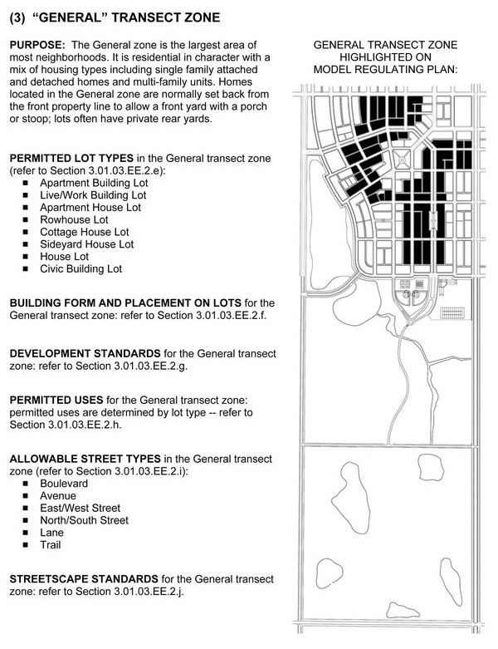
Locations

Slide 38
Graphic Codes
Design-Oriented Codes lend themselves to illustrations
Drawings can communicate much more clearly what is permitted under or sought by the code
Many towns already include drawings, photos or diagrams along with the text in land use regulations
Pictures
Not Words

Slide 39
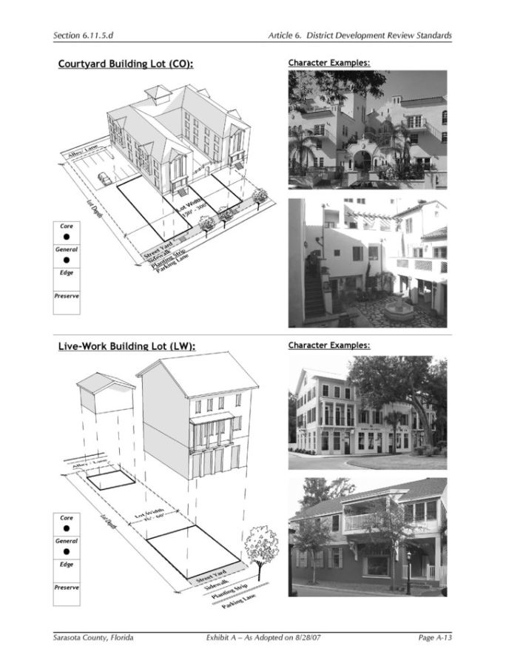
Pictures Not Words

Slide 40
Matrix

Slide 41
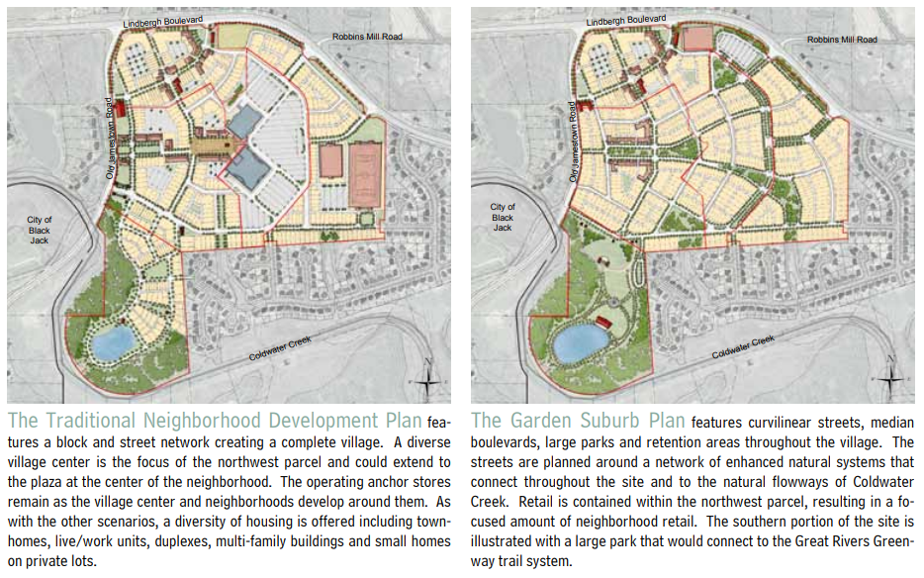
Graphic Illustrations

Slide 42
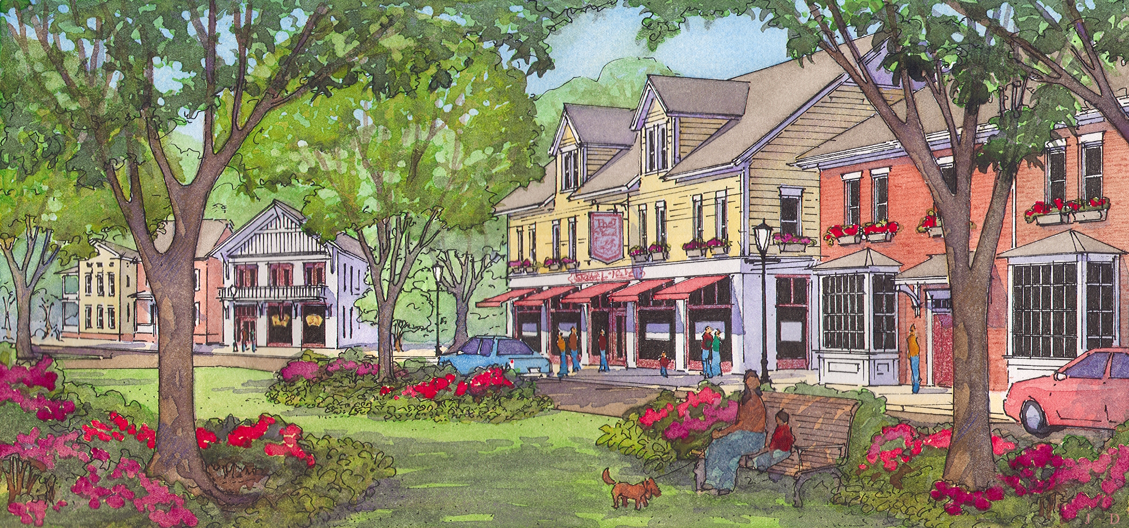
Graphic Illustration

Slide 43
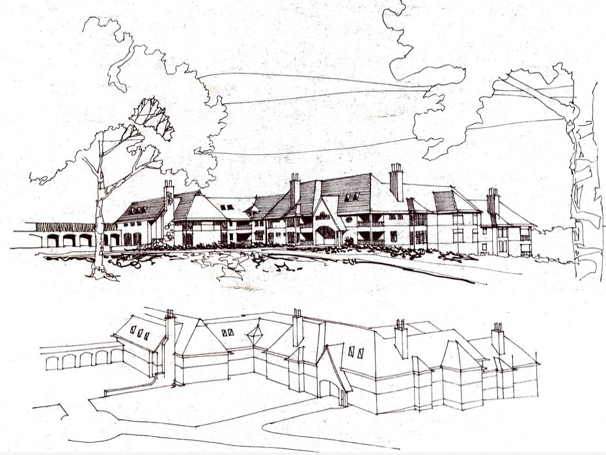

Slide 44
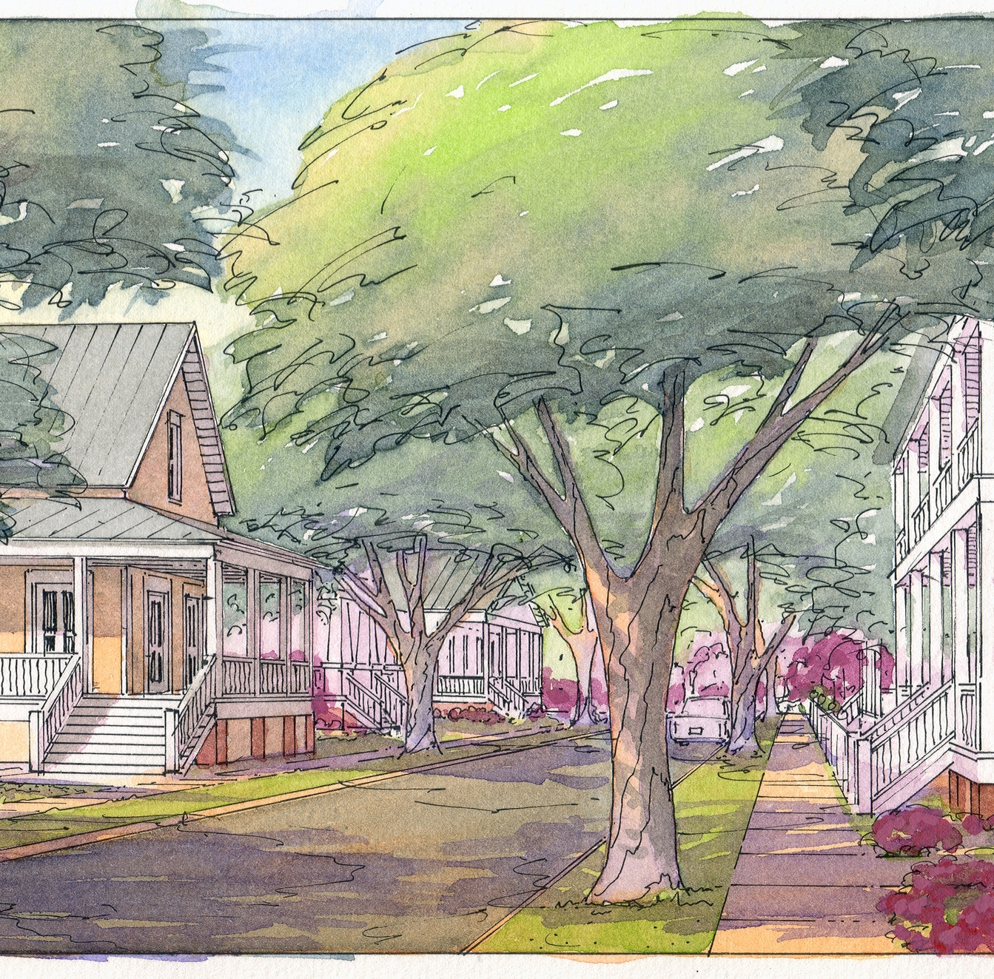
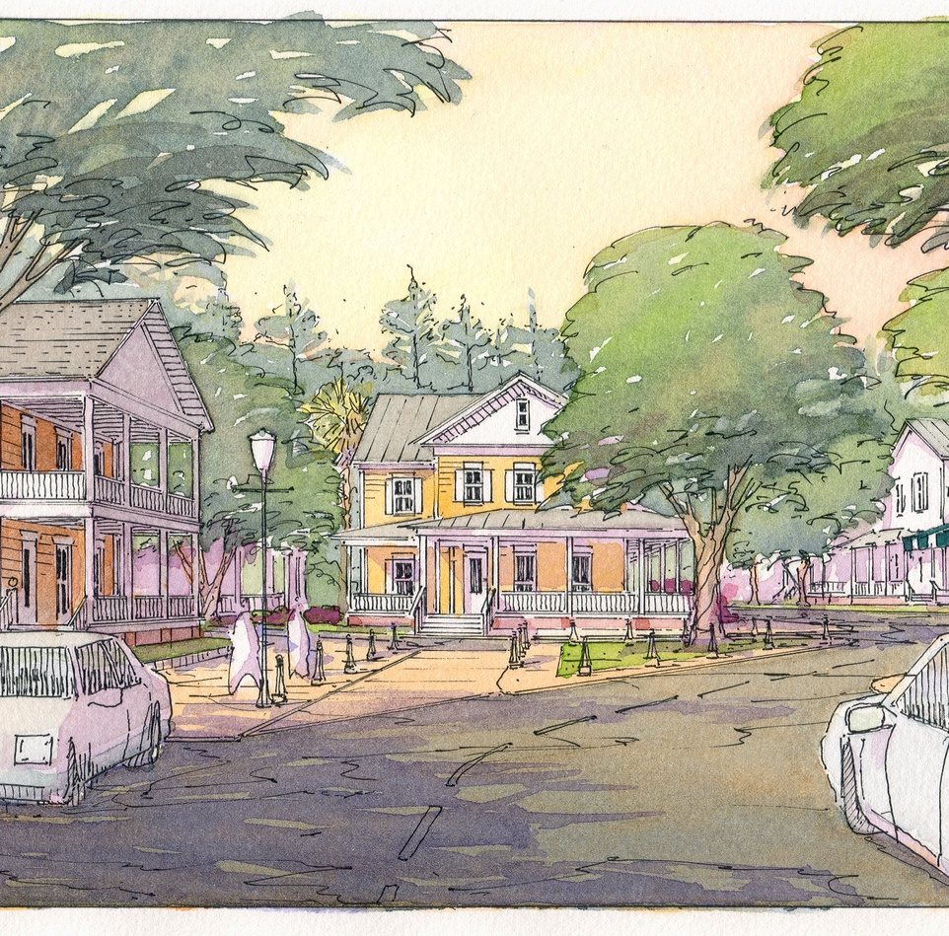
Graphic Illustration

Slide 45
The End

