Slide 1

Gordon-Conwell / Town of Hamilton
Reimagining Our Future TOGETHER

Slide 2
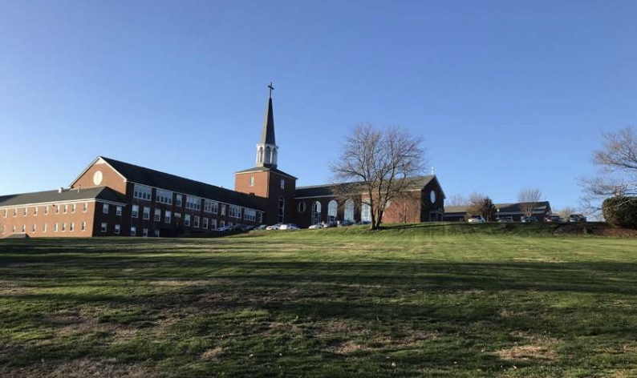
A Brief History of the Project
Fall 2019 - New Seminary President Begins Strategic Planning Process
March 2020 - COVID19 Disruption
Spring 2021 - Seminary Contracts to Sell Apartments for “Affordable Use” Development
Early Spring 2022 - Town Approaches the Seminary re Commercial Overlay
Spring / Summer 2022 – Seminary Announces “Pivot” / ZBA Considers Change-in-Use / Variance Applications
Fall 2022 – Town and Seminary Agree to “Consultation” Process – ZBA Application Withdrawn

Slide 3
A Brief History of the Project (continued)
Fall 2022 - Town / Seminary “Working Group” is Formed – Abramson and Gamble Hired to Conduct “Best Use” Study
Fall 2022 – “Working Group” Engages Planning Board – Planning Board Begins Work CONCURRENT with Consultants and Working Group
Winter 2022 / 2023 – Consultants / Working Group Host Public Hearings and Begin Formulating Reports – Planning Board Begins Working on “Concept Plans”

Slide 4
A Brief History of the Project (continued)
Winter 2022 / 2023 – Seminary Attends ALL Planning Board Sessions with Little Opportunity for Input, but Respects the Planning Board’s Modus Operandi
Feb. 2023 – Planning Board and Working Group Agree to a “Face-to-Face” Meeting (March 7, 2023) in Order to Discuss the Concept Plan / By-laws / Development Agreement in Detail
March 3, 2023 – Planning Board Presents a “Sector Plan”

Slide 5
About the Working Group
Shawn Farrell (Select Board)
Rick Mitchell (Planning Board)
Joe Domelowicz (Town Mgr.)
Scott Sunquist (Seminary)
Ken Barnes (Seminary)
Meirwyn Walters (Sem. Attorney)
Seminary Has Invested $100,000+ in Direct Costs
100s of Hours in Labor Costs
Established an Esprit de Corps from the Beginning
Seeking a “Win / Win” Solution
Sensitive to the Needs of Abutters / ALL Hamilton Tax-payers

Slide 6
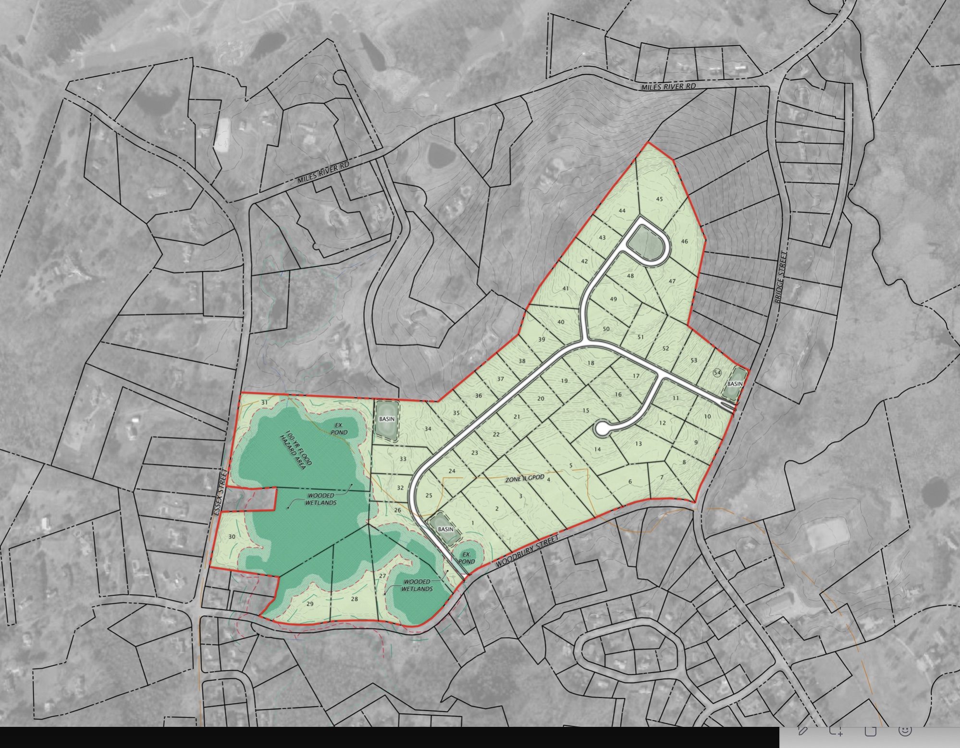
NOBODY Wants This!

Slide 7
General Points of Agreement
Any Development Must be Environmentally Sensitive and Aesthetically Pleasing
Any Development Must Work for ALL Stakeholders
The Seminary Reserves the Right to Remain on Some or All of the Campus (this is a “right-sizing” exercise)
We All Seek a Solution Where the Net Benefits Outweigh Any Perceived Negatives
We Ultimately Seek a Unified (SB/PB/GCTS) Presentation to the Town, for Town Approval at a Special Town Meeting (est. June 2023)

Slide 8
“Three-tiered” Permitting Overlay
Any Re-purposing of EXISTING Buildings Should be “By Right” w/o Additional Site Plan Review (current Town policies refer to new-build sites)
Any Re-use of EXISTING Apartments Should Include “Connecting” Structures (for ADA purposes, etc.) “By Right” but w/ Site Plan Review
Any Additions to EXISTING Buildings Should be “By Right” (up to an agreed size) w/ Site Plan Review
Any New Buildings Should be “By Right” (up to an agreed size) w/ Site Plan Review
Any Development Above the “By Right” Sizes Should be Permitted By Special Permit
The Entire Overlay District Should Have Unique Site Plan Review Criteria

Slide 9
The Logic of “Three-tiered” Permitting
The Town (particularly the Planning Board) Will Maintain Control Over the Process
Developers / Owners Will Know What They May Build w/o Additional Restrictions
The Property is More Likely to Sell in a Timely Fashion
The Town’s Tax-base Will Expand in a More Efficient and Expeditious Manner

Slide 10
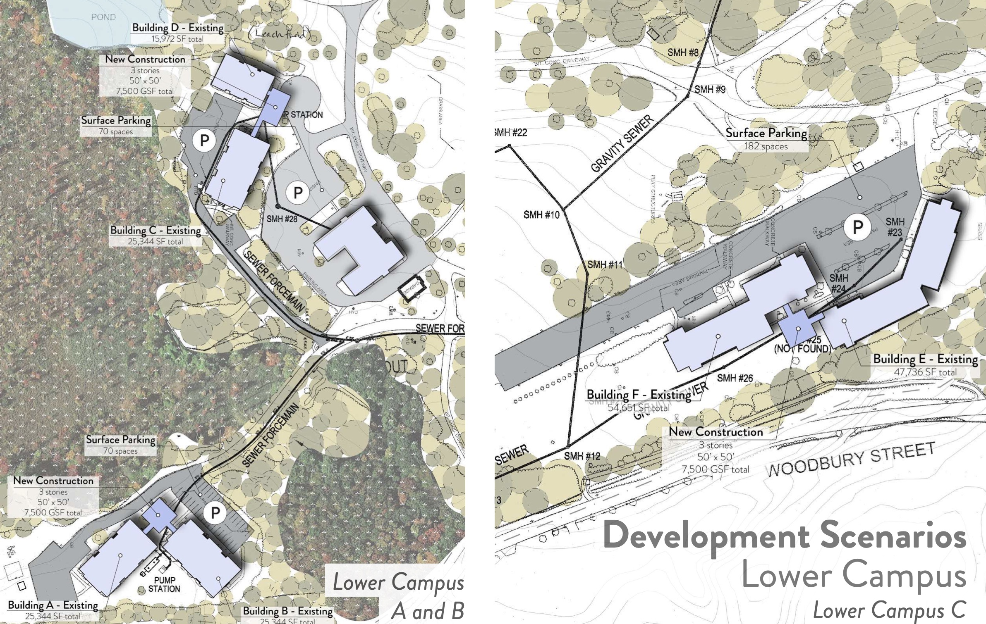
General Agreement on Lower Campus
Re-use of Existing Apartments
By Right Addition of Connecting Spaces
Up to 50% Affordable Housing (this benefits both the Town re 40B credits, and the Seminary)

Slide 11
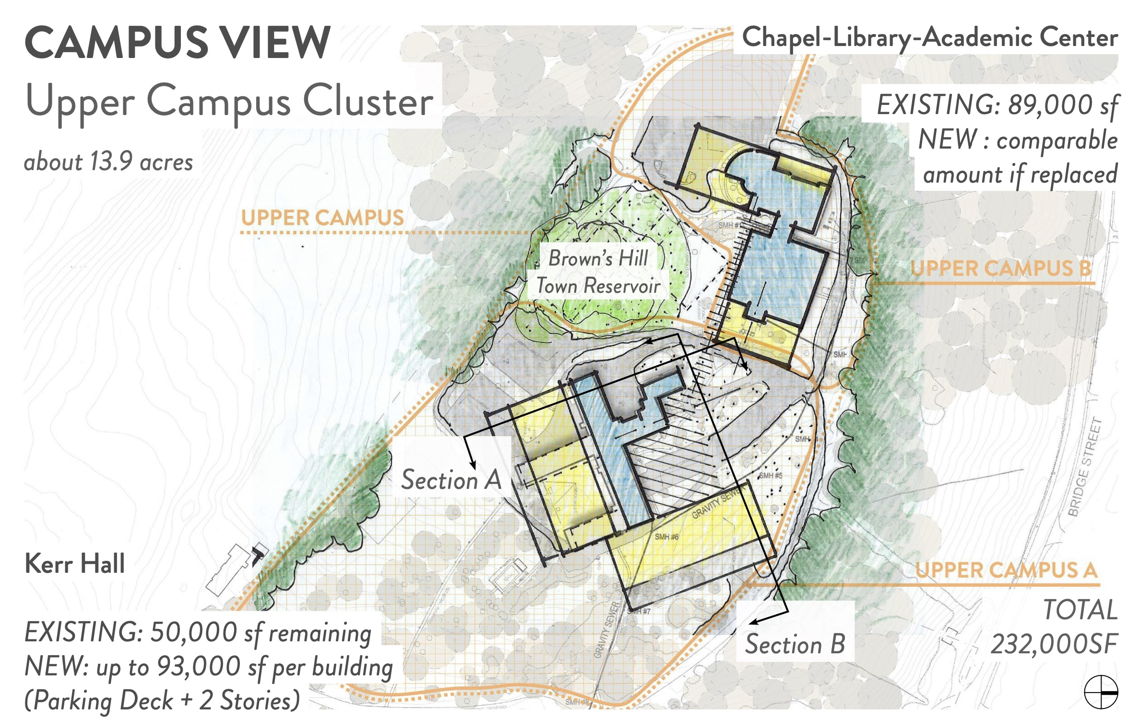
General Agreement on Upper Campus
Re-purposing of Existing Buildings (by right)
New Additions (up to 375,000 total sq.ft. by right – down from our orig. est. of 500,000 sq.ft.)
Any Additional Development by Special Permit (PB approval)

Slide 12
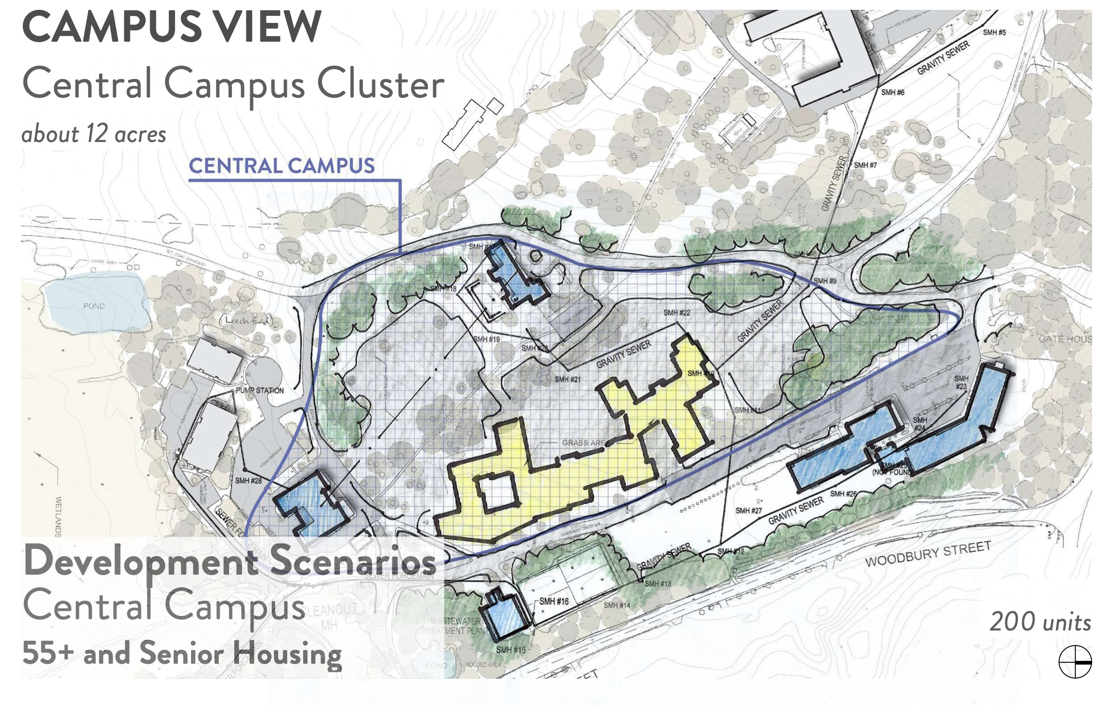
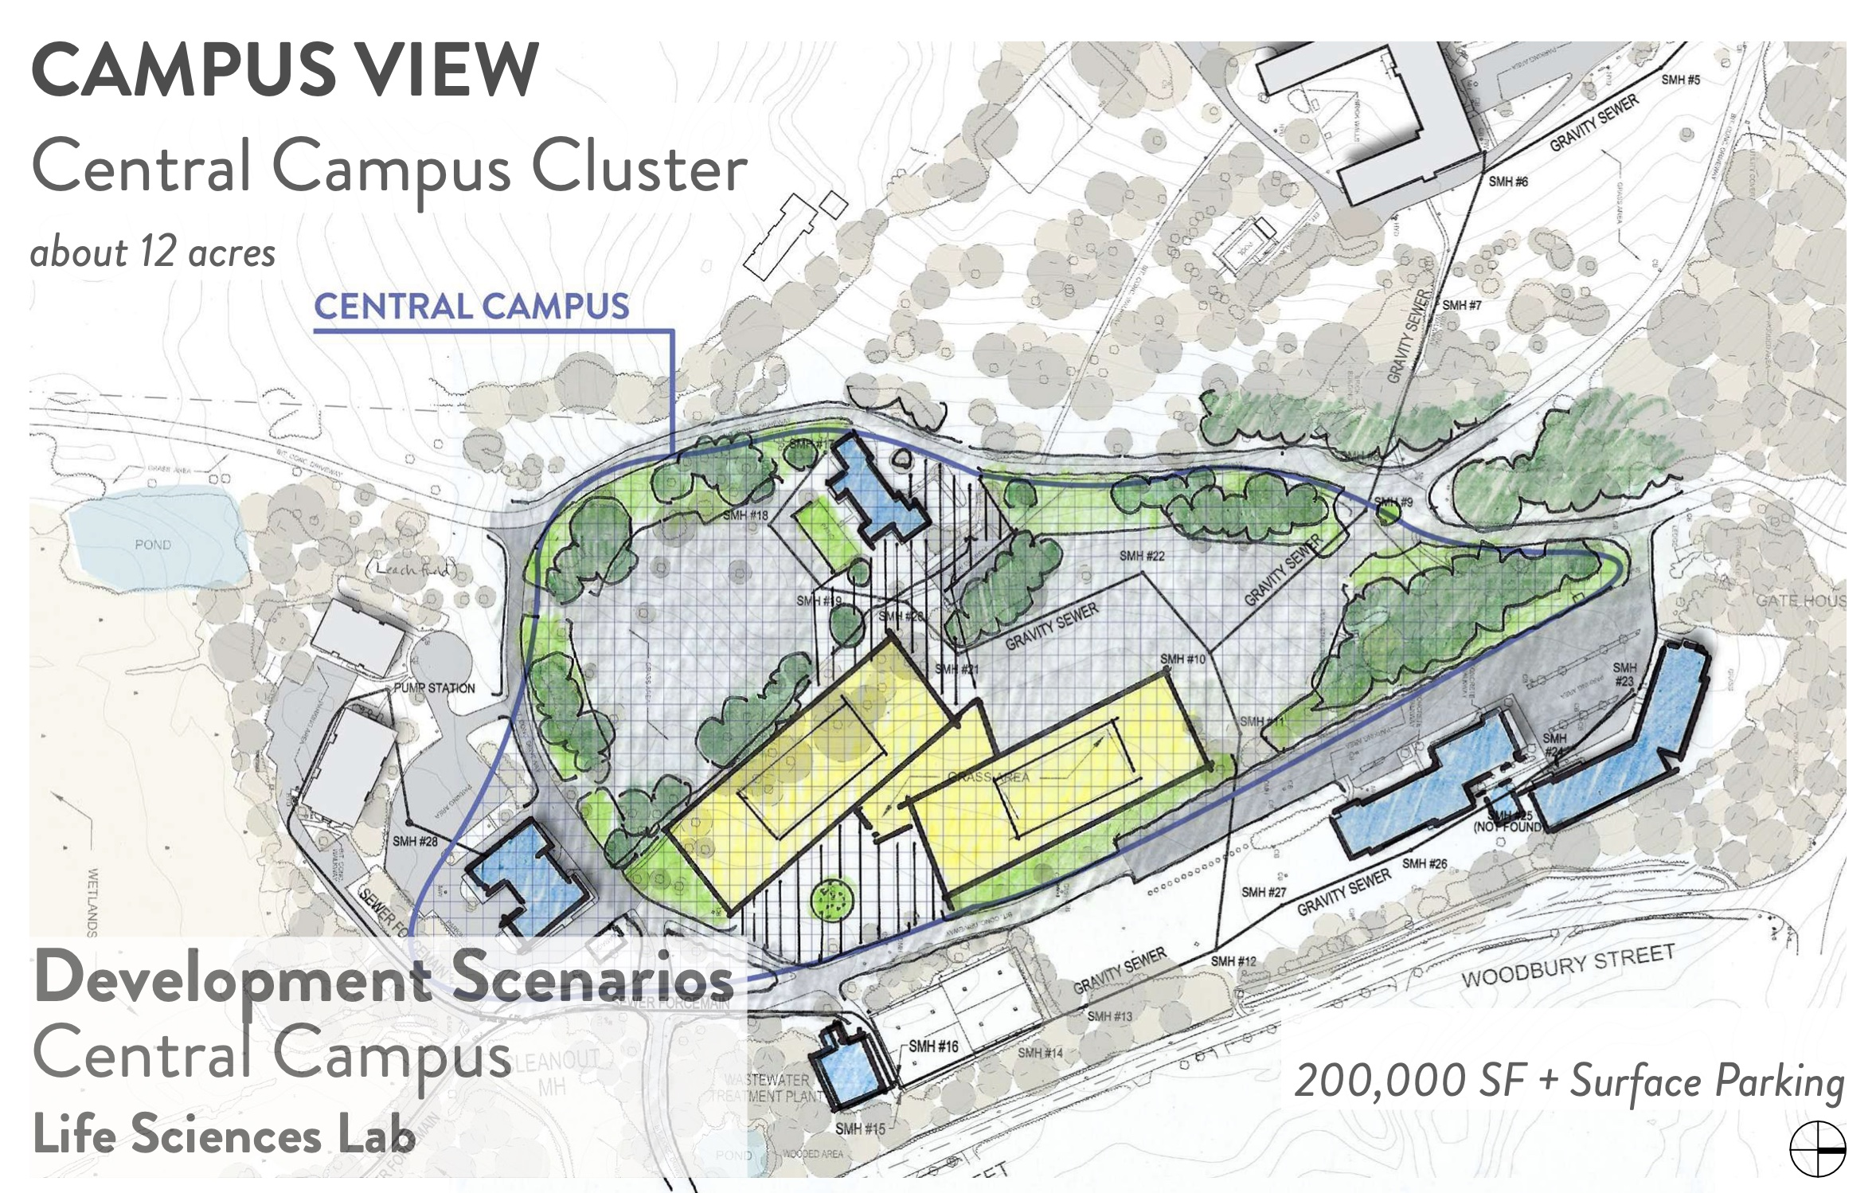
General Agreement on Middle Campus

Slide 13
General Agreement on Middle Campus
New Development Zoned for 55+ By Right (w/ Site Plan Review) Up to 200 Units
New Development Zoned for Lab / Commercial Use (w/ Site Plan Review) Up to 200,000 sq. ft.
Any Additional Development by Special Permit (PB approval)

Slide 14
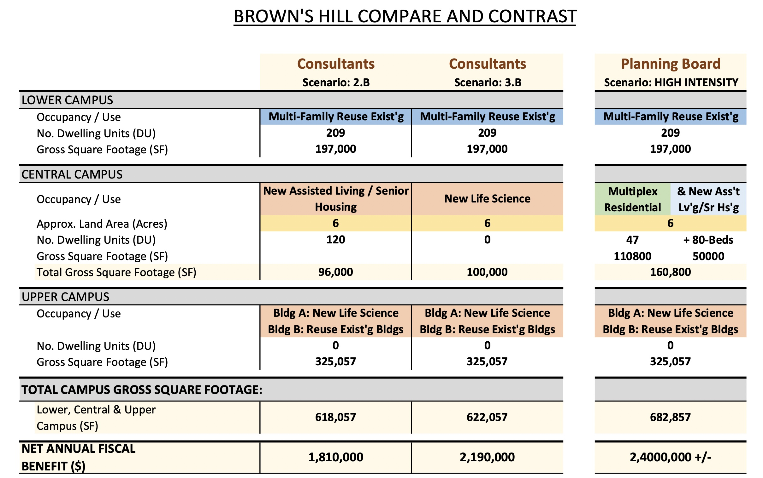
We’re Not a Million Miles Apart!

Slide 15
Overlay District
This Has Always Been an Overlay District Discussion
It is critical to the Seminary that the Current Zoning remain as the “Underlying” District.
Any Portion of the Site Retained by the Seminary for Academic Purposes Will Continue Subject to the Dover Amendment and Unaffected by the Overlay District

Slide 16
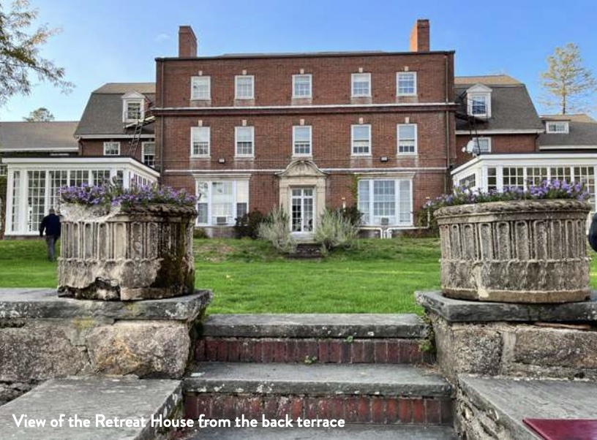
Preservation of Heritage Buildings
Retreat House (pictured) is the Most Important Building to Preserve
We Don’t Anticipate Anyone Destroying It
The Other Buildings (Pilgrim Hall, etc.) Need Considerable Repair and Would Probably Need to be Expanded
This is an Issue for the Development Agreement

Slide 17
Access to Browns Hill
The Seminary Has Always Allowed Unfettered Access to the Campus
As Security Concerns Intensify, This Policy Must Always be Under Review
Future Owners May Have Legitimate Security and Privacy Concerns As Well
We Recommend Some Form of ”Managed Access” Language in the Development Agreement

Slide 18
Perimeter Buffer Zones
Zeiff Property – We Are Amenable to an Additional Buffer Directly Opposite the Residence (but not to include the old tennis court or swimming pool area)
Bridge Street – There is Already a 50ft. Buffer Zone Deeded into the Property. We Would Entertain an Additional 25ft.

Slide 19
Internal Buffer Zones
We Believe This Should be Left Up To New Owners / Developers
Based on a Yet-to-be Agreed Concept Plan, Most Tree Canopies May Be Protected Anyway

Slide 20
Retention of Existing Walkways
See Access to Brown’s Hill and Internal Buffers (previous slides)

Slide 21
No-build Areas
Much of the Property is Already Deemed “Un-buildable” (wetlands, steeply sloping areas, etc.), and the Seminary is Wary of Designating Potentially Buildable Acreage (especially in the Central Campus) as “No-build” Areas

Slide 22
Conservation Restrictions
The Seminary is Open to Discussing Such Restrictions, but Notes that Existing State and Local Wetland Restrictions Provide Substantial Protection to the Town and Limitation on Any Development

Slide 23
Development Agreement
We Are Open to a Mutually Agreed Upon Development Agreement, but Would Remind the Planning Board that the Seminary is Not a Developer, and We Do Not Have a Current Purchaser with Specific Plans
The Enforcement of Any Development Agreement Provisions Must be Subject to Future Developers Receiving Planning Board Approvals

Slide 24
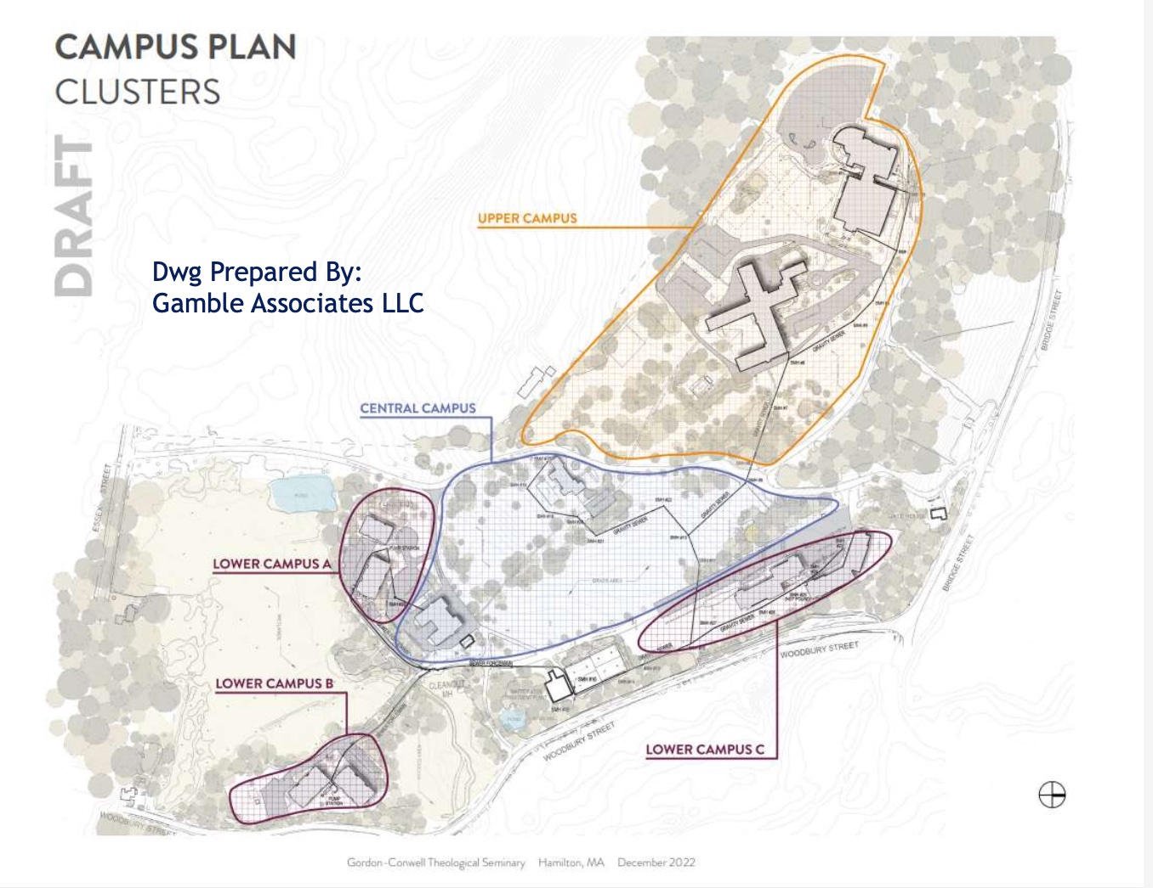
Iterations of the Concept Plan

Slide 25
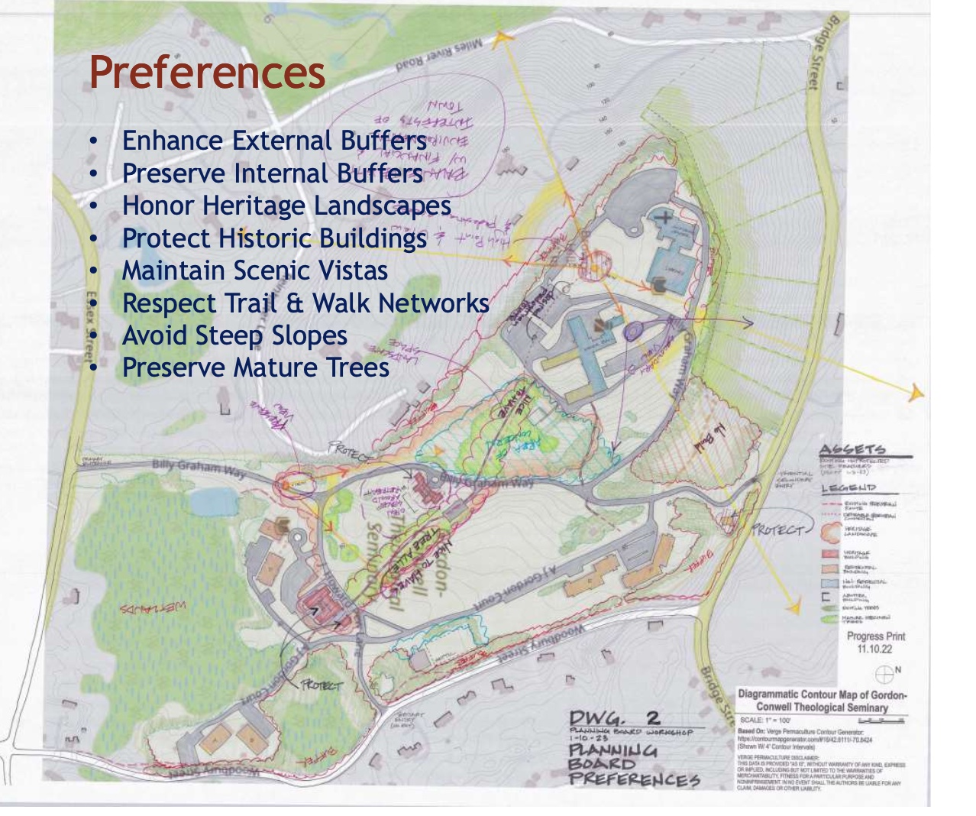
Iterations of the Concept Plan

Slide 26
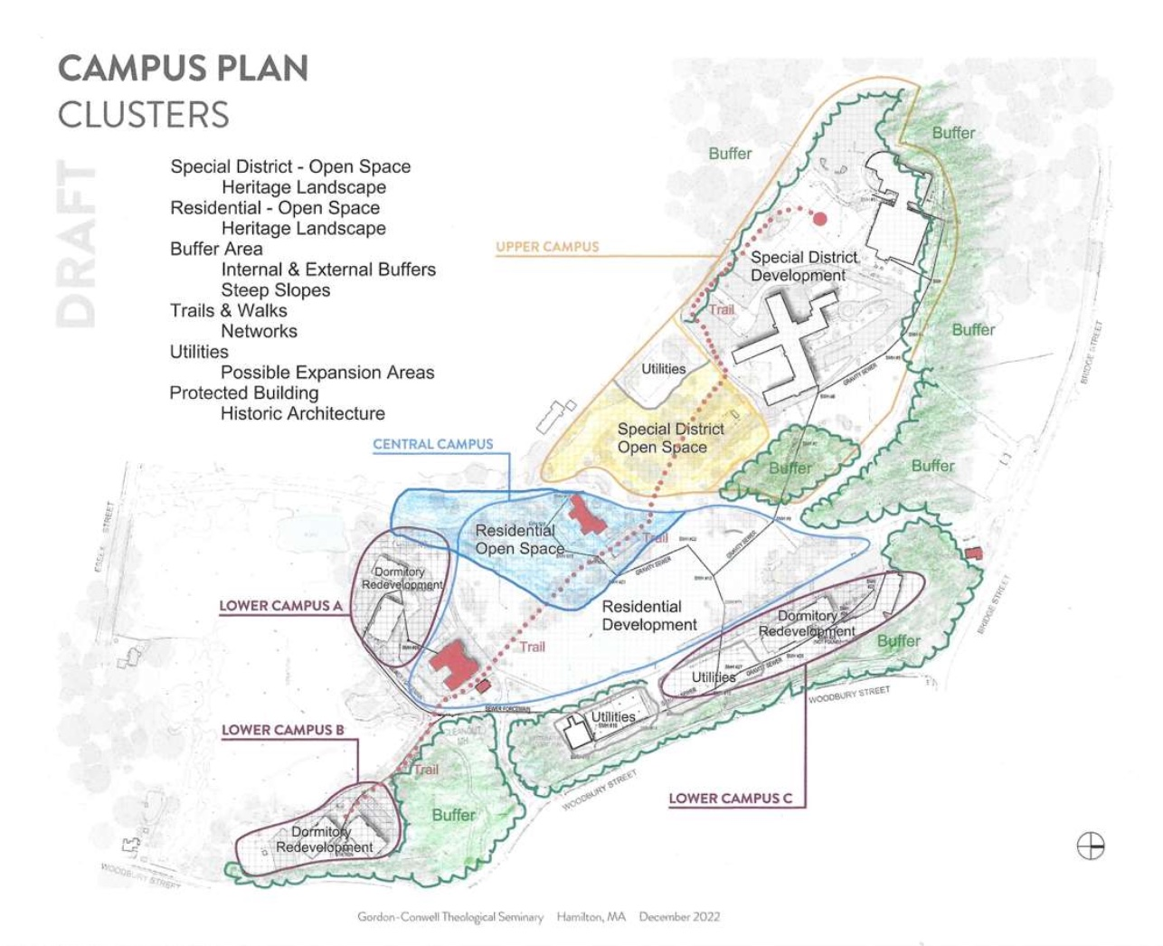
Iterations of the Concept Plan

Slide 27
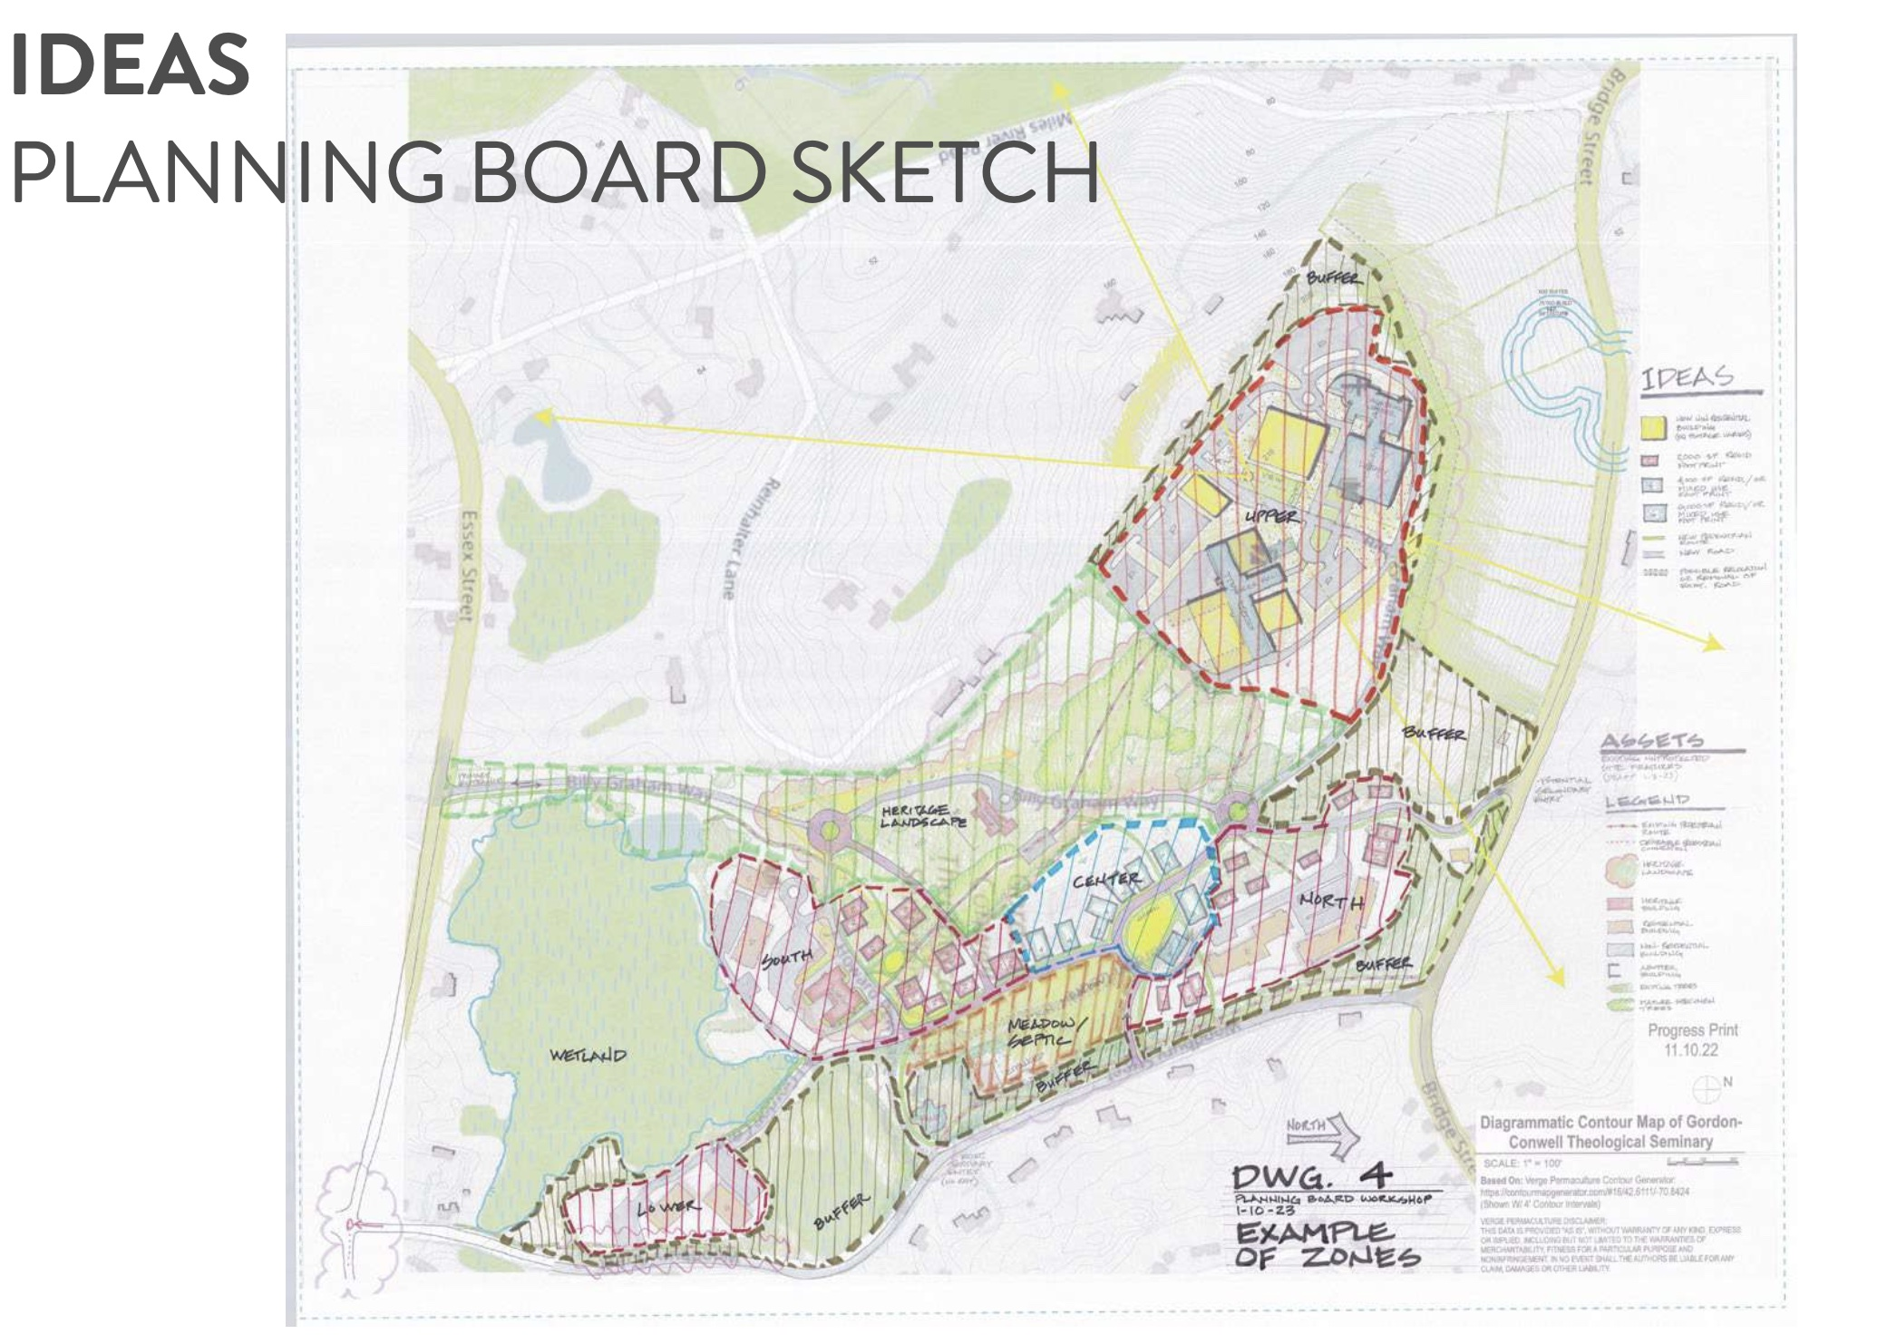
Iterations of the Concept Plan

Slide 28
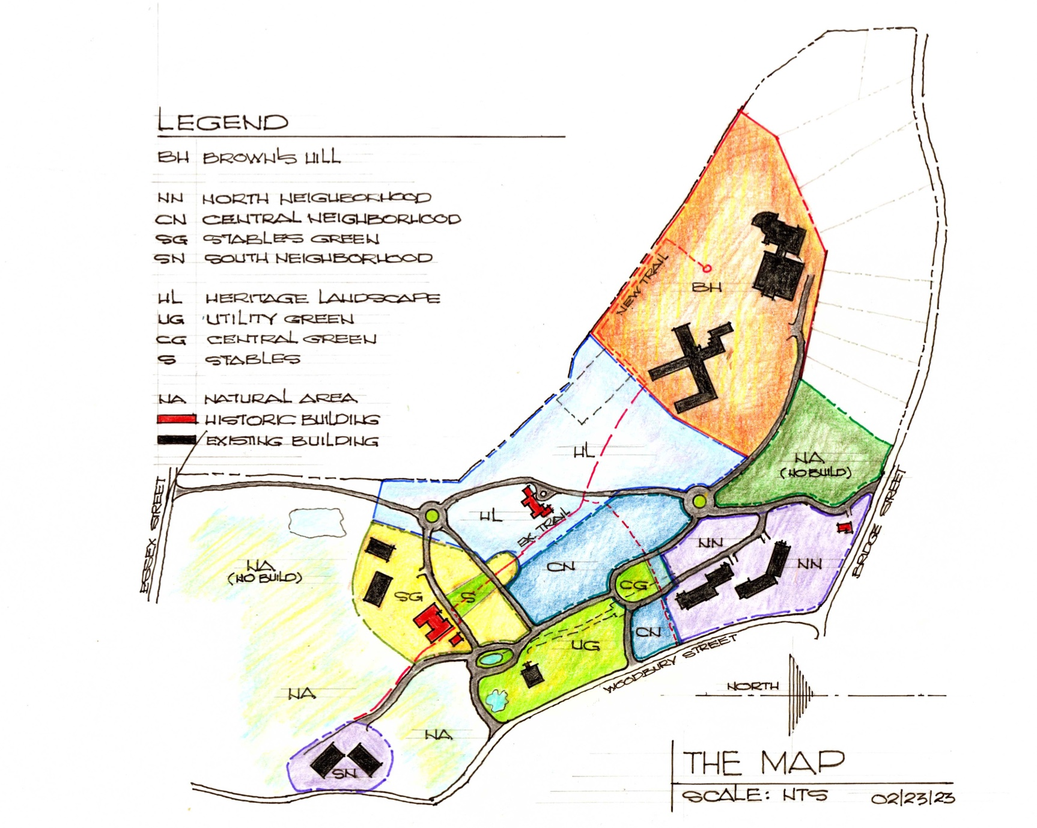
Iterations of the Concept Plan

Slide 29
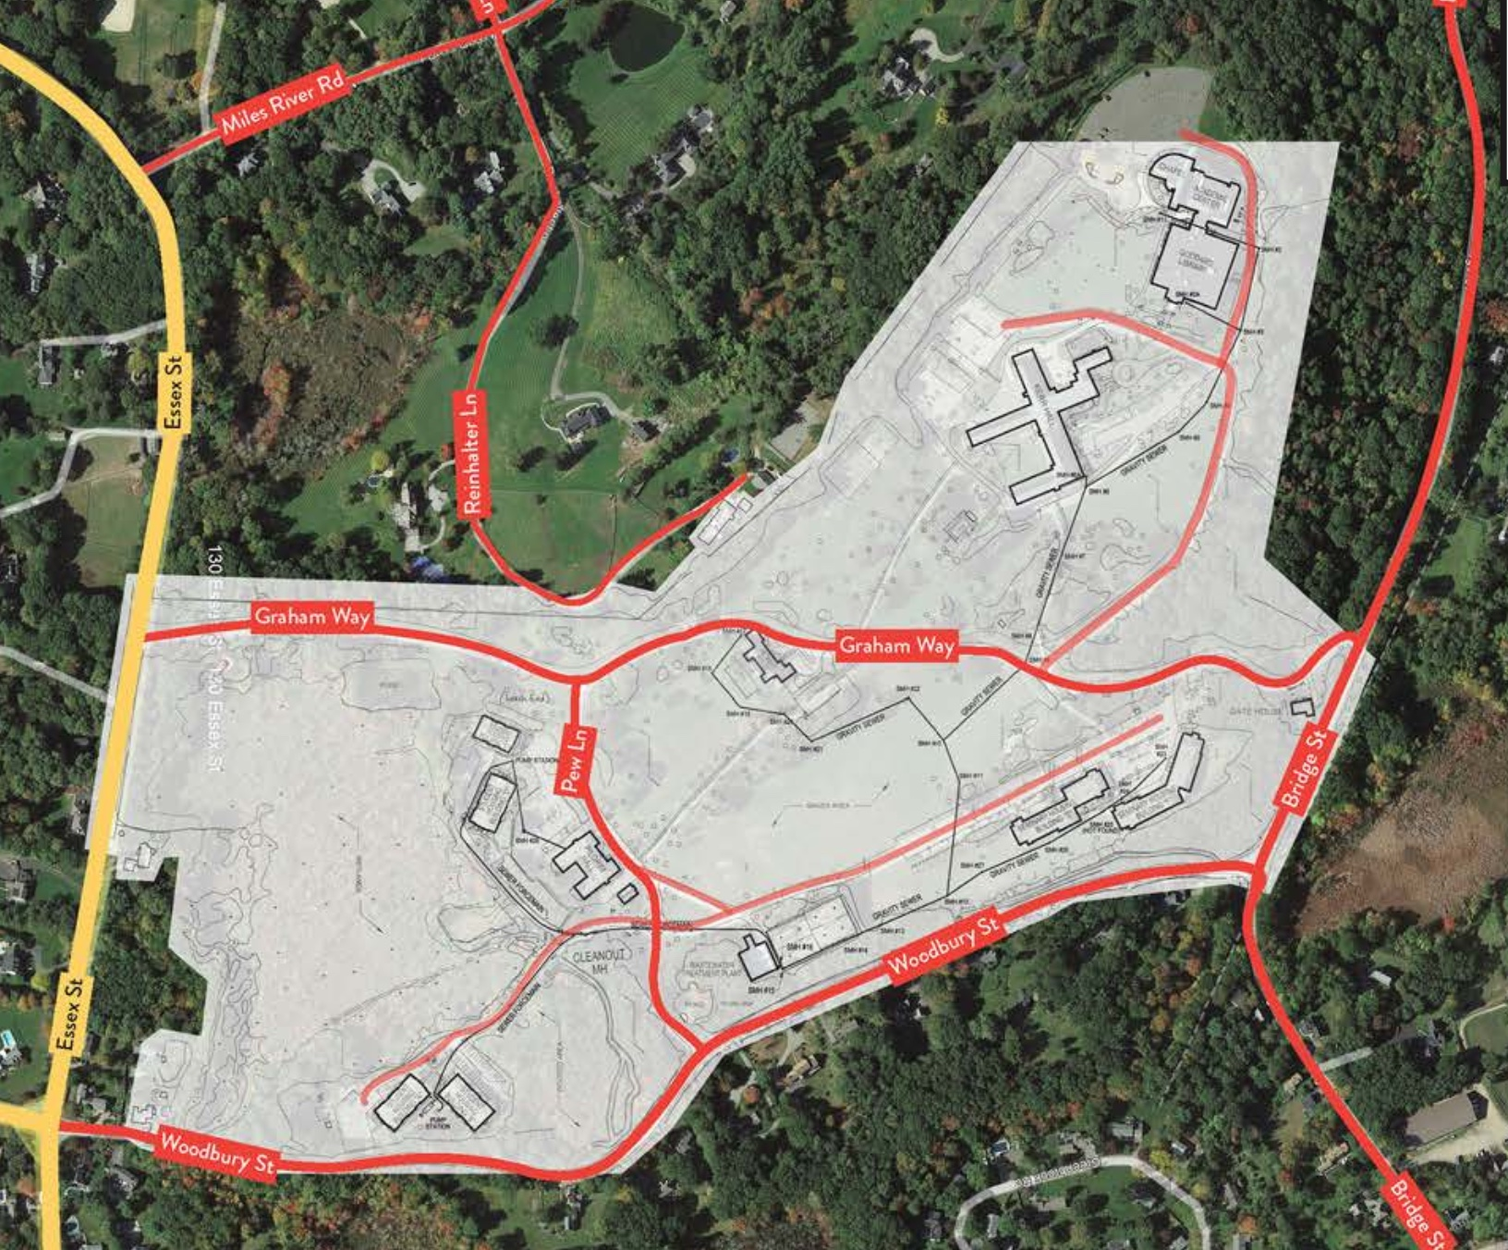
Upper Campus
Commercial Use Up to 375k sqft or 55+ up to 200 units
The Seminary
Would Like to See a Simpler, More Generic
Concept Plan
Middle Campus
Commercial Use Up to 200k sqft or 55+ up to 200 units
Middle Campus
Residential Re-use up to 50% Affordable

