Slide 1
Accessory Dwelling Units in HAMILTON
Hamilton Planning Board, November 26, 2024

Slide 2
Accessory Dwelling units in a nutshell
A self-contained dwelling unit - inclusive of sleeping, cooking, and sanitary facilities – located on the same lot as a primary dwelling unit that is
Hamilton already permits Accessory Dwelling Units by Special Permit
Provides a more accessible additional housing option
Provides homeowners additional income stream
Traditionally popular for multigenerational living, care-giving
Less disruptive and more environmentally friendly alternative to many other forms of housing development
Attractive option for smaller households or for relatives/caregivers
Increased trend of smaller single-member households
More inconspicuous, less likely to concern neighbors
Passage of the Affordable Homes Act requires municipalities to permit ADUs by right.
Still several unknowns as we are waiting for EOHLC to promulgate regulations.
Municipalities cannot unreasonably restrict provision of ADUs
ADU provisions become effective on February 2, 2025.

Slide 3
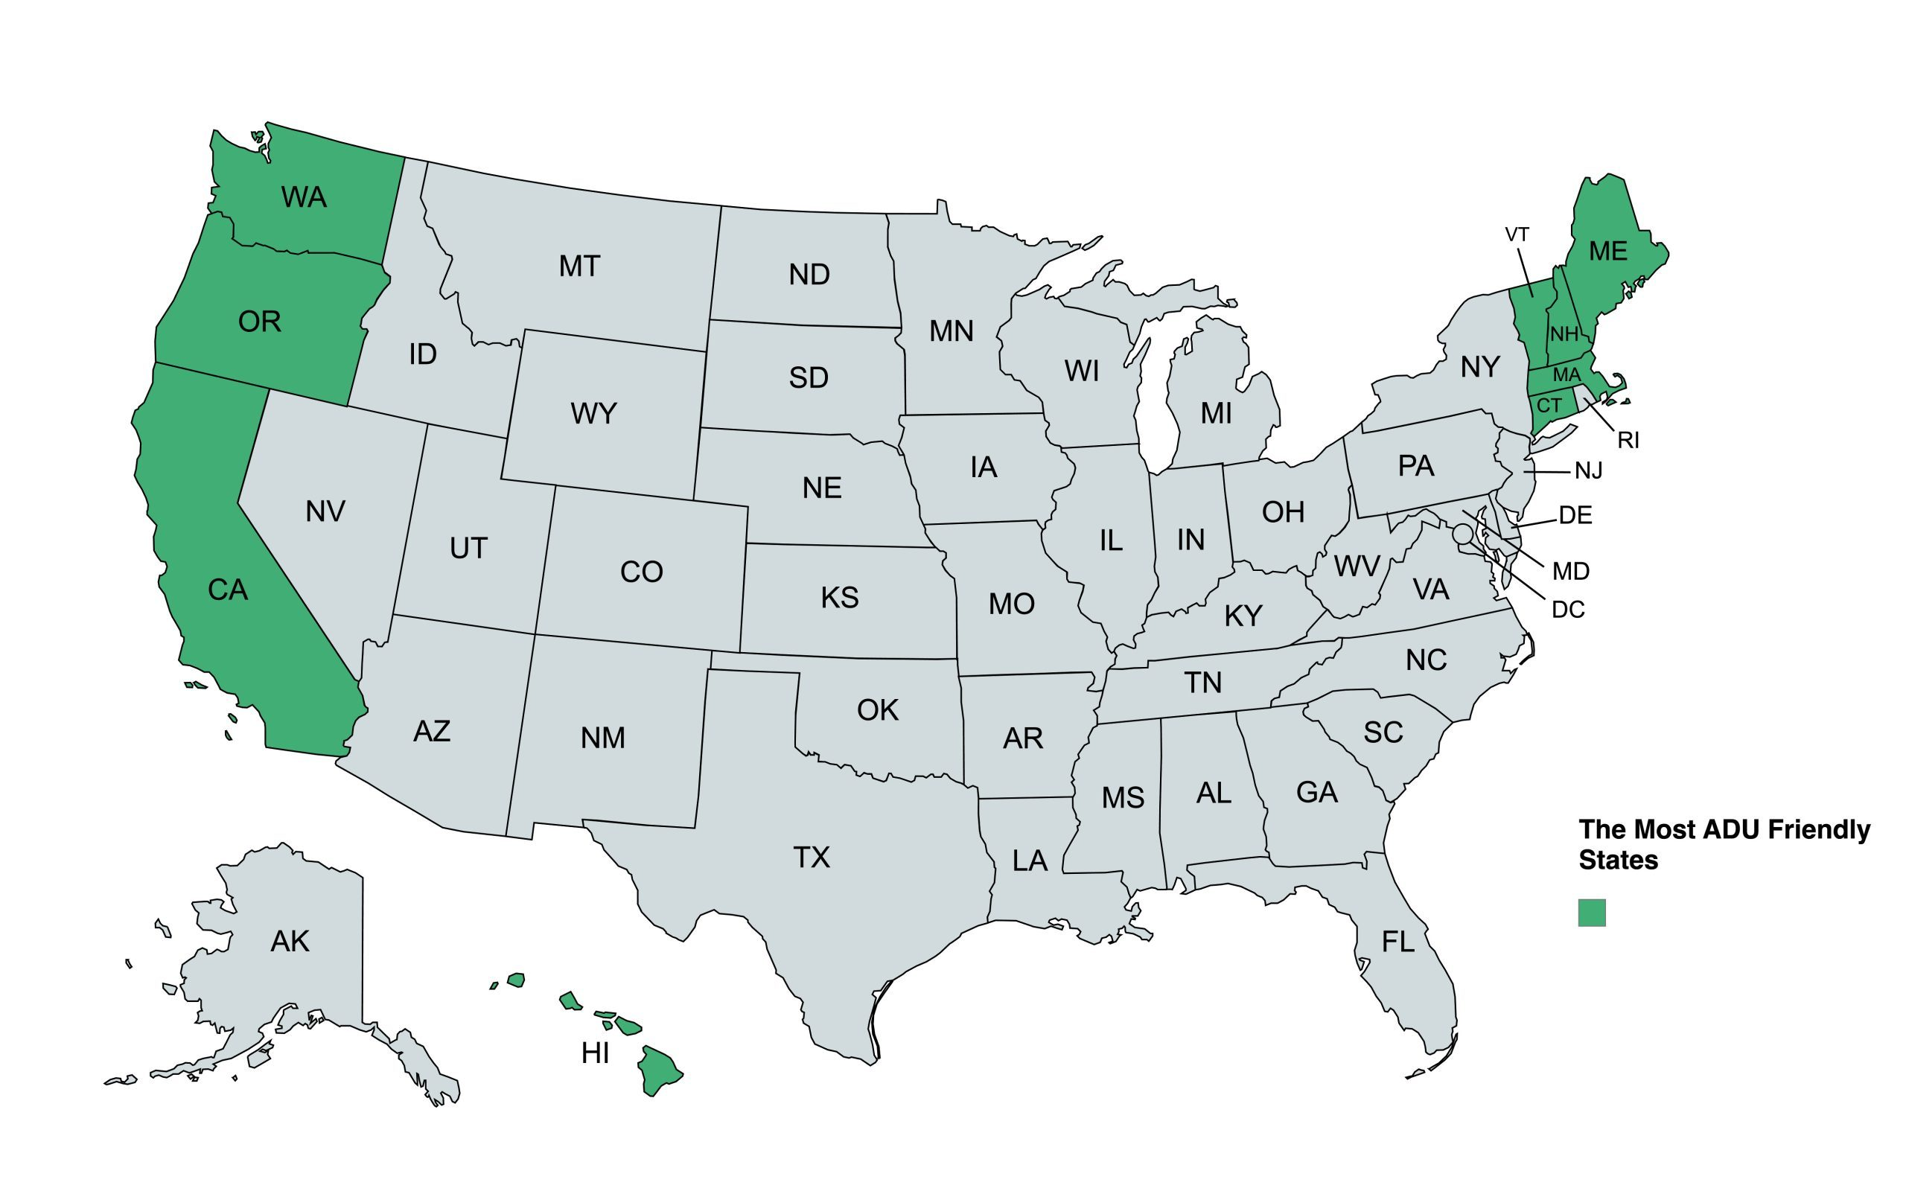

Slide 4
Existing Requirements in Hamilton
Sections 3.4 (Conversion for Temporary Additional Living Area), 3.6 Accessory Apartment, 3.7 Accessory Apartments on Large Lots
Section 3.6 is the most relevant section
Permitted by Special Permit
Must maintain single-family character and appearance
Limited to 900 square-feet and no more than 2 bedrooms and 1 bathroom
Lot must be 10,000 square-feet in size, unless ZBA finds that smaller can meet all ancillary demands (parking and septic)
Owner must reside on property (in ADU or primary dwelling)
Can be attached or detached to primary dwelling
No new utility meter
One parking space available for exclusive use of ADU
Separate door shall be on side or rear of structure
No separate ownership (condo-ization of the ADU from primary dwelling)

Slide 5
AFFoRDABLE HOMES ACT
Signed by Governor Healey in August 2024
At $5.2 billion, largest housing bond bill in history of Commonwealth
Governor’s office estimates addition of 65,000 new housing units
Adds ADUs to list of uses, including childcare facilities, handicap exit ramps, solar energy systems, and religious & educational programs – that are deemed important enough to justify state-level protection from local regulation

Slide 6
Hamilton’s Existing Definition Accessory Apartment (3.6)
Massachusetts Definition, Accessory dwelling unit:
“Accessory dwelling unit”, a self-contained housing unit, inclusive of sleeping, cooking and sanitary facilities on the same lot as a principal dwelling, subject to otherwise applicable dimensional and parking requirements, that: (i) maintains a separate entrance, either directly from the outside or through an entry hall or corridor shared with the principal dwelling sufficient to meet the requirements of the state building code for safe egress; (ii) is not larger in gross floor area than 1/2 the gross floor area of the principal dwelling or 900 square feet, whichever is smaller; and (iii) is subject to such additional restrictions as may be imposed by a municipality, including, but not limited to, additional size restrictions and restrictions or prohibitions on short-term rental, as defined in section 1 of chapter 64G; provided, however, that no municipality shall unreasonably restrict the creation or rental of an accessory dwelling unit that is not a short-term rental.
Apartment: An additional dwelling unit, subordinate in size and accessory to the principal dwelling unit on the lot, located in either the principal dwelling or an accessory structure on the lot. An Apartment is constructed so as to maintain the appearance and essential character of the single family dwelling or accessory structure to which it is added.

Slide 7
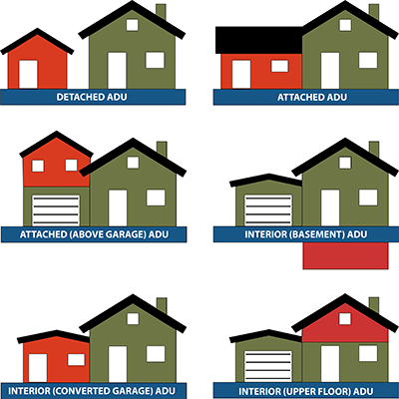

Slide 8
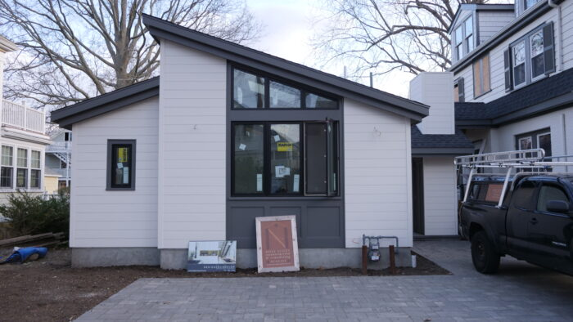
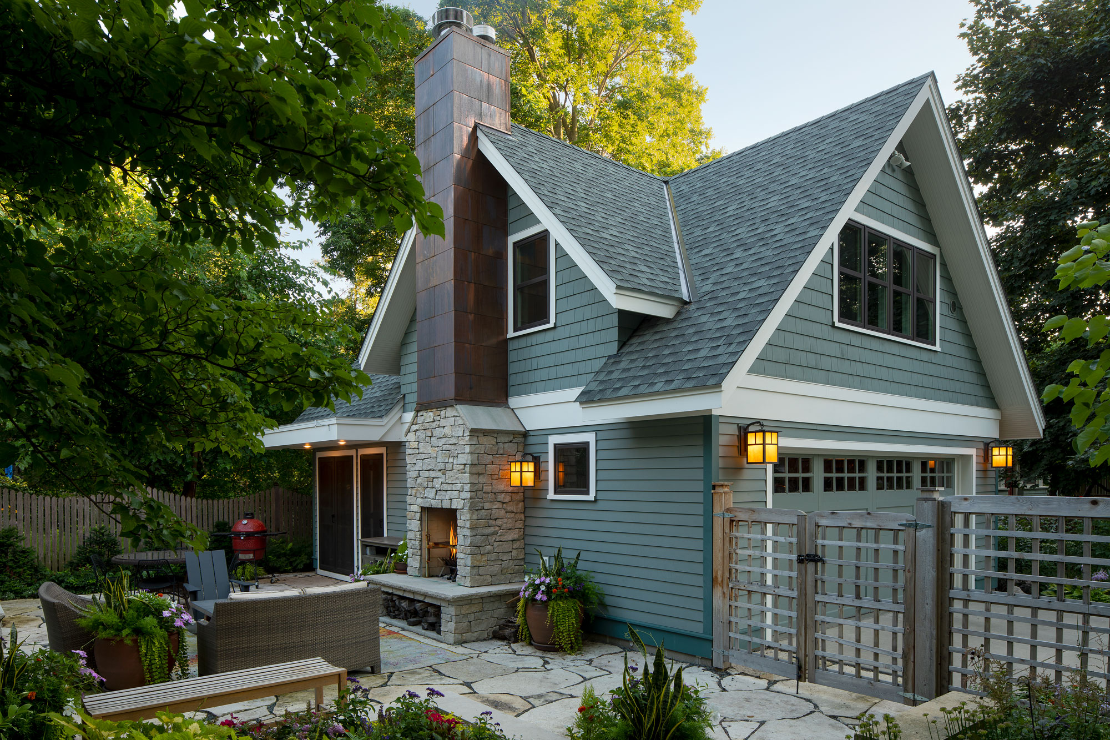
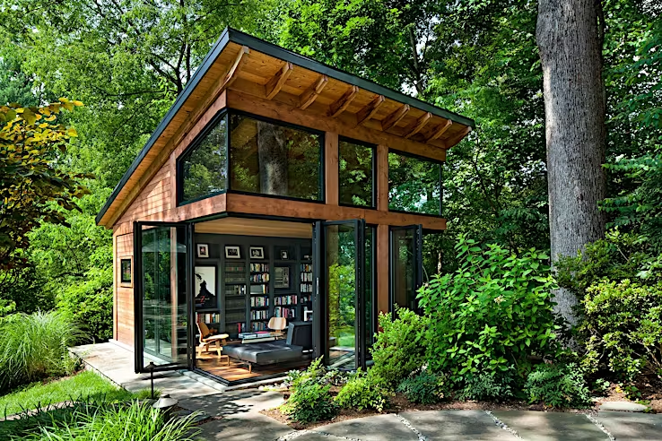
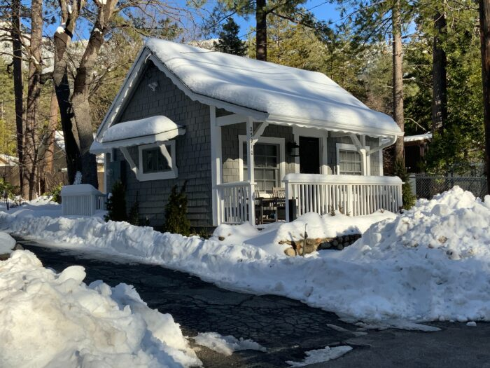
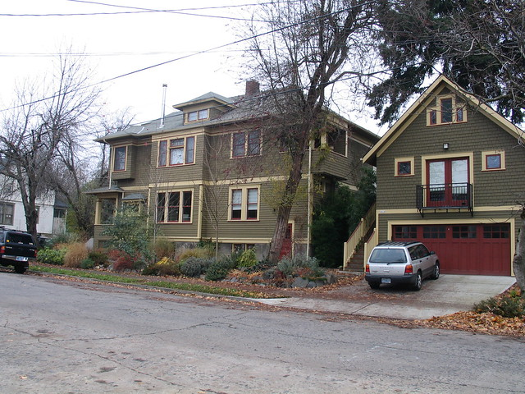

Slide 9
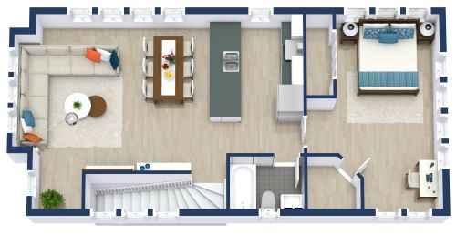
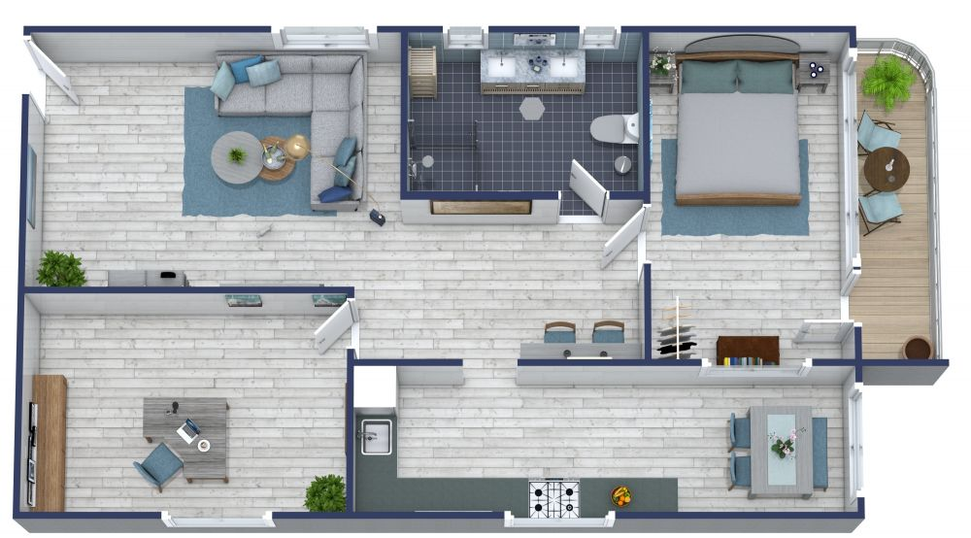
900 square-feet

Slide 10
What is clear about the ADU law:
ADUs must be permitted by right in single-family zoning districts
ADUs can be attached to the primary dwelling or in a detached structure
Municipalities CAN restrict ADUs from serving as short-term rentals
Municipalities are restricted in imposing parking requirements:
Cannot require any additional parking for ADUs within ½ mile of commuter rail station.
Cannot require more than one parking space for all other ADUs
Municipalities are restricted from imposing owner-occupancy requirements
ADUs tenancy generally cannot be restricted by municipality
Municipalities CAN restrict ADUs from serving as short-term rentals
Municipalities CAN enforce reasonable regulations on ADUs, including dimensional requirements
Second ADU on single property by special permit only
ADU definition likely needs to match of closely mirror state definition
Still awaiting issuance of Draft Regulations from EOHLC

Slide 11
Best Practices in ADU Regulations
Keep it relatively simple (main audience is existing homeowners)
Fact sheets/informational or promotional materials
Encourage re-use renovation of historic barns/out-buildings
Requirements to maintain single-family character and appearance
No new driveway curb cut
No second garage or pool to serve ADUs
Detached ADUs limited to side or rear yards
Limit footprint size of detached ADUs

Slide 12
THE path forward
Lack of EOHLC Regulations, even in draft form, is a barrier to drafting local bylaw
State Regulations are expected imminently
Bylaw language should be reasonably straight-forward
Opportunity to merge three sections of bylaws governing ADUs
Would recommend April 2024 Town Meeting consideration of revised bylaw
Minimize interim period where legislation becomes effective and draft bylaw is considered.
If bylaw is successful, outreach materials for homeowners

