Slide 1
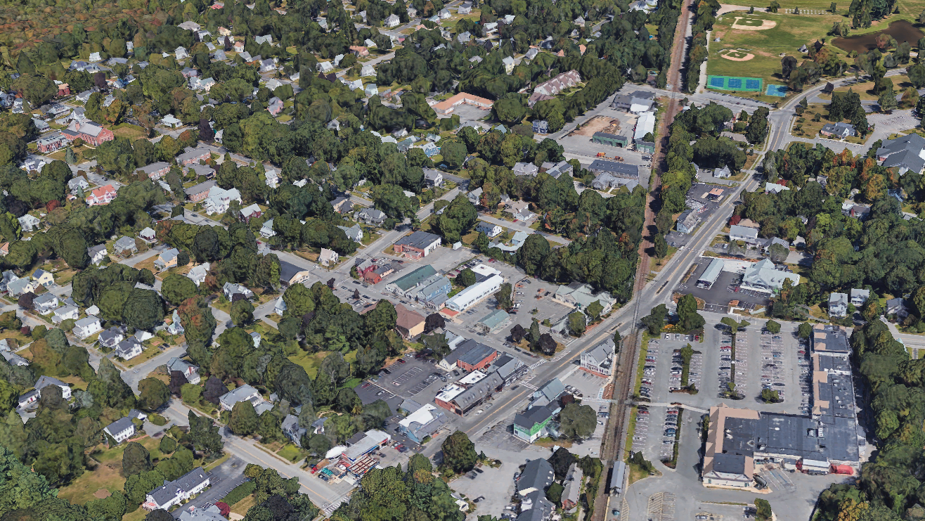
Hamilton Town Center &
Section 3A Zoning
Public Hearing
May 20, 2025

Slide 2
Agenda
Public Hearing
May 20, 2025
Presentation (20 min)
Timeline and Process
Understanding Zoning
Proposed Zoning
Overview of Districts
Comparison to Existing Zoning
Next Steps
Planning Board & Public Comments (~1 hr)
Notes:
Intro
MLi - 2 min.
Quick introduction to team members
Quick introduction to slideshow:
Key important themes that relate to our methodology
Guiding principles for engagement and context specific issues
Understanding the Project
MLi - 3 min.
Translate vision into policy
Building up consensus to get from vision to policy incrementally
Work backwards
Frame engagement as a set of choices that lead to code choices
Build up the “vision” and coding visuals in parallel
Minimal rule set to achieve max result
Town Center is not monolithic or generic - flexibility required
[MB to add comment]
CSC - 3 min.
One important aspect: Balancing uses
Density
Program mix and tradeoff
Frontage (how mixed uses engage the public realm - transition topic for CSC)
CSC - 3 min.
Another important aspect: Site Planning: Active Frontage, Site Access, and Parking
Existing - wide variety of frontage conditions
What is “active” frontage and how much is enough?
Balancing parking demand and negative impact on street character
Guidance for “front yard” uses.
Engagement
ZM - 3 min.
Three important principles that guide all of our engagement work (and would apply here).
The specific tools we use (online,in person workshop, survey etc) are TBD, based on consultation with the Town. Whatever the engagement design looks like, it must acknowledge the variety of stakeholder types…
ZM + CSC -1 min.
Stakeholder Diagram - Multiple stakeholder - acknowledge varied perspectives and how engagement must capture different voices
Closing
1 min.
MLi - most excited about working with Hamilton because there is ____

Slide 3
Revised Schedule
Site Analysis
Zoning & Design Alternatives
PROJECT PAUSE FOR SJC
Draft & Refine Zoning
Pursue Adoption
2024
2025
Apr
May
Jun
Jul
Aug
Sep
Oct
Nov
Feb
Mar
Apr
May
Jun
Jul
Advisory Committee
Planning Board
Final Warrant
6/5
6/26
Town Vote
Town Meeting
Advisory Committee Members
Jonathan Poore (Team Leader)
Ted Acworth
Angela Arvanites
Scott Clements
Chris Connolly
Tom Connors
Emil Dahlquist
Steven Derocher
Bo Lamb
Steve Ozahowski
Deb Safford
Matt Tobyne
Task Force
Rescoping & Reinitiation
Task Force Members
Joe Domelowicz
Mark Connors
Emil Dahlquist (PB)
Thomas Myers (SB)
Public Hearings
Visioning Survey
One-month preparation to resume public process based on SJC ruling, including:
EOHLC Alignment Meeting
Updated Scope, Schedule & Budget
Draft Code Framework
Draft Code
Revised Code
Final Code
#1 Public Visioning Workshop
#2 Code Development Workshop
State Compliance Deadline
7/14/2025 commuter rail community that did not submit a district compliance application to EOHLC by December 31, 2024

Slide 4
Remaining Public Process
Draft Code Framework: April 1 This Planning Board meeting focused on presenting the draft code framework developed with the Task Force to orient the Planning Board. The first full written draft of the code was shared as a follow-up to the meeting. This was the first opportunity for public comment on the code.
Draft Code: April 8 This meeting was an opportunity for more detailed feedback from the Planning Board on the full draft code.
Revised Code: April 29 This Planning Board and Select Board meeting will be the final opportunity for substantive Planning Board comment on the code.
Final Code Public Hearing: May 20
This Planning Board meeting, ideally a joint meeting with the Select Board, will serve as a handoff from the Planning to the Select Board as well as the final opportunity for public comment on the code. Note: code needs to be final and go to warrant by no less than 2 weeks prior to Town Meeting. Suggest 6/5 as a target date.
Apr
May
Jun
Planning Board
Meetings
Final Warrant
6/5
6/26
Town Vote

Slide 5
Understanding Zoning

Slide 6
Understanding “By-Right” Zoning
The strength of zoning that incorporates form-based rules is that it adds specificity and teeth to the zoning compliance and design review addressed under Site Plan Review.
Zoning is only one piece of what needs to be addressed for development to move forward. Here are some of the other elements that control development beyond zoning:
Economic Feasibility
Land value, site complexities, labor costs, market interest, and design and approval process expenses all play a big role in determining whether a development is economically feasible.
Environmental Permitting Determines if development can proceed based on site constraints.
This includes, at minimum:
Septic system review (by Board of Health)
Wetlands permitting (by Conservation Commission if applicable)
In all cases, the developer will be responsible for preparing and paying for impact studies and evaluations associated with site plan review and permitting, as well as any improvements that are deemed necessary, which must be specific to their site and development proposal.
Building Code
Building code ensures all buildings are safe and healthy to occupy, durable, and resilient to known shocks and stressors.
Site Plan Review Ensures permitted development meets standards through a public review process with comment.
Zoning Compliance: verification that a project meets the applicable zoning requirements with the advice of Town staff, including all design standards set by a form-based code, such as but not limited to:
Height
Coverage
Setbacks
Floor to Area Ratio (FAR)
On-site parking
Roof form
Entry and facade relationship to the street
Design Review: to ensure an acceptable solution to qualitative and contextual impact issues like:
Traffic and other impact analysis
Safe vehicular and pedestrian access / egress
Appropriate site drainage
Appropriate screening of nearby properties
Architectural design review
Note: The scope of Site Plan Review is limited to imposing reasonable terms and conditions on the proposed use, consistent with applicable case law. This review cannot unreasonably delay a project nor impose conditions that make it infeasible or impractical to proceed.

Slide 7
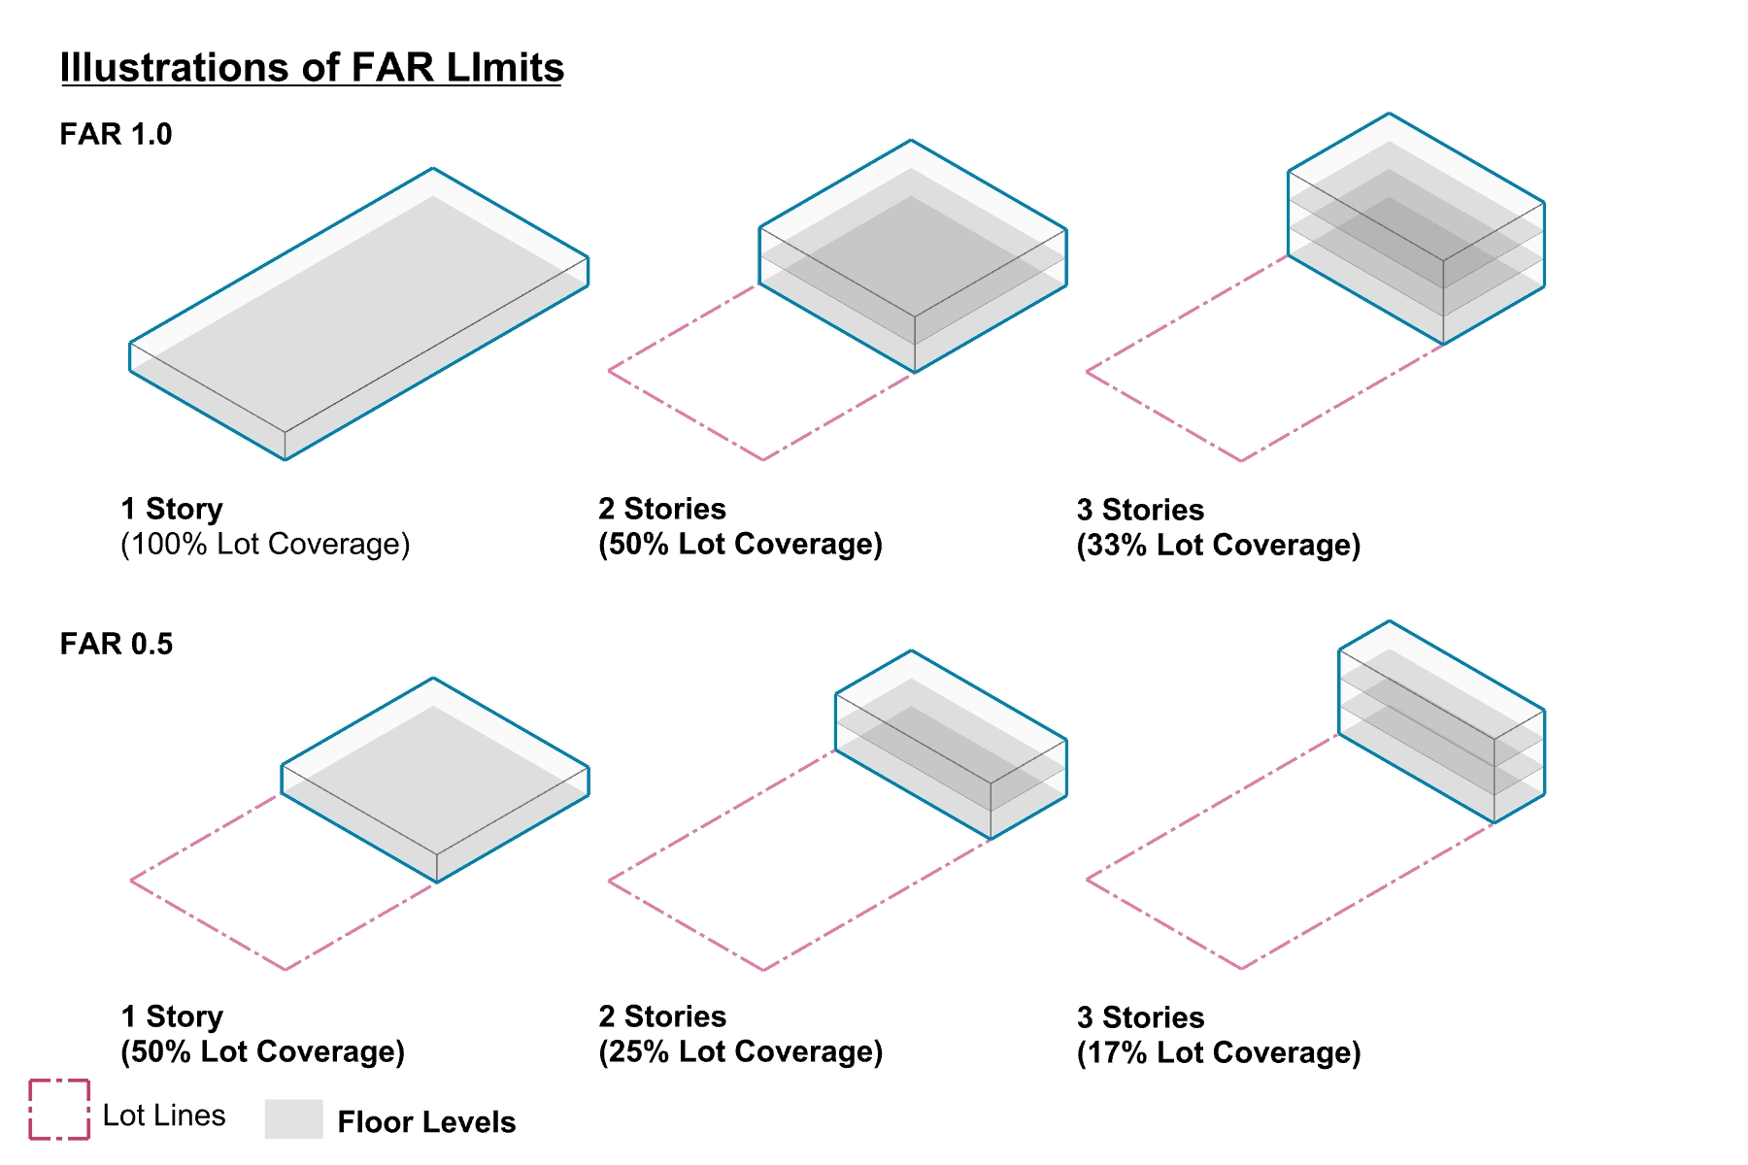
Floor Area Ratio (FAR)

Slide 8
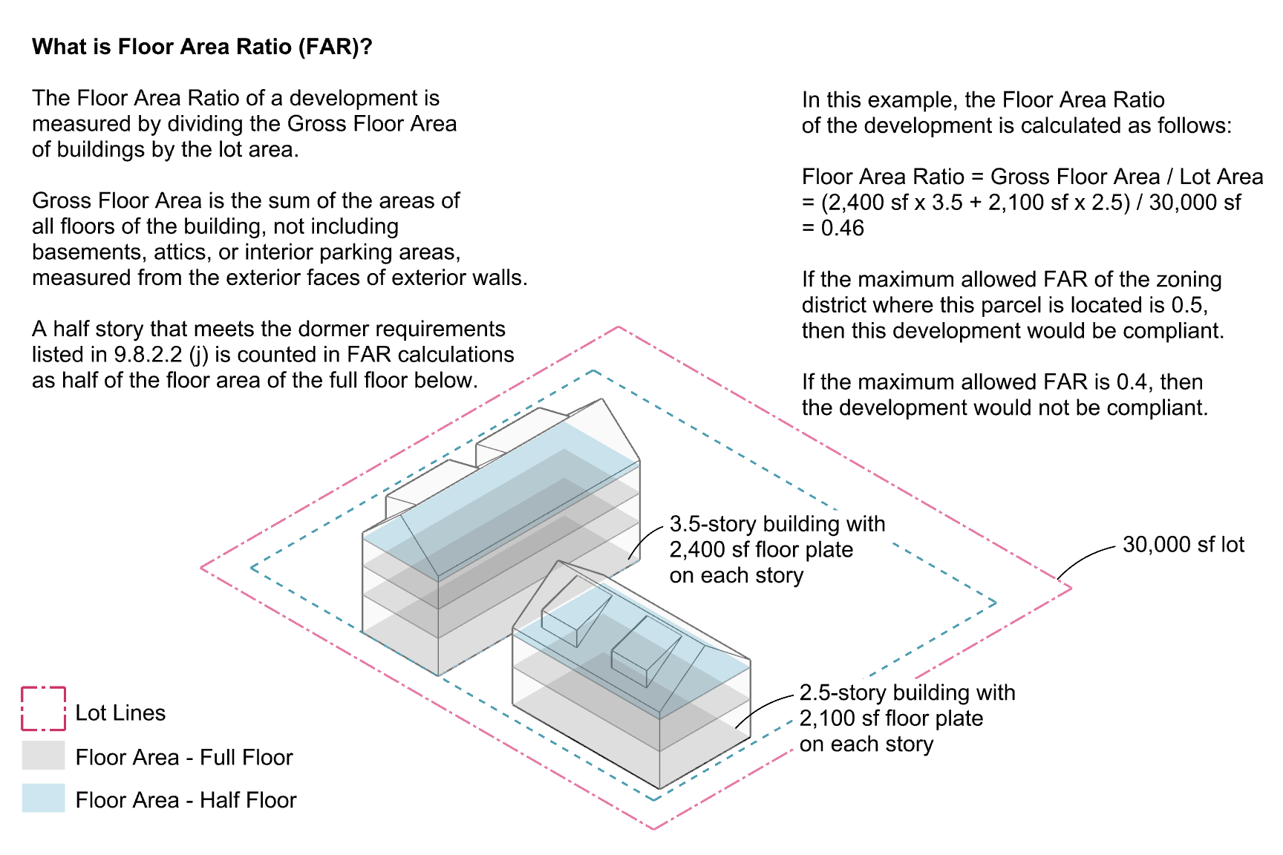
Floor Area Ratio (FAR) in the Town Center Districts

Slide 9
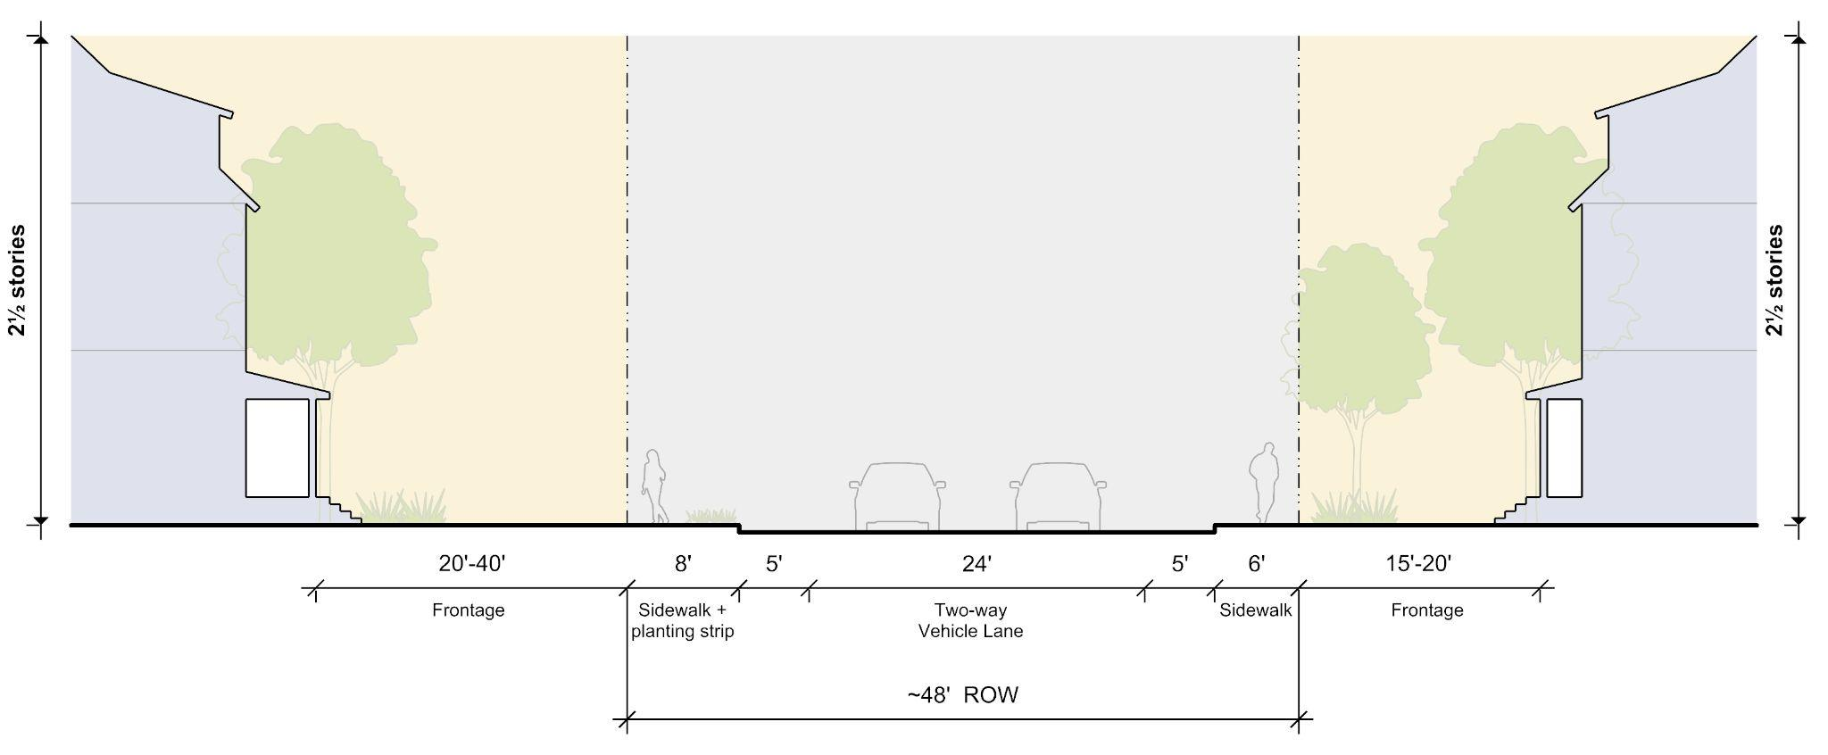
Understanding the Limits of Zoning
The role of building frontages versus public and infrastructural capital projects
Private Street Frontage
This is the domain of zoning
Form-Based Code is very effective at controlling how private property owners design buildings and site elements in relationship to the street. This is referred to as a property’s “frontage” on a street, path or even a rail right-of-way.
Public Right-of-Way
Zoning doesn’t apply here
Form-Based Code (and zoning more generally) cannot control the design of the publicly owned street, nor can it mandate the private or public delivery of infrastructure and services.
The Town can, however, choose to pursue capital investment plans that align with and reinforce the vision laid out through the Town Center Vision Plan and Form-Based Code.

Slide 10
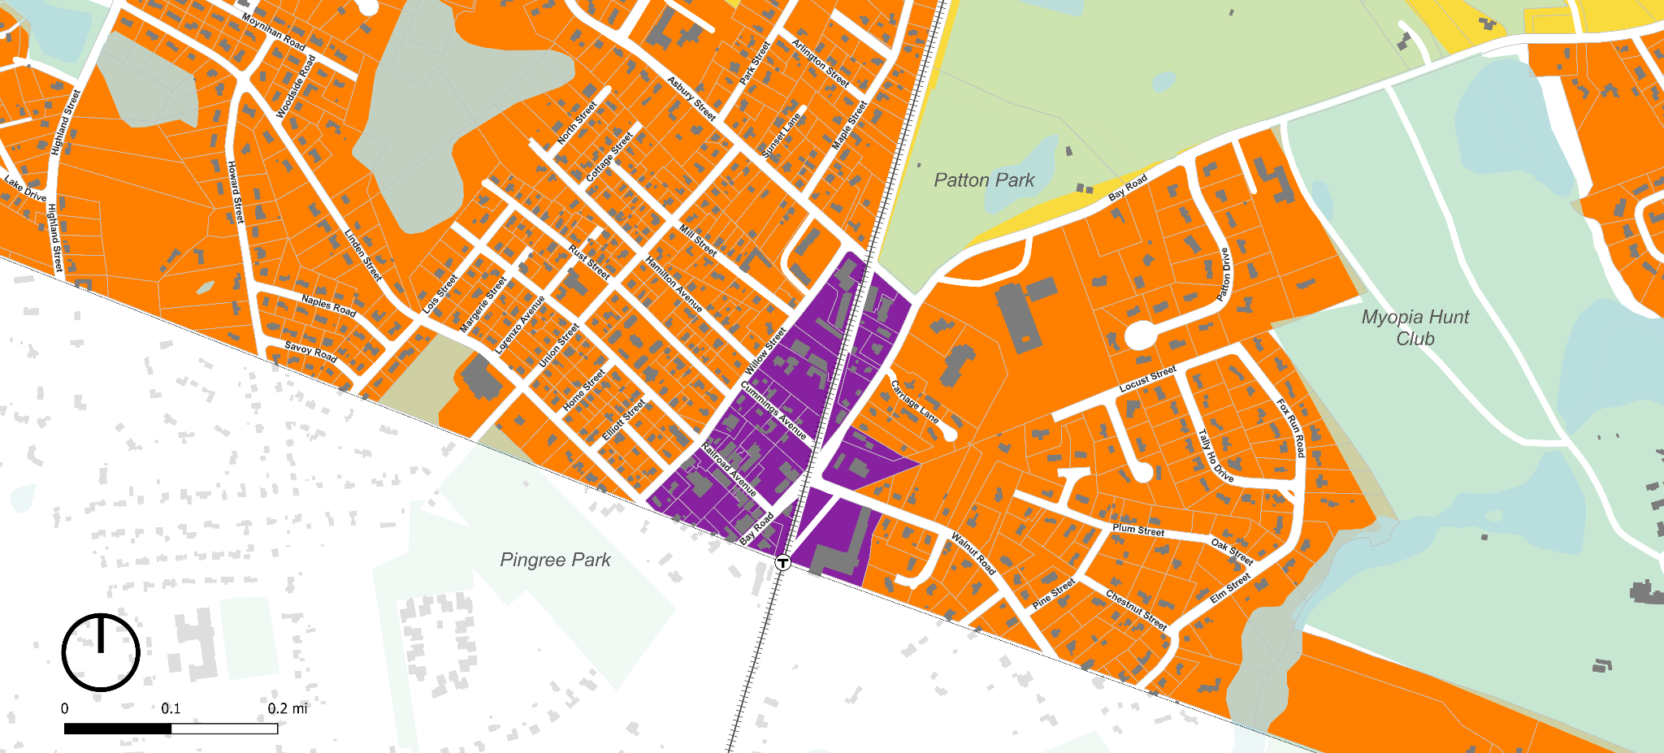
Existing Zoning Subdistricts
We will plan to conduct a net new analysis relative to existing buildings, what the current base zoning allows, and what the proposed zoning would allow.
B (Business)
Use: allows MF on upper floors
35’ height / 3 stories / 75% bldg coverage
Setbacks & Buildable Lot: ZBA
R-1A (Residence District)
Use: Single Family, MF prohibited
20,000sf min lot size / 125’ frontage
35’ height / 3 stories / 25% bldg coverage
Setbacks (F/S/R): 25’ / 15’ / 15’
R-1B (Residence District)
Use: Single Family, MF prohibited
40,000sf min lot size / 175’ frontage
35’ height / 3 stories / 25% bldg coverage
Setbacks (F/S/R): 25’ / 15’ / 15’
RA (Residence Agricultural District)
Use: Single Family, MF prohibited
80,000sf min lot size / 175’ frontage
35’ height / 3 stories / 25% bldg coverage
Setbacks (F/S/R): 25’ / 15’ / 15’
Senior Center
Winthrop School
Public
Library
Public Safety
Note: this is a rough transcription of Hamilton’s existing zoning map. It does not include overlay districts and precise boundaries may be slightly off where the boundaries do not align with parcel boundaries.
Hamilton/Wenham Station
Newburyport/Rockport Commuter Rail Line

Slide 11
When do you need to come into conformity with new zoning?
Current Bylaw
Section 5 : Nonconforming Uses and Structures
Nonconforming Uses - ZBA required for expansion or change
No proposed changes in new zoning
Nonconforming Structure - Single and Two Family Structures with nonconforming lot sizes or non-conforming structures may propose alterations which do not require a special permit
No proposed changes in new zoning, but additional language has been added to clarify what comprises a nonconformity relative to new dimensional standards

Slide 12
Proposed Zoning

Slide 13
Overall Zoning & Compliance Approach
Districts contributing to 3A compliance
Depot Square Mixed Use
Bay Road Mixed Use
Willow St Mixed Use
Downtown Residential
Bay Road Civic
3A - MFOD
Asbury North
New Base Zoning
Town Center Zoning with Design Standards
This to includes 5 subdistricts,
each with distinctive patterns and standards. This would replace existing zoning in these areas.
Overlay 3A Multi Family Overlay District
The Asbury subdistrict outside of the boundaries of the Town Center provides the final piece of the puzzle to meet 3A requirements. Outside of the Town Center, this would be an alternative to existing zoning.

Slide 14
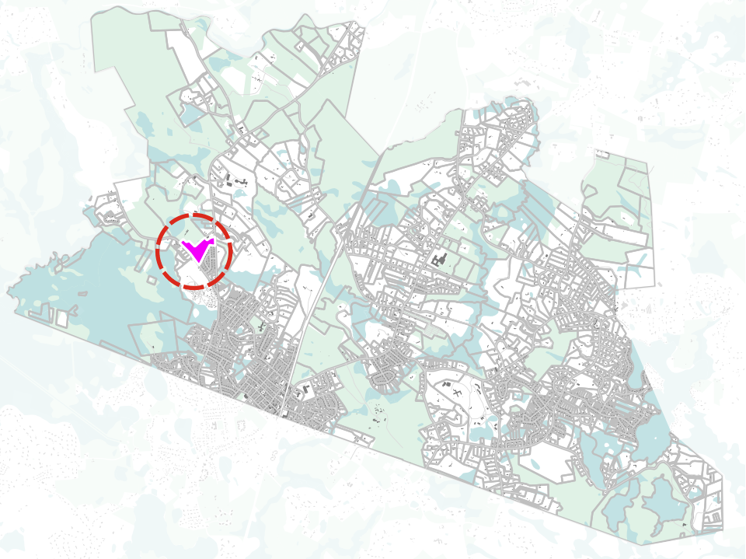
3A-MFOD Asbury North
Key Stats
Acres | 19.1
Density Denominator | 16.4
Existing/Planned Units | 68
Existing Density (with DD) | 4.1 units per acre
Current Use | Housing
Current Ownership | Private
Potential Issue
Groundwater Protection Overlay District (GPOD) Interaction | All Parcel Have Some 1985 + Fully Zone II Min lot size 80k sf Impervious surface 15% / 2,500sf triggers SP
45
23
Notes:
23 existing condo units on one parcel, 45 units permitted via 40B are moving into construction on the other parcel
1
Multi-family homes along Asbury Street
69 units in planned and existing projects

Slide 15
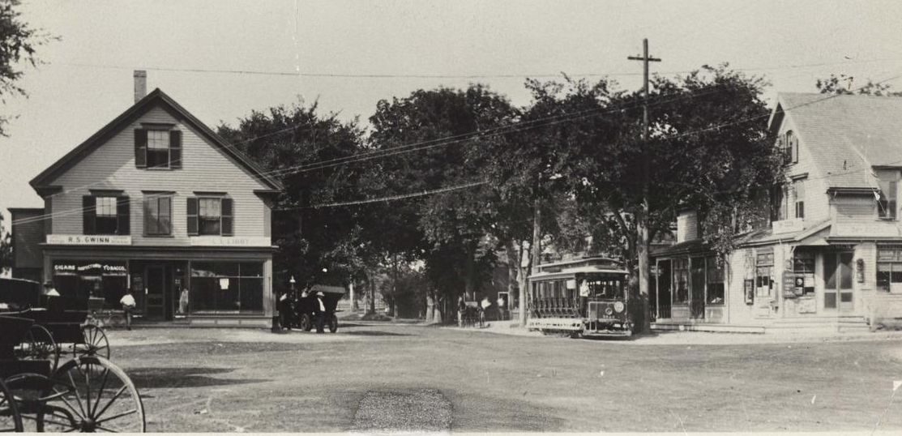
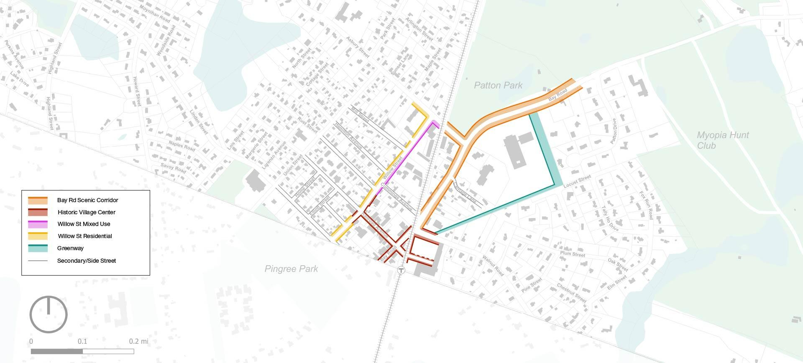
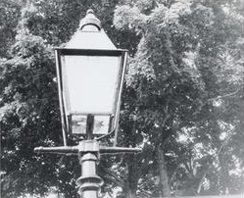
Town Center Proposed Street Frontage Types
5 frontage types
Bay Rd Scenic Corridor & Greenway Inspiration

Slide 16
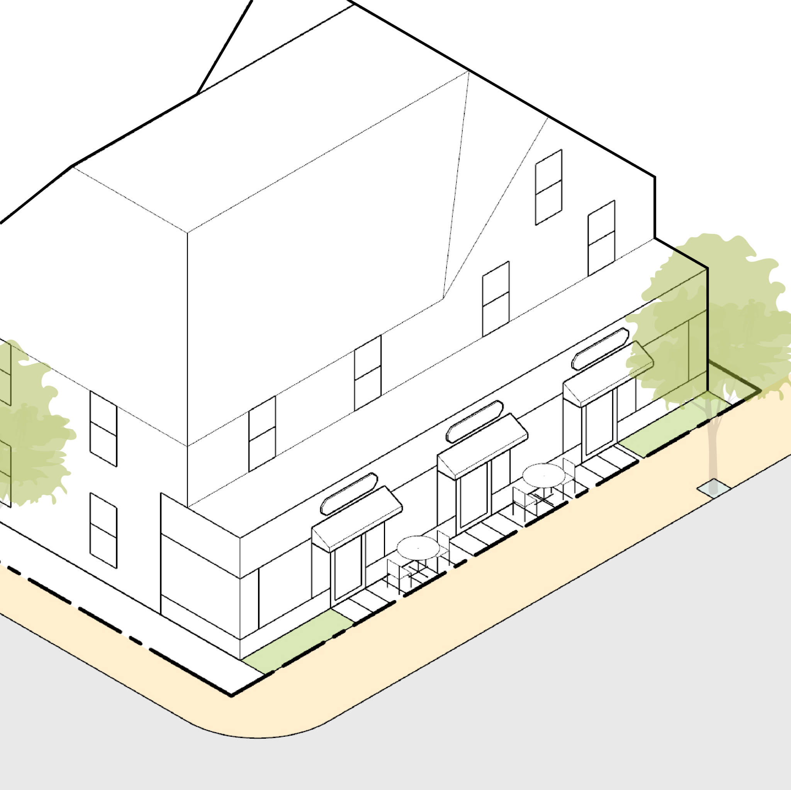
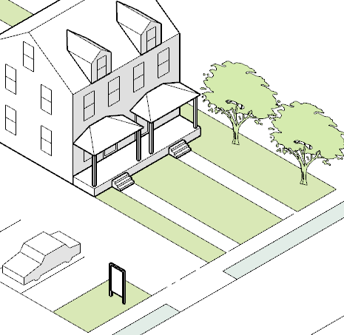
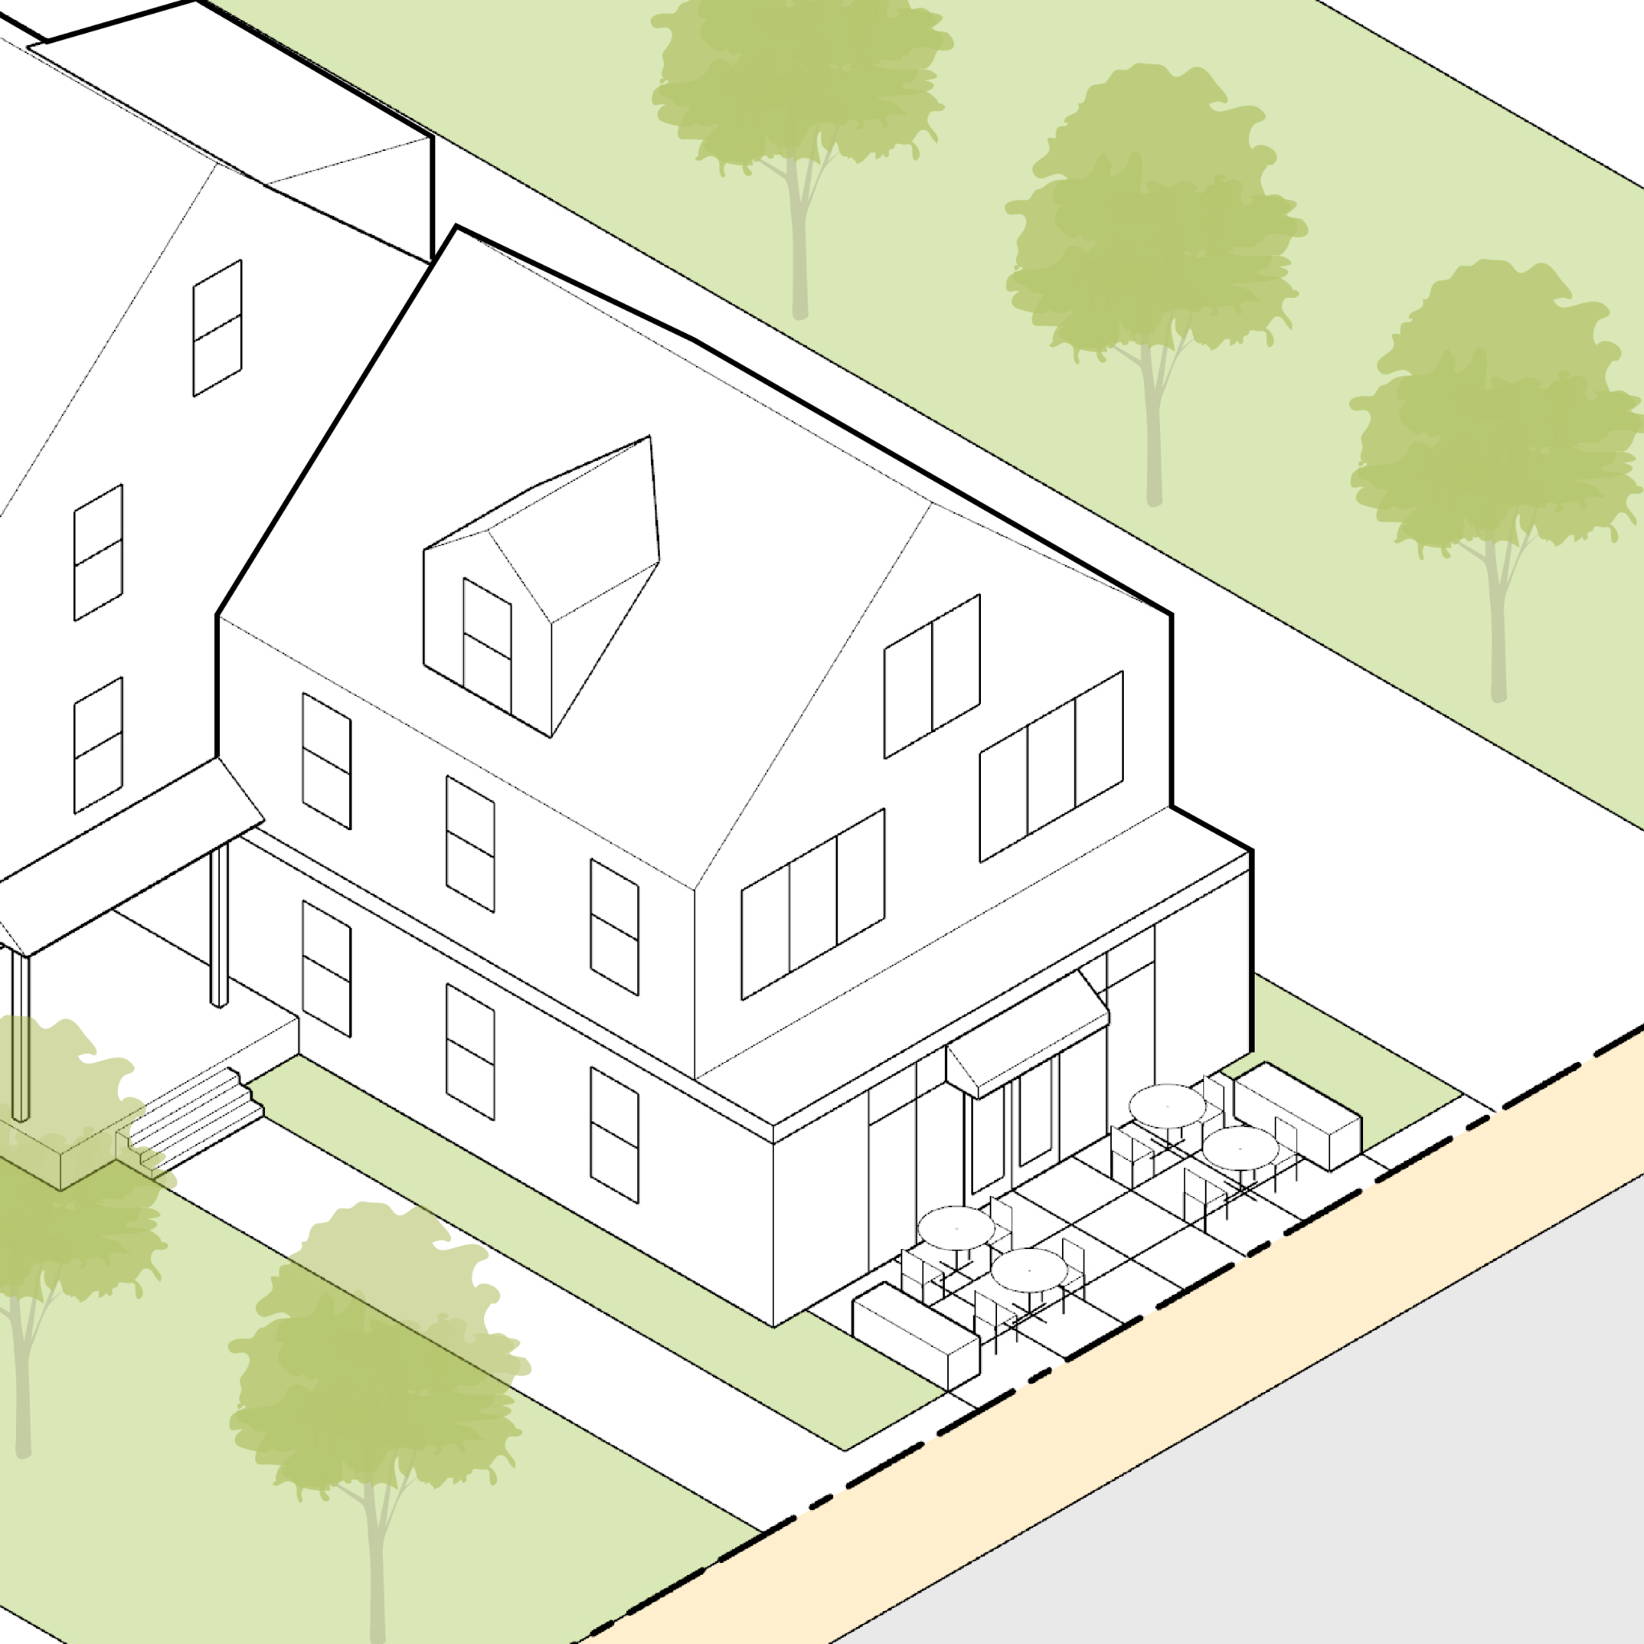
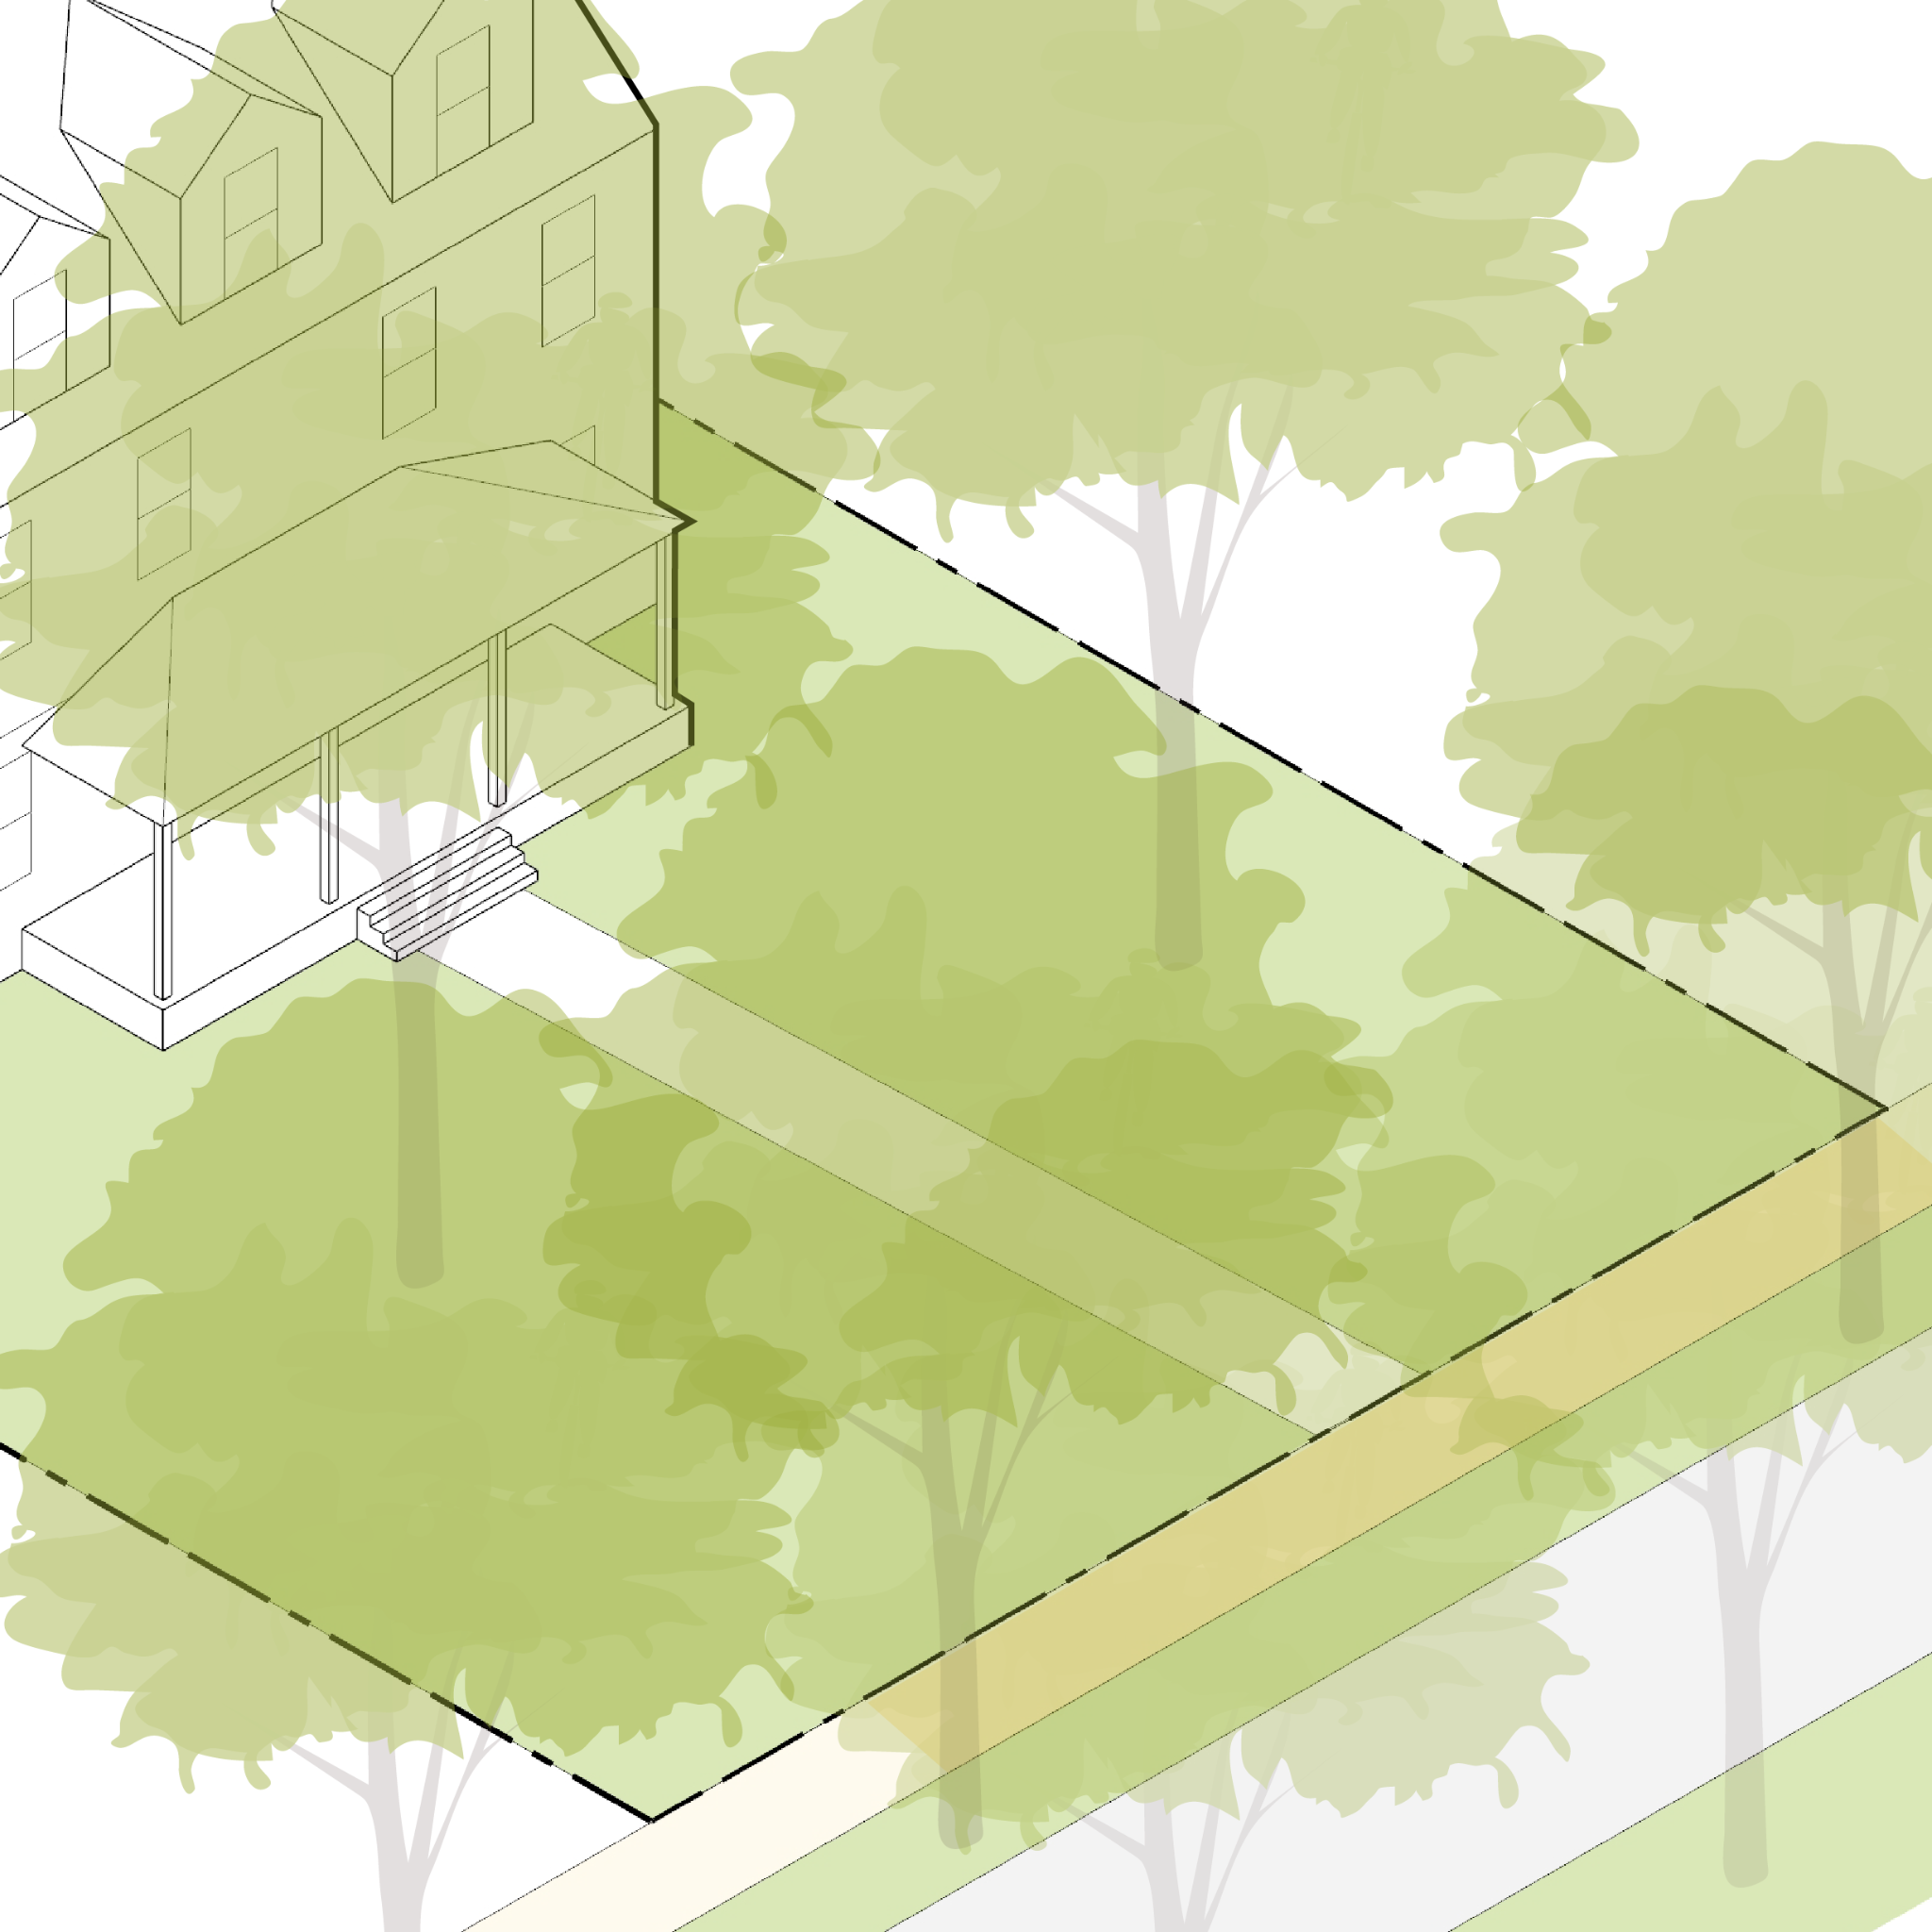
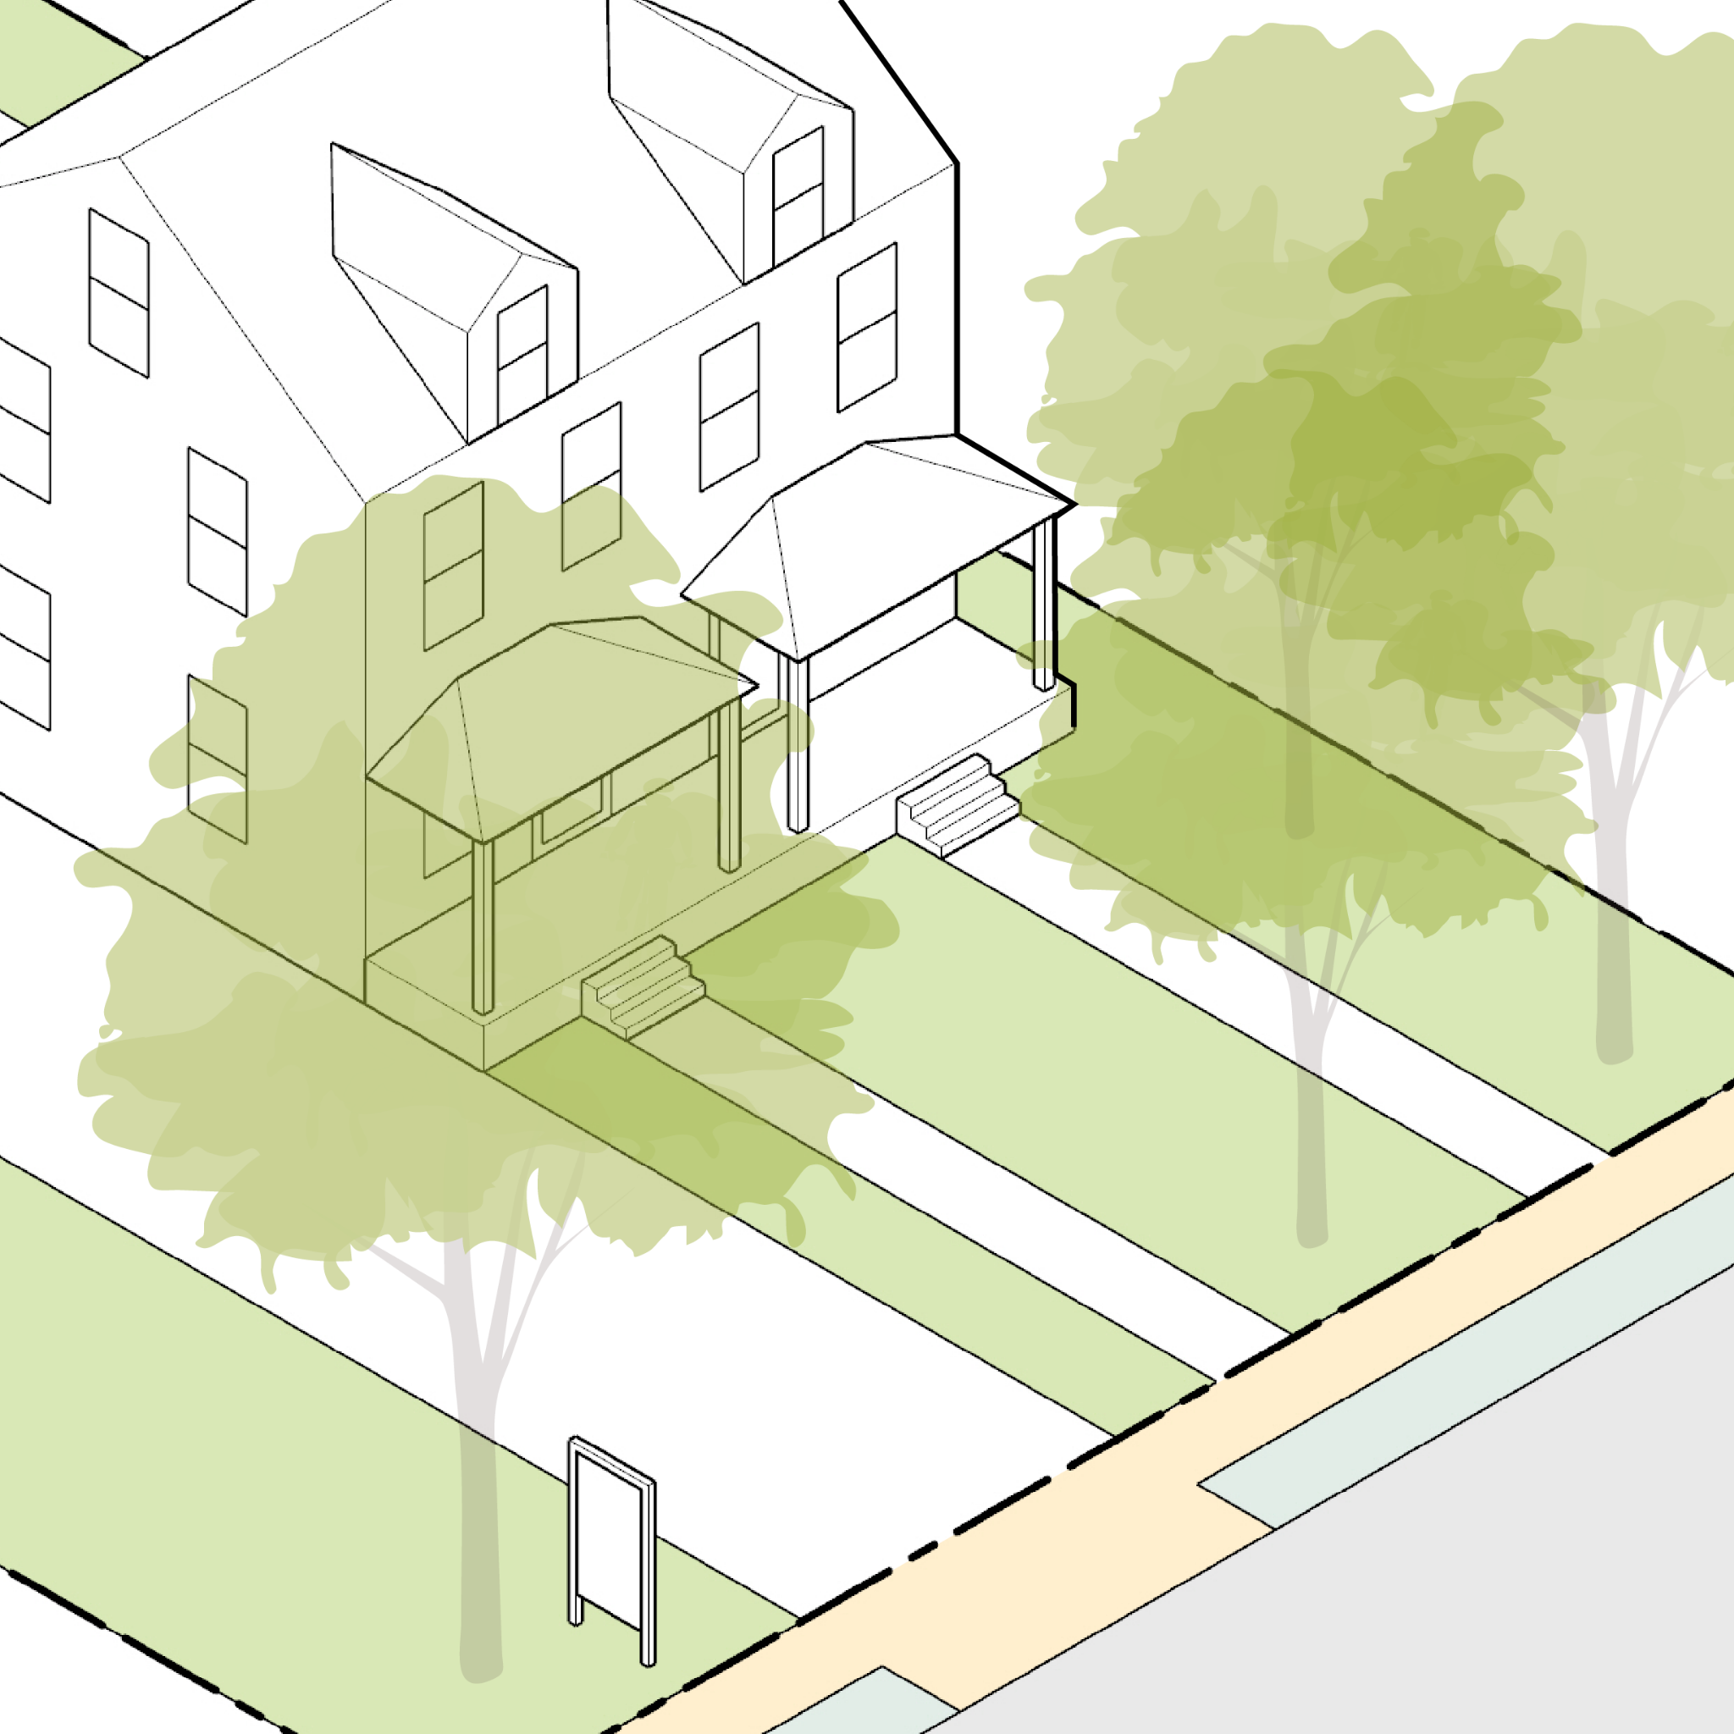
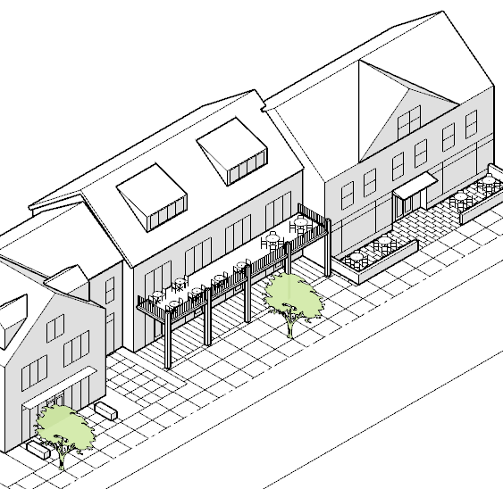
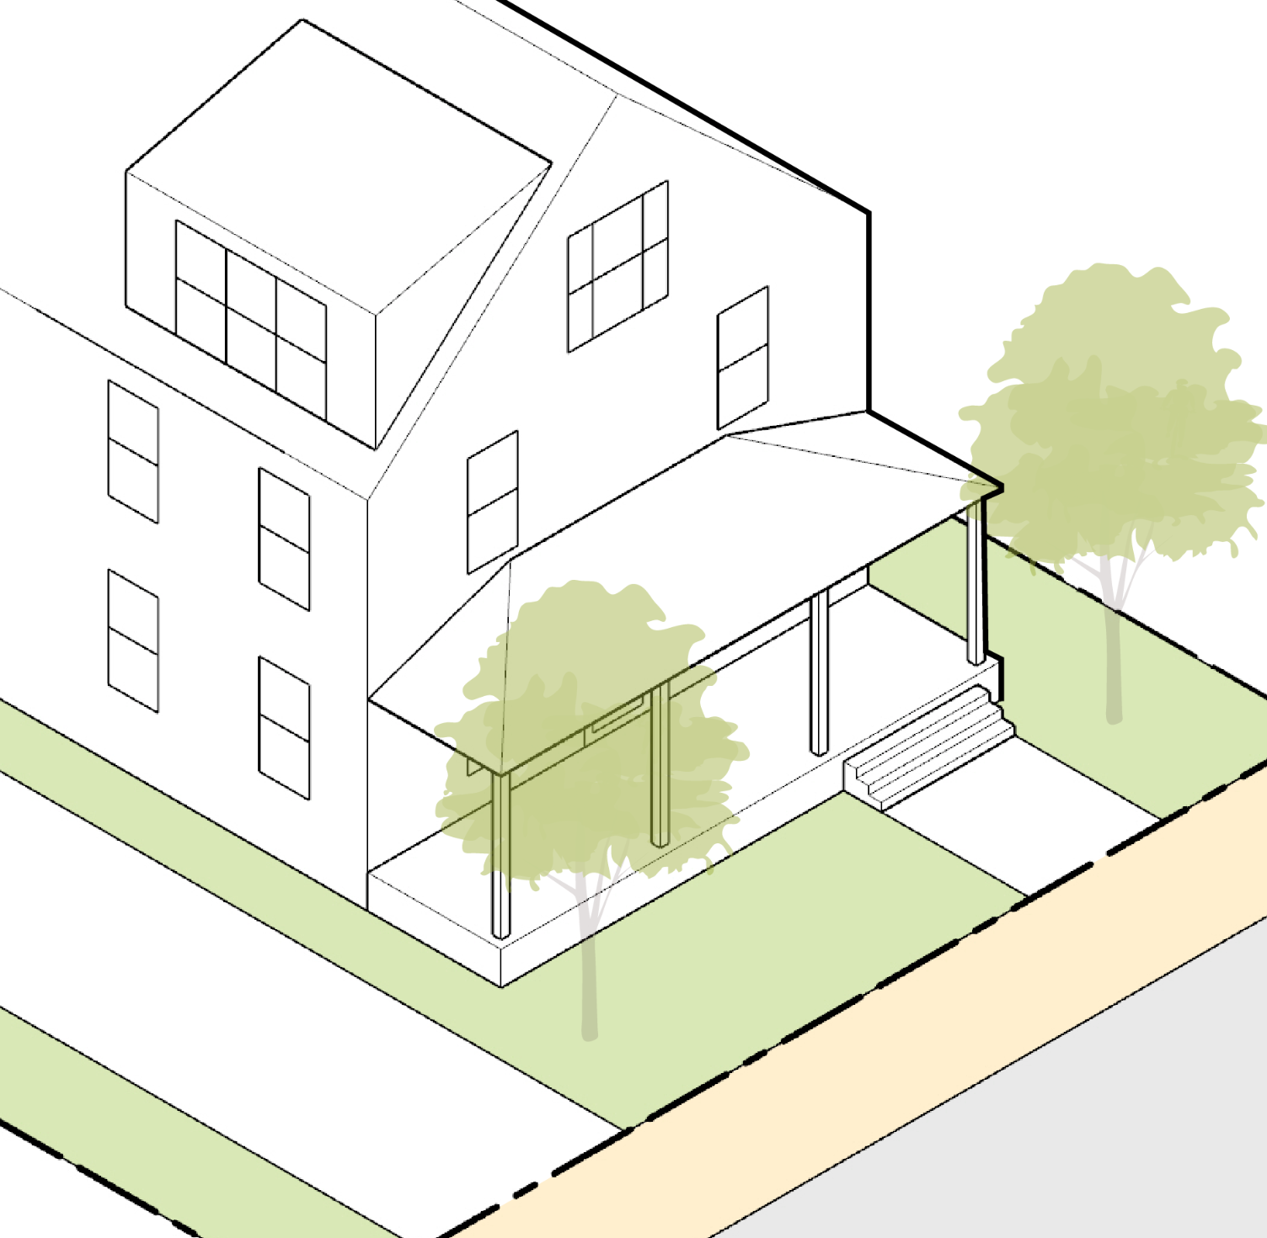
Proposed Frontage Types
Preservation of front yard and porch style for residential front
Densely landscaped frontage
Streets that would be regulated under this new frontage type:
Cummings Ave
Carriage Ln
Mill St
Hamilton Ave
Rust St
Pleasant St
Elliott St
Linden St
New service drives and side streets would also fall under this new category
Parking relocation to back of lot
Awning and signage improvement
Minimal roadway
Commercial signage improvement
Secondary frontage access for parcels with next to the Greenway
Storefront furnishing zone
Separated residential entry
Storefront furnishing zone
Parking relocation to back of lot
Parking relocation to back of lot
Historic Village Center
Existing Pattern
Bay Rd Scenic Corridor
Existing Pattern
Willow St Mixed Use
New Pattern
Greenway
New Pattern
Willow St Residential
Existing Pattern
Town Center Residential
Existing Pattern
Public Realm Character
Moderate front setback from sidewalk
Small landscaped front yard
Use Mix
Residential
Scale
Medium
Secondary / Side Street
Existing Pattern

Slide 17
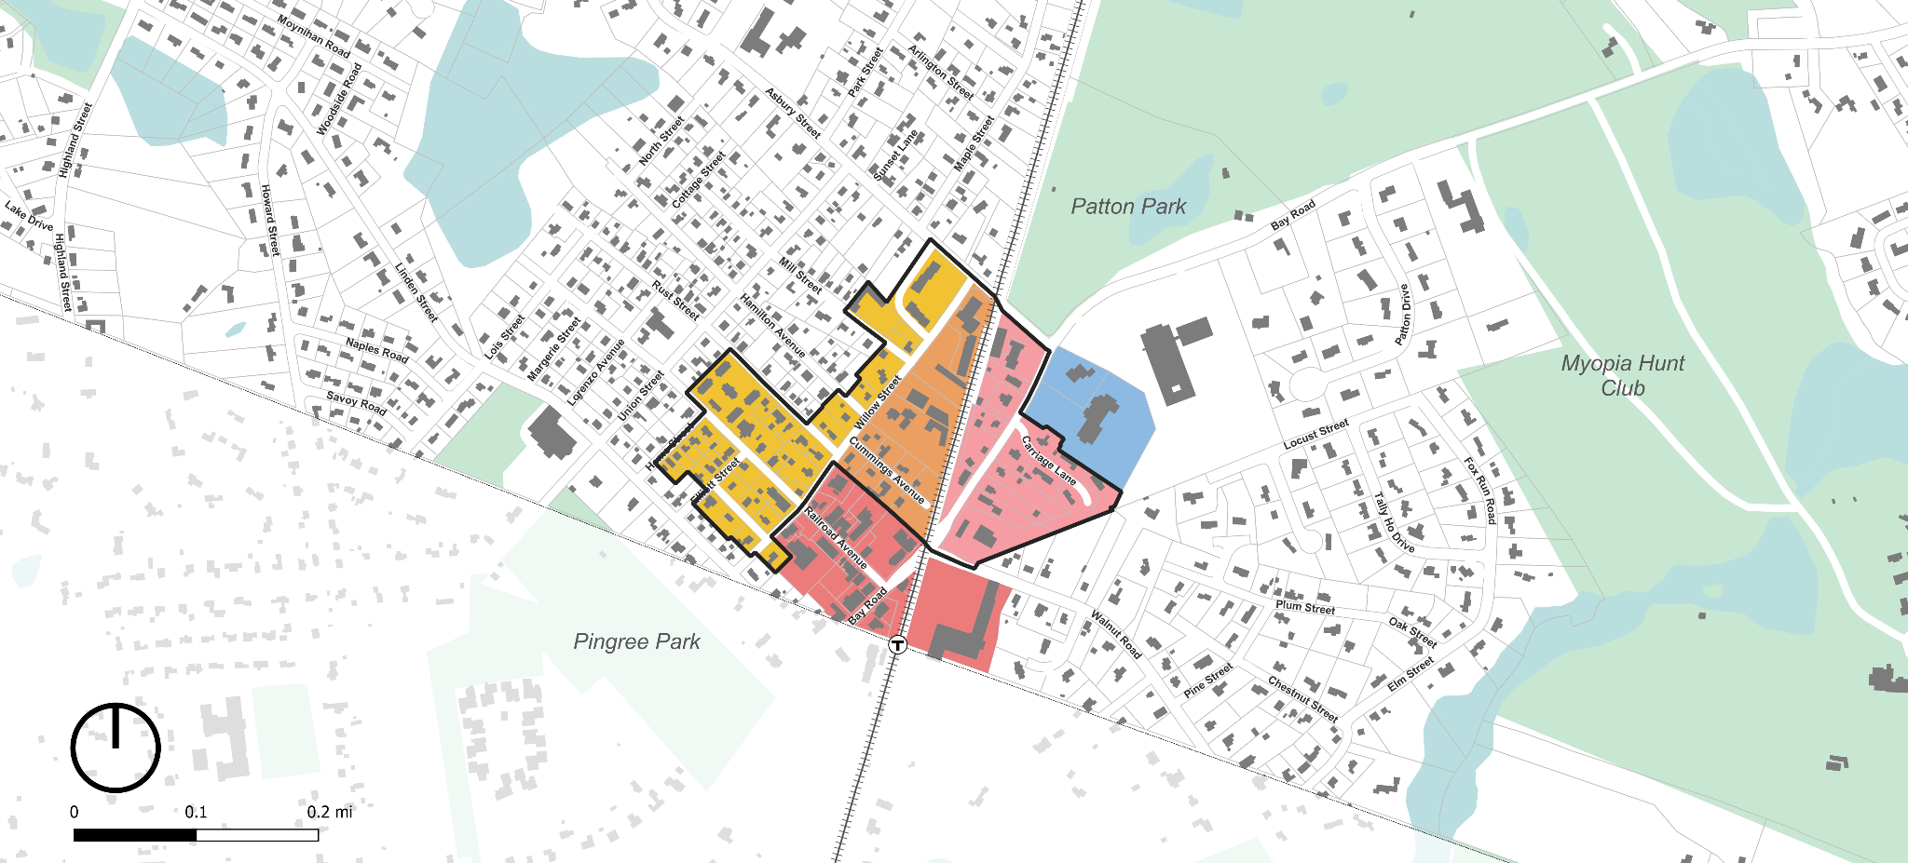
Town Center Zoning Subdistricts
Depot Square Mixed Use
Bay Road Mixed Use
Willow St Mixed Use
Downtown Residential
Bay Road Civic
Contribute to 3A
Senior Center
Winthrop School
Public Library
Public Safety
Hamilton/Wenham Station
Newburyport/Rockport Commuter Rail Line

Slide 18
Town Center Zoning Subdistrict Standards
Subdistricts and dimensional standards for the Town Center zoning

Slide 19
Town Center Subdistricts Contributing to 3A
All three of these, as shown, can contribute to 3A compliance, when combined with other 3A overlay subdistricts outside the Town Center.
Key Map
Bay Rd Mixed Use
Willow St Mixed Use
Downtown Residential

Slide 20
Town Center Subdistricts NOT Contributing to 3A
These two Town Center Subdistricts will NOT contribute to 3A, and therefore are independent of the constraints of 3A.
Key Map
T
Depot Square Mixed Use
Bay Rd Civic

Slide 21
Lets Test How Zoning Matches Up to Actual Properties

Slide 22
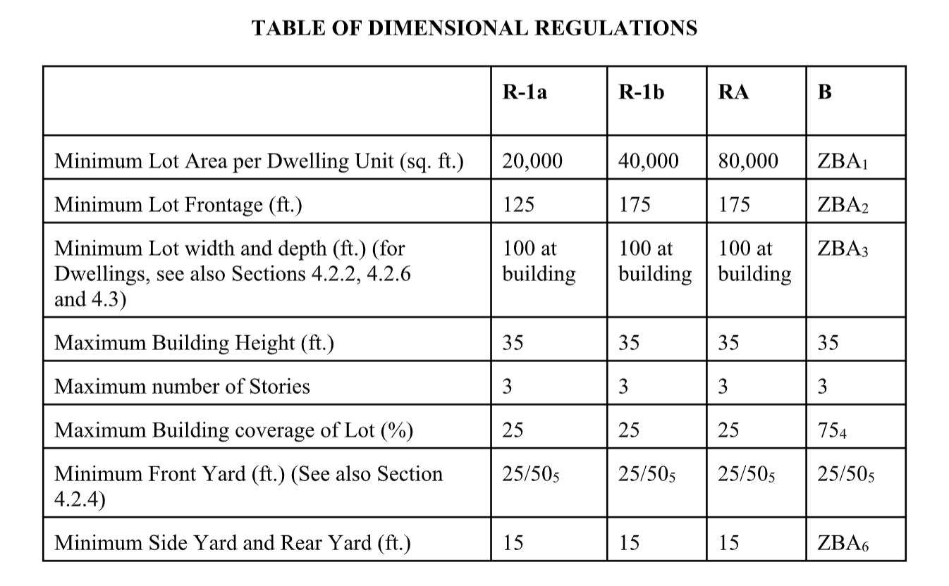
Lot Area, Lot Frontage, & Lot Coverage
Testing these three metrics; minimum lot area per dwelling, minimum lot frontage, and maximum lot coverage.
These three metrics are all partially responsible for controlling how built-up Hamilton feels - how frequently buildings occur and how large they can be.

Slide 23
Existing Zoning Does not Represent Hamilton
76% of lots in the Study Area are smaller than the minimum lot size for parcels with at least one dwelling unit.
These are all considered “nonconforming lots” because they do not meet current zoning standards.
If you were to consider existing lots with multiple units, it is likely that even more lots are nonconforming.

Slide 24
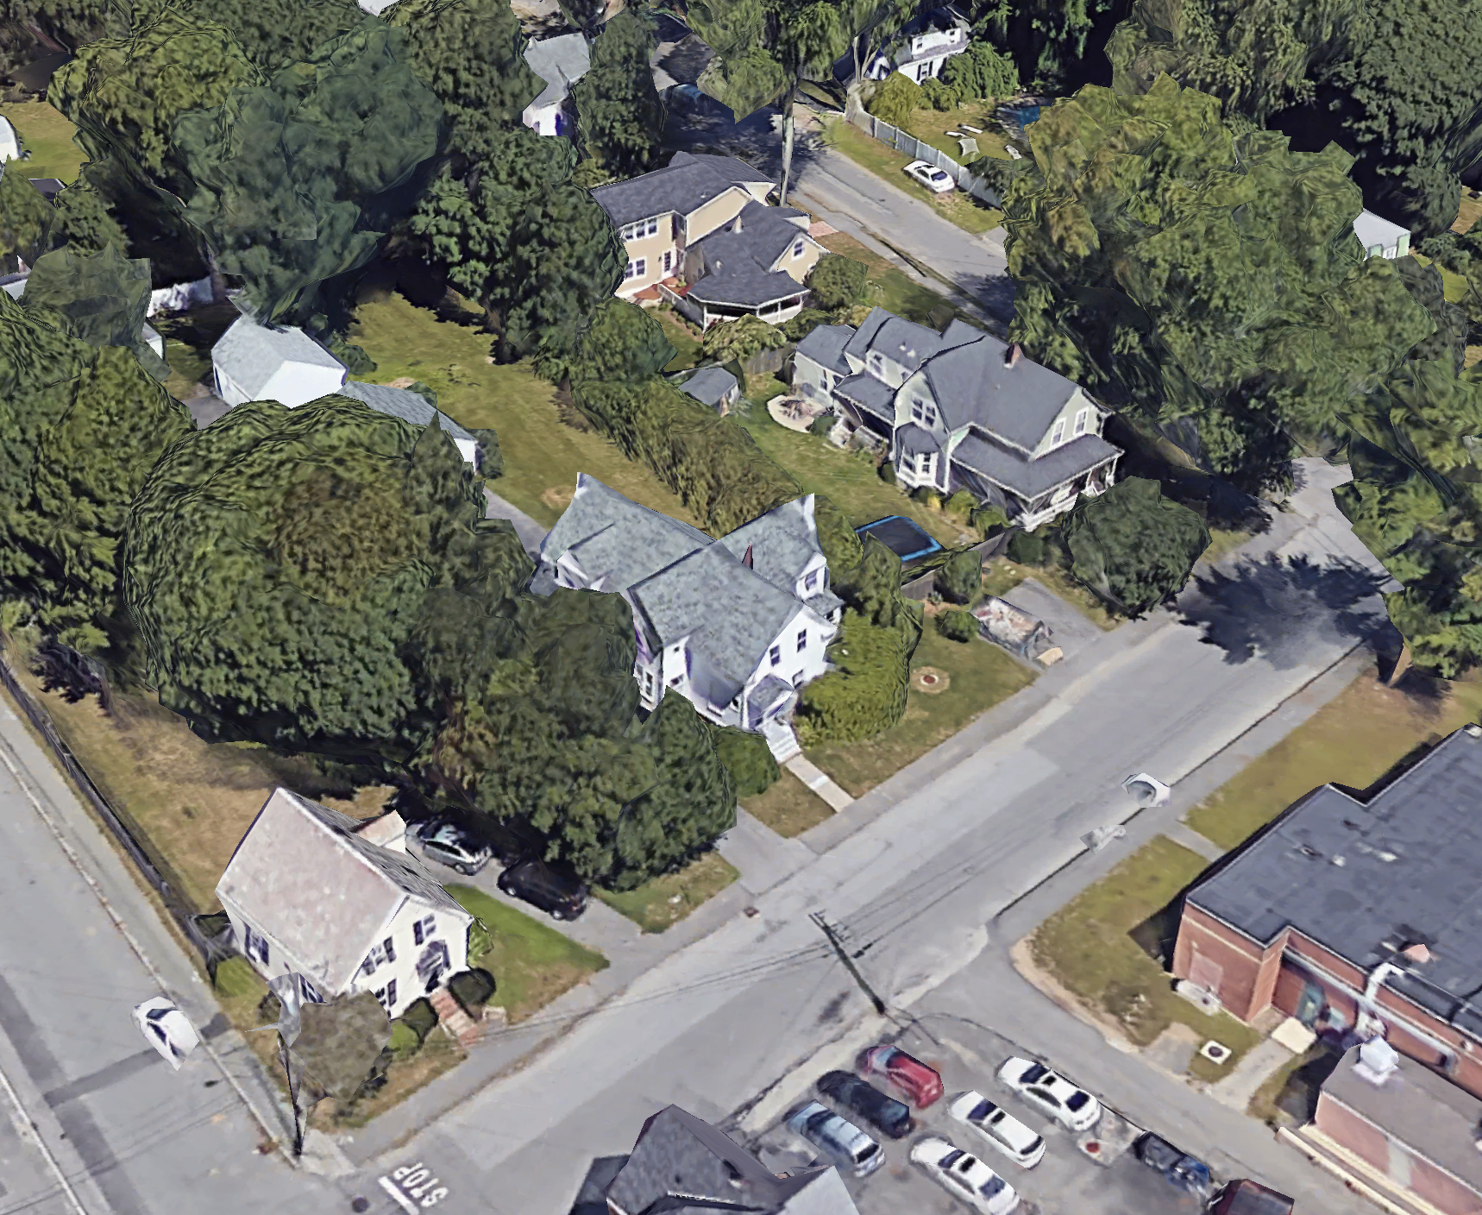
Downtown Residential
Bay Rd Mixed Use
Bay Rd Civic
Depot Square Mixed Use
Willow St Mixed Use
Scenario 01 Residential 1a vs Downtown Residential
Existing Zoning - Nonconformity
The existing zoning is poorly matched to Hamilton’s fabric and built conditions. The zoning allows for much larger homes and requires lots that are out of scale with the community.
Total SF: 18,700 SF
NONCONFORMING
Willow Street

Slide 25
Downtown Residential
Bay Rd Mixed Use
Bay Rd Civic
Depot Square Mixed Use
Willow St Mixed Use
Scenario 01 Residential 1a vs Downtown Residential
Existing Zoning - Minimum Lot Area
The existing zoning requires a minimum of 20,000 square feet per a dwelling unit. The example lot to the right which is larger than all of its neighbors, is only 18,700 square feet.
Total SF: 18,700 SF
NONCONFORMING
The area outlined in yellow represents 20,000 SF, the minimum lot size in the existing zoning
Willow Street

Slide 26
Downtown Residential
Bay Rd Mixed Use
Bay Rd Civic
Depot Square Mixed Use
Willow St Mixed Use
Scenario 01 Residential 1a vs Downtown Residential
Existing Zoning - Minimum Lot Frontage
The existing zoning requires a minimum of 125’ of lot frontage. The example lot to the right, again larger than all of its neighbors, is still only 83’.
83’
NONCONFORMING
Willow Street

Slide 27
Downtown Residential
Bay Rd Mixed Use
Bay Rd Civic
Depot Square Mixed Use
Willow St Mixed Use
Scenario 01 Residential 1a vs Downtown Residential
Existing Zoning - Minimum Lot Frontage
The existing zoning requires a minimum of 125’ of lot frontage. The example lot to the right, again larger than all of its neighbors, is still only 83’.
The yellow line represents 125’ of minimum frontage required in the existing zoning
83’
NONCONFORMING
Willow Street

Slide 28
Downtown Residential
Bay Rd Mixed Use
Bay Rd Civic
Depot Square Mixed Use
Willow St Mixed Use
Scenario 01 Residential 1a vs Downtown Residential
Existing Zoning - Maximum Lot Coverage
The existing zoning allows up to 25% lot coverage. While this metric does not create a non-conformity for this property, it can allow buildings that are drastically out of scale with their surroundings.
This existing home has a footprint of roughly 1,500 SF
Willow Street

Slide 29
Downtown Residential
Bay Rd Mixed Use
Bay Rd Civic
Depot Square Mixed Use
Willow St Mixed Use
Scenario 01 Residential 1a vs Downtown Residential
Existing Zoning - Maximum Lot Coverage
A lot of 18,700 SF would be allowed to have a building with a footprint of 4,675 SF, significantly larger than the existing homes and its neighbors.
Under existing rules, a lot this large could have a home with a footprint of 4,675 SF
Willow Street

Slide 30
Downtown Residential
Bay Rd Mixed Use
Bay Rd Civic
Depot Square Mixed Use
Willow St Mixed Use
Scenario 01 Residential 1a vs Downtown Residential
New Zoning - Existing Fabric
The new zoning is designed to look like Hamilton. It is tailored to match Hamilton’s fabric and scale. It brings existing buildings into conformity and allows contextual future growth.
Building Footprint: 1,200 SF
35’
Total SF: 3,900 SF
FAR: 0.45
Willow Street
Willow St

Slide 31
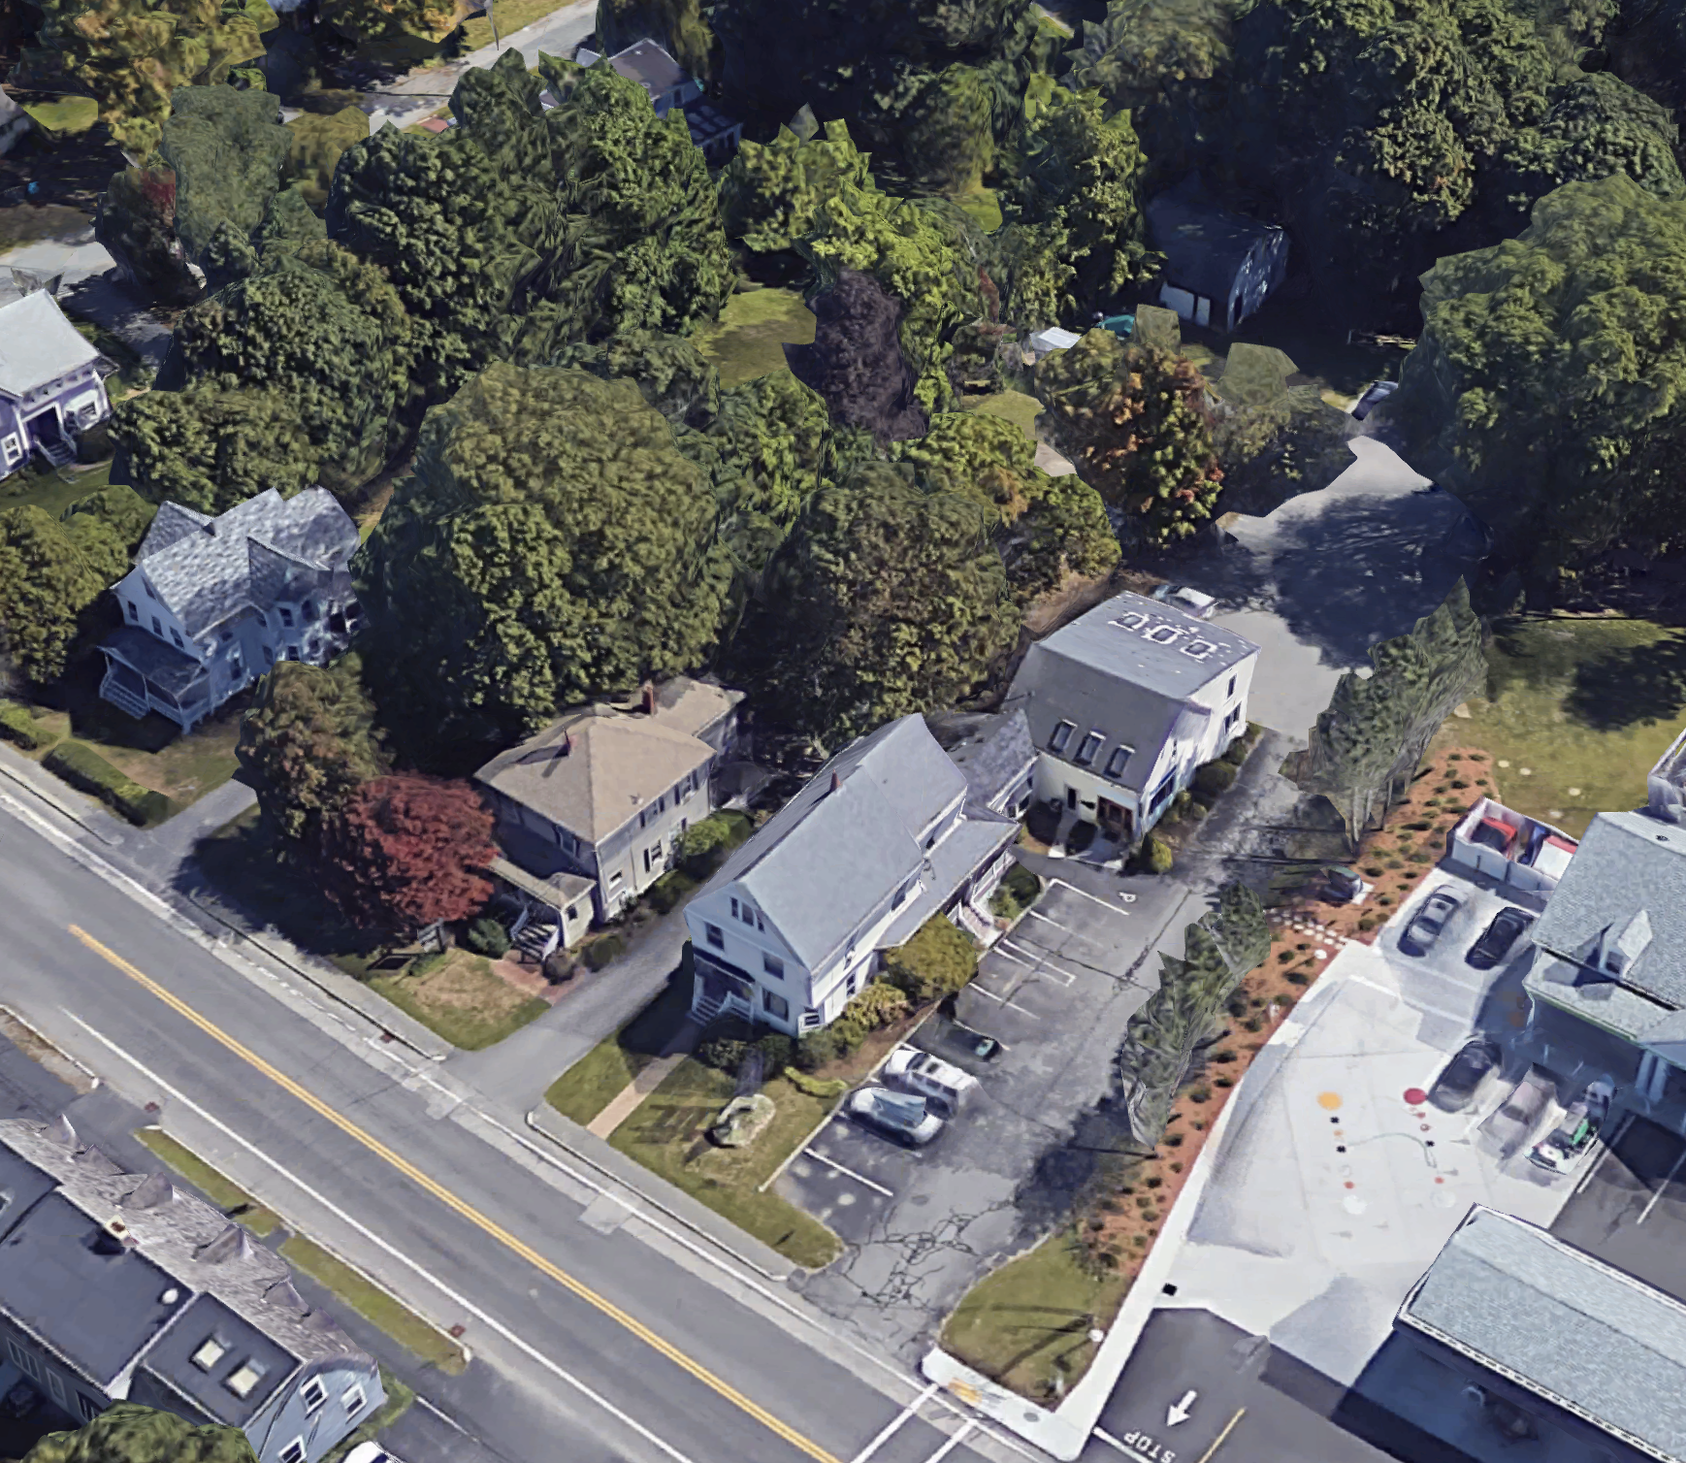
Downtown Residential
Bay Rd Mixed Use
Bay Rd Civic
Depot Square Mixed Use
Willow St Mixed Use
Scenario 02 Business vs Bay Road Mixed Use
Existing Zoning - Non-Conformity
The existing Business District zoning carries the same lot and frontage dimensional constraints as R-1a for buildings with dwelling units. Here again a relatively large lot fails both tests.
Total SF: 18,415 SF
NON-CONFORMING
Bay Road
1. For each Dwelling Unit, minimum lot area is twenty thousand (20,000) square feet or as determined by the SPGA. For other uses, to be determined during site plan review.
2. For a Building that contains a Dwelling Unit, 125 feet. For all other uses, to be determined during site plan review.
4. Or as determined during site plan review.

Slide 32
Downtown Residential
Bay Rd Mixed Use
Bay Rd Civic
Depot Square Mixed Use
Willow St Mixed Use
Scenario 02 Business /Bay Road Mixed Use
Existing Zoning - Minimum Lot Area
The existing zoning requires a minimum of 20,000 square feet per a dwelling unit. The example lot to the right is only 18,415 square feet.
Total SF: 18,415 SF
NON-CONFORMING
Bay Road
The area outlined in yellow represents 20,000 SF, the minimum lot size in the existing zoning
1. For each Dwelling Unit, minimum lot area is twenty thousand (20,000) square feet or as determined by the SPGA. For other uses, to be determined during site plan review.
2. For a Building that contains a Dwelling Unit, 125 feet. For all other uses, to be determined during site plan review.
4. Or as determined during site plan review.

Slide 33
Downtown Residential
Bay Rd Mixed Use
Bay Rd Civic
Depot Square Mixed Use
Willow St Mixed Use
Scenario 02 Business /Bay Road Mixed Use
Existing Zoning - Minimum Lot Frontage
The existing zoning requires a minimum of 125 of lot frontage. The example lot to the right is only 80’.
Bay Road
80’
NON-CONFORMING
1. For each Dwelling Unit, minimum lot area is twenty thousand (20,000) square feet or as determined by the SPGA. For other uses, to be determined during site plan review.
2. For a Building that contains a Dwelling Unit, 125 feet. For all other uses, to be determined during site plan review.
4. Or as determined during site plan review.

Slide 34
Downtown Residential
Bay Rd Mixed Use
Bay Rd Civic
Depot Square Mixed Use
Willow St Mixed Use
Scenario 02 Business /Bay Road Mixed Use
Existing Zoning - Minimum Lot Frontage
The existing zoning requires a minimum of 125 of lot frontage. The example lot to the right is only 80’.
The yellow line represents 125’ of minimum frontage required in the existing zoning
Bay Road
80’
NON-CONFORMING
1. For each Dwelling Unit, minimum lot area is twenty thousand (20,000) square feet or as determined by the SPGA. For other uses, to be determined during site plan review.
2. For a Building that contains a Dwelling Unit, 125 feet. For all other uses, to be determined during site plan review.
4. Or as determined during site plan review.

Slide 35
Downtown Residential
Bay Rd Mixed Use
Bay Rd Civic
Depot Square Mixed Use
Willow St Mixed Use
Scenario 02 Business vs Bay Road Mixed Use
Existing Zoning - Maximum Lot Coverage
The existing zoning allows up to 75% lot coverage. While this metric does not create a non-conformity for this property, it can allow buildings that are drastically out of scale with their surroundings.
This existing structure has a footprint of roughly 9,900 SF
Bay Road
1. For each Dwelling Unit, minimum lot area is twenty thousand (20,000) square feet or as determined by the SPGA. For other uses, to be determined during site plan review.
2. For a Building that contains a Dwelling Unit, 125 feet. For all other uses, to be determined during site plan review.
4. Or as determined during site plan review.

Slide 36
Downtown Residential
Bay Rd Mixed Use
Bay Rd Civic
Depot Square Mixed Use
Willow St Mixed Use
Scenario 02 Business vs Bay Road Mixed Use
Existing Zoning - Maximum Lot Coverage
The existing zoning allows up to 75% lot coverage. While this metric does not create a non-conformity for this property, it can allow buildings that are drastically out of scale with their surroundings.
Under existing rules, a lot this large could have a building with a footprint of 13,811 SF
Bay Road
1. For each Dwelling Unit, minimum lot area is twenty thousand (20,000) square feet or as determined by the SPGA. For other uses, to be determined during site plan review.
2. For a Building that contains a Dwelling Unit, 125 feet. For all other uses, to be determined during site plan review.
4. Or as determined during site plan review.

Slide 37
Downtown Residential
Bay Rd Mixed Use
Bay Rd Civic
Depot Square Mixed Use
Willow St Mixed Use
Scenario 02 Business /Bay Road Mixed Use
New Zoning - Existing Fabric
The new zoning is designed to look like Hamilton. It is tailored to match Hamilton’s beloved fabric and scale. It brings existing buildings into conformity and allows contextual future growth.
Greenway frontage for parcels with access to the pedestrian/bike path
37’
Building Footprint: 2,100 SF
Bay Road
Total SF: 6,900 SF
FAR: 0.35
Bay Rd

Slide 38
Next Steps
Known Areas of Planning Board Comments
Special Permit Granting Authority
Additional Use Table changes
Applicability/nonconforming section
Will be addressed in a revised final draft to be issued on 5/27, provided there is clear direction from the full Planning Board on desired changes.
Outreach
Existing vs. Proposed Zoning Comparison Factsheets

Slide 39
Thank You!

Slide 40
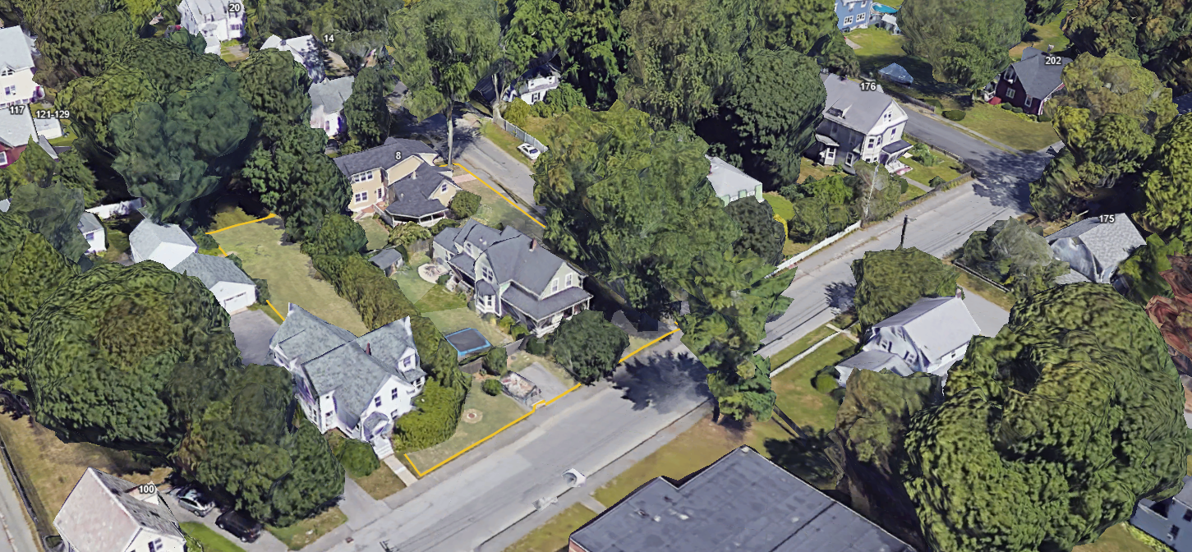
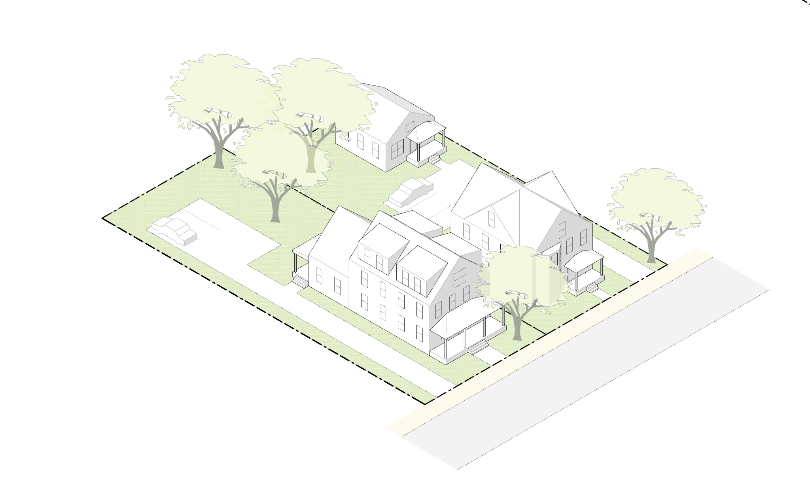

Slide 41
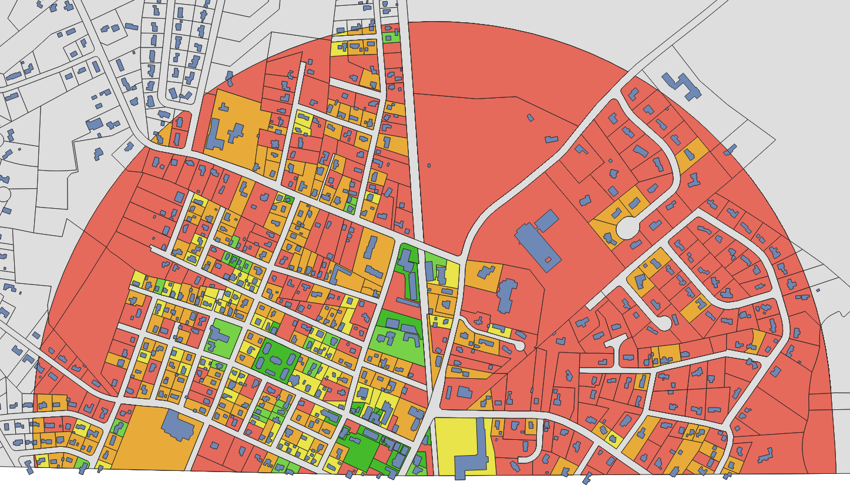
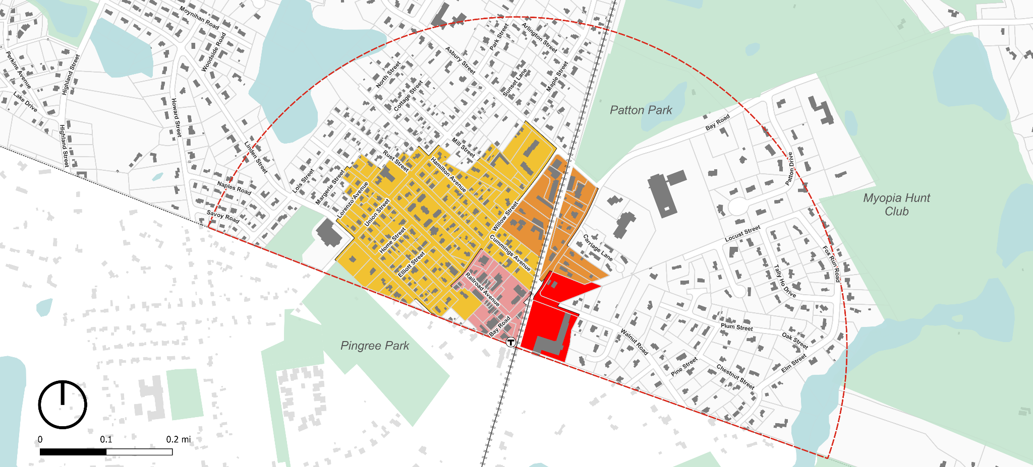
Downtown FAR Analysis
FAR > 0.4 | FAR 0.33-0.4 | FAR 0.25-0.33 | FAR 0.15-0.25 | FAR <0.15
Senior Center
Winthrop School
Public Safety
Hamilton/Wenham Station
Newburyport/Rockport Commuter Rail Line

Slide 42
Downtown Residential
Bay Rd Mixed Use
Depot Square Mixed Use
Willow St Mixed Use
Downtown Residential
Bay Rd Mixed Use
Bay Rd Civic
Bay Rd Civic
Depot Square Mixed Use
Willow St Mixed Use
Bay Road Civic Building Form Standards
Relationship to 3A:
This subdistrict does not contribute to 3A.
Special Massing Rules:
Civic buildings are allowed to have more freedom of form and massing.
Allow flat roofs for rear buildings only.
Unrestricted Building Footprint for civic buildings
Dimensional Standards
Building Footprint, max. | –
Building Height, max. | 2.5 stories
Ground Floor Height, min/max. | 13’ / 15’
Height / Stories, max. | 35’ / 2.5
Setback - Front, min/max | 20’ / 35’
Setback - Side, min. | 10’
Setback - Rear, min. | 10’
Open Space, min. | –
Parking located behind civic building, never fronting the street.
Civic building fronting the street with the same set back and green yard requirement than the rest of Bay Rd.
Bay Road
Contextual Building Height Research:
Currently 30’ - 35’
Most commercial businesses are using residential building forms.

Slide 43
Downtown Residential
Bay Rd Mixed Use
Bay Rd Civic
Depot Square Mixed Use
Downtown Residential
Bay Rd Mixed Use
Bay Rd Civic
Depot Square Mixed Use
Willow St Mixed Use
Willow St Mixed Use
Willow Street Mixed Use Building Form Standards
Relationship to 3A:
This subdistrict does contribute to 3A.
Special Massing Rules:
Building height may increase to 3.5 stories after setback of 60’ from the front lot line
Step up to 3.5 stories in rear, but only allow 2.5 stories along the Willow Street frontage
Dimensional Standards
Building Footprint, max. | 5,000 SF
Building Height, max. | 35’ / 2.5 stories
Building Height after 60’ setback, max | 45’ / 3.5 stories
Ground Floor Height, min/max. | 13’ / 15’
Setback - Front, min/max | 10’ / 20’
Setback - Side, min. | 5’
Setback - Rear, min. | 20’
Open Space, min. | 40%
Combined Building Footprint: 3,930 SF
Willow St
Total SF: 18,100 SF
FAR: 0.42

Slide 44
Bay Rd Mixed Use
Bay Rd Civic
Depot Square Mixed Use
Willow St Mixed Use
Downtown Residential
Downtown Residential
Bay Rd Mixed Use
Bay Rd Civic
Depot Square Mixed Use
Willow St Mixed Use
Downtown Residential Building Form Standards
Relationship to 3A:
This subdistrict does contribute to 3A.
Special Massing Rules:
Adaptive reuse standards allow an addition along the rear and side elevations of the existing structure, up to 50% of the footprint of the existing structure.
Additions along the side elevation must be set back at least 20’ from the front facade of the existing structure.
Building Footprint: 1,200 SF
Dimensional Standards
Building Footprint, max. | 3,000 SF
Building Height, max. | 35’ / 2.5 stories
Ground Floor Height, min/max. | –
Setback - Front, min./max. | 10’ / 20’
Setback - Side, min. | 10’
Setback - Rear, min. | 20’
Open Space, min. | 40%
Total SF: 3,900 SF
FAR: 0.45
Willow St

Slide 45
Bay Road Scenic Corridor Building Form Standards
Downtown Residential
Bay Rd Civic
Depot Square Mixed Use
Willow St Mixed Use
Downtown Residential
Bay Rd Mixed Use
Bay Rd Mixed Use
Bay Rd Civic
Depot Square Mixed Use
Willow St Mixed Use
Relationship to 3A:
This subdistrict does contribute to 3A.
Special Massing Rules:
We will include rules around the relationship of a second accessory structure to the primary structure (e.g. minimum distance between primary and secondary structure)
Greenway frontage for parcels with access to the pedestrian/bike path
Building Footprint: 2,100 SF
Dimensional Standards
Building Footprint, max. | 3,000 SF
Building Height, max. | 35’ / 2.5 stories
Ground Floor Height, min/max. | 12’ / 15’
Half-Story Height, max. | 14’
Setback - Front, min/max | 20’ / 35’
Setback - Side, min. | 5’
Setback - Rear, min. | 20’
Open Space, min. | 40%
Contextual Building Height Research:
Currently 30’ - 35’
Most commercial businesses are using residential building forms.
Total SF: 6,900 SF
FAR: 0.35
Bay Rd

Slide 46
Railroad Ave Building Form Standards
Downtown Residential
Bay Rd Mixed Use
Bay Rd Civic
Willow St Mixed Use
Downtown Residential
Bay Rd Mixed Use
Bay Rd Civic
Depot Square Mixed Use
Depot Square Mixed Use
Willow St Mixed Use
Relationship to 3A:
This subdistrict does not contribute to 3A.
Special Massing Rules:
We are considering allowing flat roofs in this subdistrict given it is already present
Different rules for first 60’ vs rear buildings
Parcels over a certain size trigger a special permit process
This illustration includes separation between buildings, but the angle obscures it
Dimensional Standards
Building Footprint, max. | 5,000 SF
Building Height, max. | 35’ / 2.5 stories
Ground Floor Height, min/max. | 13’ / 15’
Setback - Front, min/max. | 0’ / 10’
Setback - Side, min. | 0’
Setback - Rear, min. | 0’
Open Space, min. | 0%
Artcie Building Footprint: 5,060 SF
Railroad Ave
Bay Road
Combined Building Footprints: 4,120 SF

Slide 47
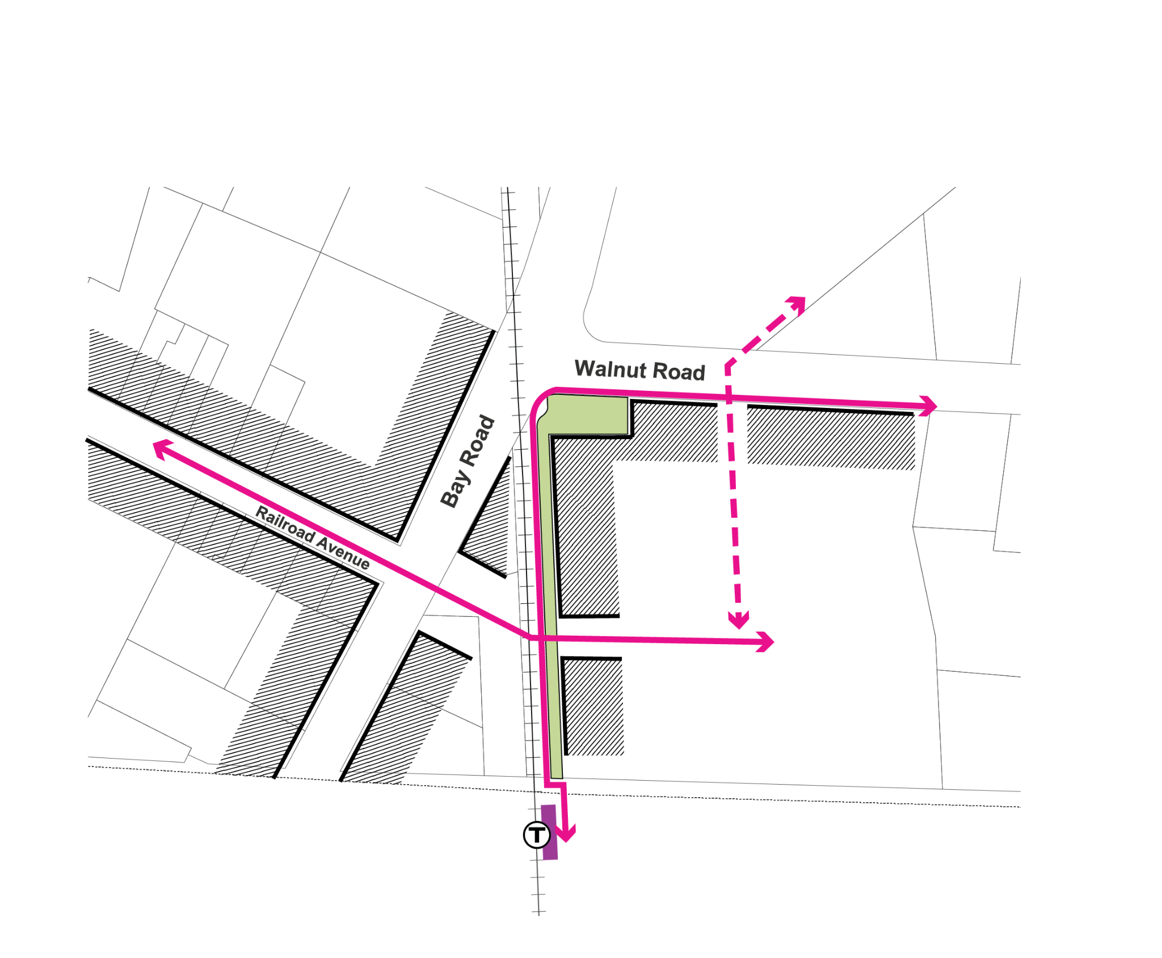
Hamilton Crossing Site Design Framework
Downtown Residential
Bay Rd Mixed Use
Bay Rd Civic
Willow St Mixed Use
Downtown Residential
Bay Rd Mixed Use
Bay Rd Civic
Depot Square Mixed Use
Depot Square Mixed Use
Willow St Mixed Use
Frontage Approach
Overall Approach
Merge Hamilton Crossing parcel with Railroad Ave subdistrict to form unified “Depot Square” Subdistrict
Control frontage heavily for first 60’ then have lighter formal controls for rear buildings
Require any parcel over a certain square footage to go through a special permit process
Potential greenway connection
Maintain character with buildings continuously fronting along the street
Walnut Road Frontage
Gateway aligns with Railroad Ave ROW
Residential scale (up to 2.5 stories)
Setback transition to residential pattern to the east
Looser building clustering with landscaping and breaks in massing
Create clear opening for potential future greenway connection
Pedestrian connection across the R-ROW
Railroad Track Frontage
Residential scale (up to 2.5 stories)
Match Railroad Ave frontage type, but with more pedestrian cut-throughs to rear parking and mall area
Create clear gateway that aligns with Railroad Ave

Slide 48
Hamilton Crossing Building Form Framework
Downtown Residential
Bay Rd Mixed Use
Bay Rd Civic
Willow St Mixed Use
Downtown Residential
Bay Rd Mixed Use
Bay Rd Civic
Depot Square Mixed Use
Depot Square Mixed Use
Willow St Mixed Use
This is an approximation of the Hamilton Crossing shopping plaza site for the purposes of exploring the building form vision for this subdistrict
Retain large commercial footprints that support key anchor tenants (grocery store, pharmacy)
Key Features:
Retain existing landscaped corner at Walnut & Bay
Create gateways that encourage pedestrian through connections in alignment with Railroad Ave and potential future Greenway connection
Emulate Railroad Avenue frontage along rail line but with more generous setback, and along Walnut Rd with less intensity
Allow for connected building forms to encourage variety in the massing while still providing larger commercially viable tenant spaces. Encourage cut-through pedestrian alleys to access the parking lot and rear lot uses.
Allow for larger footprint buildings set back from the street
Retain Anchors
Parking relocation to back of lot,
Treat Extension of RR Ave as a Frontage
Wenham
T
Sufficient Parking
Hold Street
Walnut Rd
Strengthen Connection & Sense of Gateway
Encourage connection to potential future Greenway in former rail ROW
Pedestrian path lined up with historic village center frontages
Bay Rd
Street lined with buildings that fit the Historic Village Center character and scale
Treat Rail as a Frontage
Notes:
Crossroads Plaza Ownership:
HAMILTON WENHAM LLC
& C/O SSG COMMERCIAL LLC
(TAMPA, FL)
Wenham Property Ownership:
(1) MBTA
(2) HAMILTON WENHAM LLC
& C/O SSG COMMERCIAL LLC
(TAMPA, FL)
(3) HAVERHILL GAS CO
& C/O ESSEX COUNTY GAS CO
(WALTHAM, MA)
Cumberland Farms Ownership:
OBSIDIAN ML 6 LLC & 11995 EL CAMINO REAL (SAN DIEGO, CA)

Slide 49
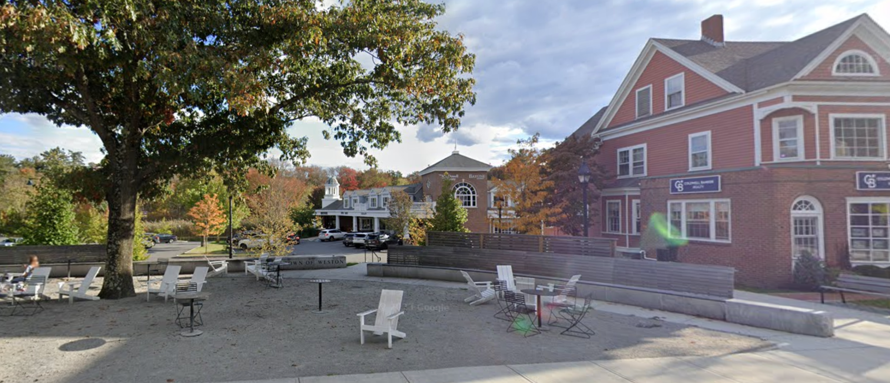
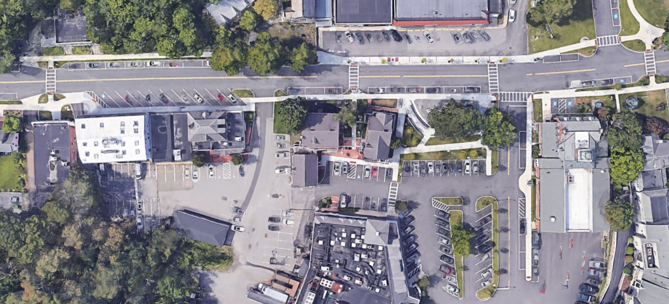
Hamilton Crossing Precedent
Downtown Residential
Bay Rd Mixed Use
Bay Rd Civic
Willow St Mixed Use
Downtown Residential
Bay Rd Mixed Use
Bay Rd Civic
Depot Square Mixed Use
Depot Square Mixed Use
Willow St Mixed Use
This precedent from Weston, MA shows an example of how a shopping plaza can be successfully integrated into a traditional town center pattern.
Weston Town Center
Weston, MA
Notes:
Crossroads Plaza Ownership:
HAMILTON WENHAM LLC
& C/O SSG COMMERCIAL LLC
(TAMPA, FL)
Wenham Property Ownership:
(1) MBTA
(2) HAMILTON WENHAM LLC
& C/O SSG COMMERCIAL LLC
(TAMPA, FL)
(3) HAVERHILL GAS CO
& C/O ESSEX COUNTY GAS CO
(WALTHAM, MA)
Cumberland Farms Ownership:
OBSIDIAN ML 6 LLC & 11995 EL CAMINO REAL (SAN DIEGO, CA)

Slide 50
Downtown Residential
Bay Rd Mixed Use
Depot Square Mixed Use
Willow St Mixed Use
Downtown Residential
Bay Rd Mixed Use
Bay Rd Civic
Bay Rd Civic
Depot Square Mixed Use
Willow St Mixed Use
Bay Road Civic Building Form Standards
Relationship to 3A:
This subdistrict does not contribute to 3A.
Special Massing Rules:
Civic buildings are allowed to have more freedom of form and massing.
Allow flat roofs for rear buildings only.
Unrestricted Building Footprint for civic buildings
Dimensional Standards
Building Footprint, max. | –
Building Height, max. | 2.5 stories
Ground Floor Height, min/max. | 13’ / 15’
Half-Story Height, max. | 14’
Setback - Front, min/max | 30’ or Average / 40’
Setback - Side, min. | 5’
Setback - Rear, min. | 20’
Open Space, min. | –
Parking located behind civic building, never fronting the street.
Civic building fronting the street with the same set back and green yard requirement than the rest of Bay Rd.
Bay Road
Contextual Building Height Research:
Currently 30’ - 35’
Most commercial businesses are using residential building forms.
Note: for more intuitive understanding, we have used the top of the ridgeline for all measurements of height in this table (e.g. building height, half-story height). This will be updated in the final zoning article to be consistent with how Hamilton measures building height.

Slide 51
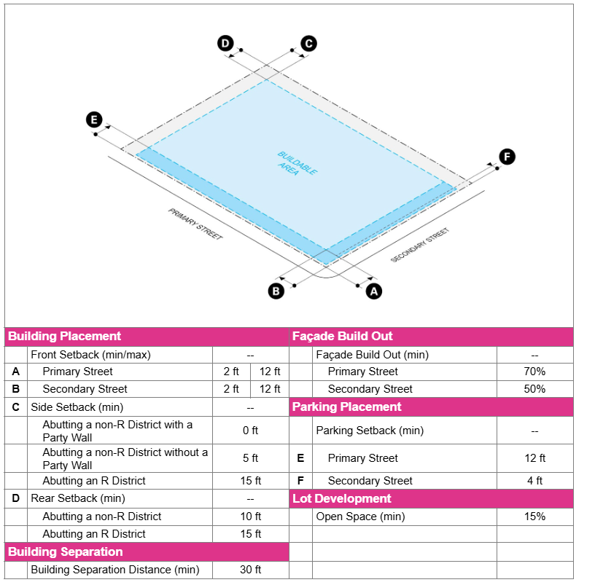
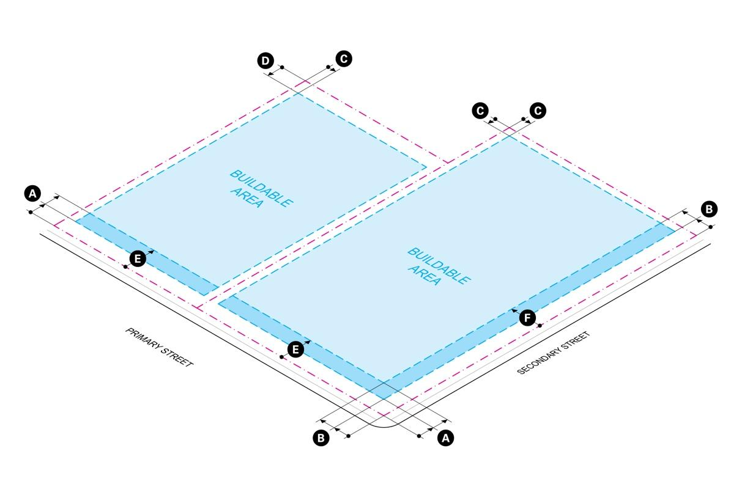
Structure of the Town Center Zoning Code
1. INTRODUCTION - Purpose, Intent, and Applicability
Example of FBC sheet for each district (numbers are to illustrate structure and do not correspond to any specific district in Hamilton Town Center):
2. INTERPRETATION - Defining Standards, and Measurements
3. TOWN CENTER DISTRICTS
Metrics per District:
- Description
- Lot Standards
- Building Standards
- Use Provisions
Design and Development Standards
4. ADMINISTRATION - Process, Roles, and Responsibilities

Slide 52
Subdistrict Degree of Change Spectrum
How the subdistricts might change in response to frontage type insights
Minimal
Substantial
Downtown Residential
Bay Rd Mixed Use
Bay Rd Civic
Depot Square Mixed Use
Willow St Mixed Use
8% of survey participants believed this area should be changed and enhanced
Rezoning Goals:
Reduce nonconformity due to zoning not matching existing built pattern
Encourage engaging pedestrian-oriented frontage and sidewalks, especially on Willow St
43% of survey participants believed this area should be changed and enhanced
Rezoning Goals:
Improve walkability and activation, focusing on frontage
Allow incremental, improved development in the rear of lots while maintaining historic scenic road frontage
Note: this area was not part of the survey
Rezoning Goals:
Improve walkability and activation, focusing on frontage
Encourage incremental, improved development in the front of lots to reinforce historic scenic road frontage vision
45% of survey participants believed that Hamilton Crossing (HC) & the gas station should be changed and enhanced
34% of survey participants believed Railroad Ave (RR) should be changed and enhanced
Rezoning Goals:
HC frontage change to extend Railroad Ave and Bay Rd patterns
Encourage infill to complete an active “street wall” with parking in rear
Reduce RR nonconformity due to zoning not matching existing built pattern
54% of survey participants believed this area should be changed and enhanced
Rezoning Goals:
Frontage mixed-use activation along Willow St, blend the Bay Rd scenic road and Willow Street residential frontage patterns

