Slide 1

Hamilton Community Preservation Committee (CPC)
2026 Annual Public Information Meeting
CPC and Select Board Joint Meeting
September 28, 2026
Robert Preston Chair, CPC
Notes:
This presentation is part educational, informational, and historical in terms of the Community Preservation Act (CPA) and the Hamilton Community Preservation Committee (CPC). Annual trends, historical performance, and tutorial information are contained herein.
Tonight’s meeting is held to satisfy the requirement for an annual public meeting of the CPC.
The intent of the meeting is to update the Select Board on CPC activities and surrounding conditions, promote awareness of the CPC, and stimulate applications for CPC grants.

Slide 2
Hamilton CPC 2026 Annual Meeting
Hamilton CPC Committee – 9 members
  Robert Preston – at-large - Chair
  Shawn Farrell – at-large - Vice Chair
  Kim Dietel – at-large
  Vacant – at-large
  Vacant – Historic District Commission Rep.
  Sandy Codding – Conservation Commission Rep.
  Michelle Horgan - Housing Authority Rep.
  Darcy Dale – Planning Board Rep.
  Bill Olson – Select Board Rep.
  Coordinator – Laurie Wilson

Slide 3
Hamilton CPC 2026 Annual Meeting
MA Community Preservation Act (CPA)
Became law in 2000. Hamilton adopted the CPA in 2005.
201 of 351 or 57% of MA communities participate.
Communities choose from a 1% to 3% surcharge on their property taxes.
The CPA Trust Fund, managed by the MA Dept. of Revenue (DOR) sets and distributes the state match in November.
The CPA Trust Fund source of funds:
  All property transaction fees from the 21 MA Registry of Deeds offices
  Any potential year-end state budget surplus voted by the MA legislature. (Approved 6 times since 2000.)
Notes:
Real estate activity drives the amount of funds available for state match.

Slide 4
Hamilton CPC 2026 Annual Meeting
MA Community Preservation Act (CPA)
Requires communities to appoint a 9-person Community Preservation Committee (CPC), some with specific representation.
Requires communities to set up dedicated internal financial accounts with required transfers amongst them voted at the ATM. Allows bonding of large projects.
Allows CPC’s to evaluate and approve projects for funding in three eligible categories: Open Space and Recreation; Historic Preservation; and Community Housing.
Requires an annual Public Information Meeting advertised to all voters.

Slide 5
Hamilton CPC 2026 Annual Meeting
Hamilton November 2025 CPA Trust Fund Distribution
2% Surcharge Revenue = $617,216
17% State Match = $104,106
Total CPA Revenue = $721,322
Wenham November 2025 CPA Trust Fund Distribution
3% Surcharge Revenue = $580,000
34% State Match with additional distributions = $190,400
Total CPA Revenue = $770,400
Notes:
The comment on the 3% surcharge serves as a reminder of what could be done. Note, however, that it would take approximately 2 years to get such an increase installed even if it were approved every step of the way, starting with a Town Meeting vote and subsequent vote at the polls.

Slide 6
Historical CPA Trust Fund Distributions
CPA Trust Distribution Years? | Number of Communities | State Match
2002 - 2007 | 34 - 113 | 100%
2008 | 127 | 67.62%
2009/2010/2011/2012 | 135/142/143/148 | 34.81%/27.2%/26.64%/26.83%
2013 | 148 | 52.23% (includes $25M budget surplus)
2014 | 155 | 31.46% (includes $11.4M budget surplus)
2015 | 156 | 29.67% (includes $10M budget surplus)
2016 - 2017 | 157 - 162 | 20.58% - 17.2%
2018 | 172 | 19.01% (includes $10M budget surplus)
2019 | 173 | 23.9%
2020 | 176 | 28.63%
2021 | 177 | 43.84% (includes $10M budget surplus)
2022 | 187 | 38.51% (includes $20M budget surplus)
2023/2024/2025 | 195/200/201 | 21.02%/18.06%/16.87%
Notes:
Note that the legislature added surplus revenue to the Trust Fund on six occasions. There appears to be a need to identify other sources of funds for the Trust Fund. Grouping of certain years is random to allow all current and past data to fit on the slide.

Slide 7
Hamilton CPC 2026 Annual Meeting
Department of Revenue CPA Trust Fund Update
In March 2026, the MA Department of Revenue estimated the state match at 15.5% for November 2026 vs. November 2025 state match of 15.9%.
Registry of Deeds revenues were up $1M at the end of June over last year so it’s possible the state match may be a couple of percentages higher over last year.

Slide 8
Hamilton CPC 2026 Annual Meeting
MA Community Preservation Coalition
Boston based non-profit coalition of all communities who adopted the CPA – www.communitypreservation.org
  Executive Director: Stuart Saginor
  Formed in 1990 to help passage of the CPA
  Communities pay annual dues (Hamilton = $2875) and submit reports on approved grants.
  Maintains data on all CPA adoptions, all approved grants, and information on all CPC’s statewide
  Helps communities with understanding, adoption, and implementation of the CPA, and advocates for the CPA at the state level
  Provides opinions on the eligibility of grant requests when solicited

Slide 9
Hamilton CPC 2026 Annual Meeting
Essex County Communities CPA Status
No Participation – Andover, Danvers, Haverhill, Ipswich, Lawrence, Lynn, Lynnfield, Marblehead, Merrimac, Methuen, Newbury, Salisbury, Topsfield
1% Surcharge – Amesbury, Beverly, Gloucester, Middleton, Peabody, Salem
1.5% Surcharge – Essex, Manchester, Swampscott, Tewksbury
2% Surcharge – Hamilton, Newburyport
3% Surcharge – Boxford, Georgetown, Groveland, Nahant, North Andover, Rockport, Rowley, Wenham, West Newbury
Notes:
Danvers voted down their potential participation last year while Swampscott approved a vote.

Slide 10
Hamilton CPC 2026 Annual Meeting
Select Essex County Communities Tax Rate and (CPA Info)
Highest – Wenham @ $15.99 (3% surcharge)
2nd Highest – Topsfield @ $15.66 (0% surcharge)
3rd Highest – Amesbury @ $15.05 (1% surcharge)
4th Highest – Hamilton @ $15.04 (2% surcharge)
Lowest – Newbury @ $7.51 (0% surcharge)
2nd Lowest – Rockport @ $8.46 (3% surcharge)
3rd Lowest – Marblehead @ $8.56 (0% surcharge)
Highest in MA – Longmeadow @ $22.92 (1% surcharge)
Lowest in MA – Hancock @ $2.18 (0% surcharge)
Notes:
No correlation between tax rate and CPA adoption.

Slide 11
Hamilton CPC 2026 Annual Meeting
CPA Surcharge Calculation
Property Assessed Valuation | Property Tax at $15.04 per Thousand | Annual 2% CPA Surcharge (For 3% surcharge multiply by 1.5)
$500k | $6016 | $120
$600k | $7520 | $150
$700k | $9024 | $180
$800k | $10,528 | $211
$900k | $12,032 | $240
$1M | $13,536 | $271
$1.5M | $21,056 | $421
Annual CPA Surcharge Calculation
(Assessed Value - $100k) x (Tax Rate/$1k) x 2% Surcharge = Surcharge
Notes:
NOTE: The annual 3% surcharge cost can be easily calculated by multiplying the 2% surcharge cost by 1.5 since the increase would be 50%. For example, look at the $1M valuation and note that with a 3% surcharge the annual surcharge increases from $282 to $423 or approximately $12 per month.

Slide 12
Hamilton CPC 2026 Annual Meeting
Exemptions in 2026 to CPA Surcharge
First $100k valuation of property – full exemption for all residents
Taxpayers over 65 who receive the annual $1000 Elderly 41D exemption from the state - full CPA exemption determined by residency requirements and annual income limits
Hamilton exemptions for seniors 60+ and low-income non-senior families - full CPA exemption based on income limits

Slide 13
Hamilton CPC 2026 Annual Meeting
Hamilton’s Full Exemptions to the CPA Surcharge
Property Owned by Non-Senior 2026 Low Income Limits:
1-Person Household: $ 92,180
2-Person Household: $105,350
3-Person Household: $118,520
4-Person Household: $131,680
Property Owned by Senior (60+) 2026 Moderate Income Limits:
1-Person Household: $115,300
2-Person Household: $131,700
3-Person Household: $148,200
4-Person Household: $164,600
NOTE: Application via the Assessor’s office

Slide 14
Hamilton CPC 2026 Annual Meeting
CPA Grant Application Process
Eligibility Application – CPC approval needs vote of 5 members
  Vetting of applicant. Determination of eligibility, with opinions from Town Counsel or the Community Preservation Coalition.
Funding Application – CPC approval needs 5 of 9 members
  Review of cost estimate, including identification of additional funding sources. Decision on bonding if necessary.
Town Meeting Vote – needs a simple majority for approval; if a bond is required, a 2/3’s vote needed
  CPC approved grants are automatically placed on the warrant for the upcoming Town Meeting
  Subsequent reviews and votes by the Select Board and Finance and Advisory Committee are advisory only

Slide 15
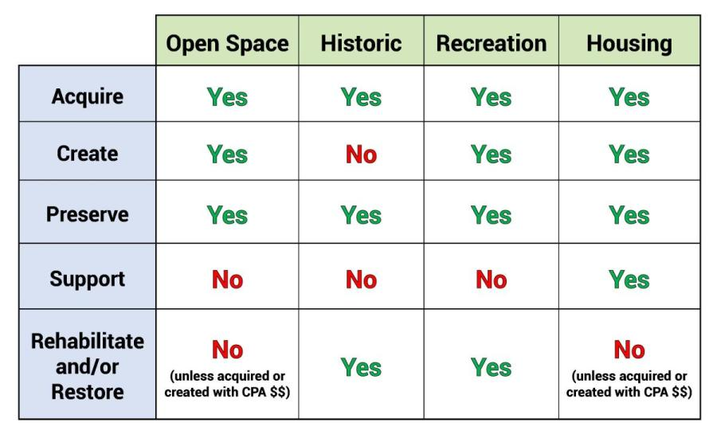
Hamilton CPC 2026 Annual Meeting
CPA Allowable Eligibility Categories
Notes:
This chart was developed by the Community Preservation Coalition.

Slide 16
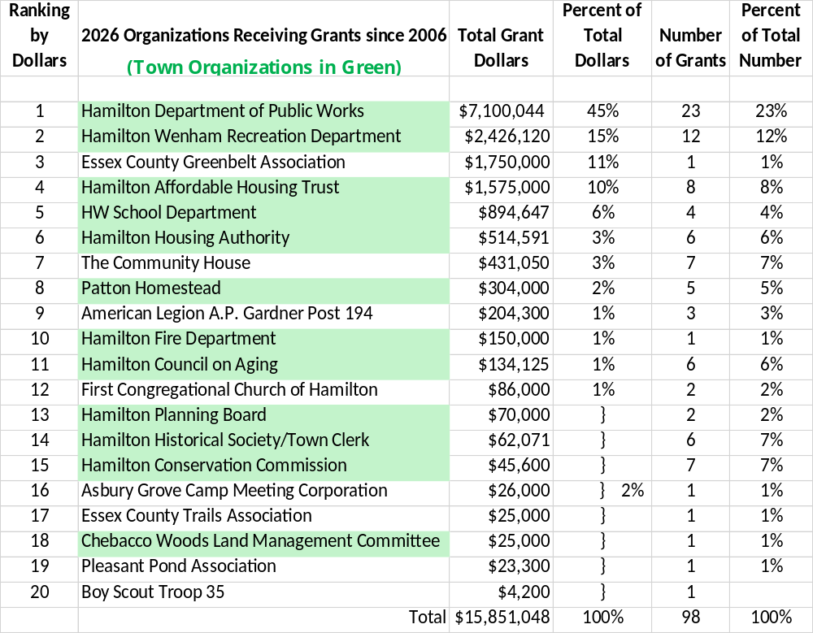
Notes:
Details on the total number of grants awarded available in the 2025 CPC Report.

Slide 17
Hamilton CPC 2026 Annual Meeting
Organizations Receiving Grants Since 2006
Orgs | Number of Orgs | Per Cent of Total Number of Orgs | Dollars of Grants | Per Cent of Total Dollars | Number of Grants | Per cent of Total Grants
Town Orgs | 12 | 60% | $13.3M | 84% | 81 | 83%
Other Orgs | 8 | 40% | $2.5M | 16% | 17 | 17%
Total | 20 | 100% | $15.8M | 100% | 98 | 100%

Slide 18
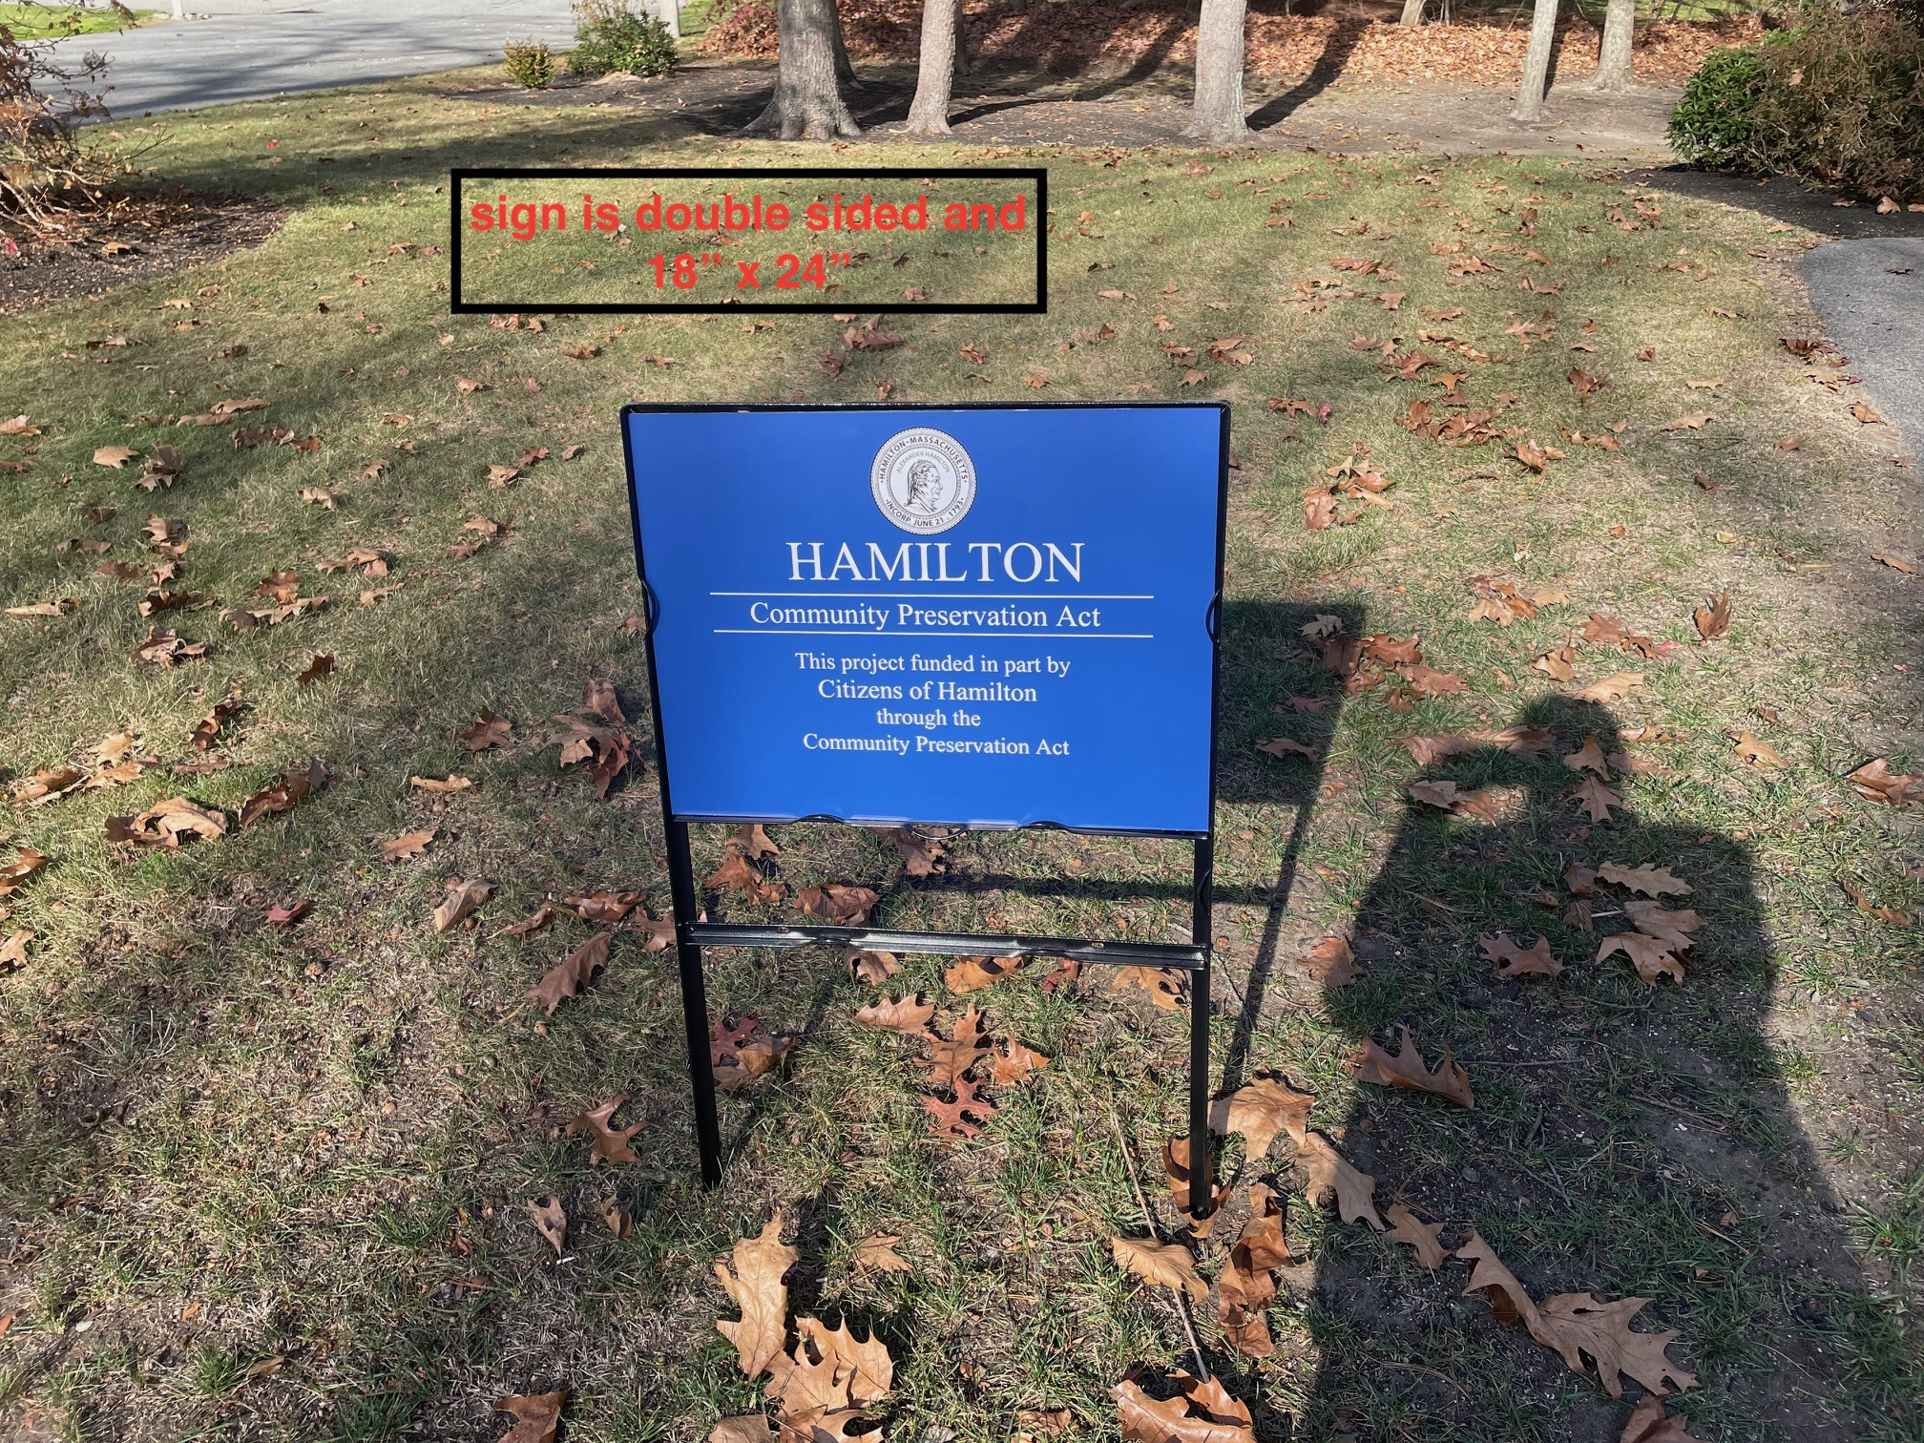
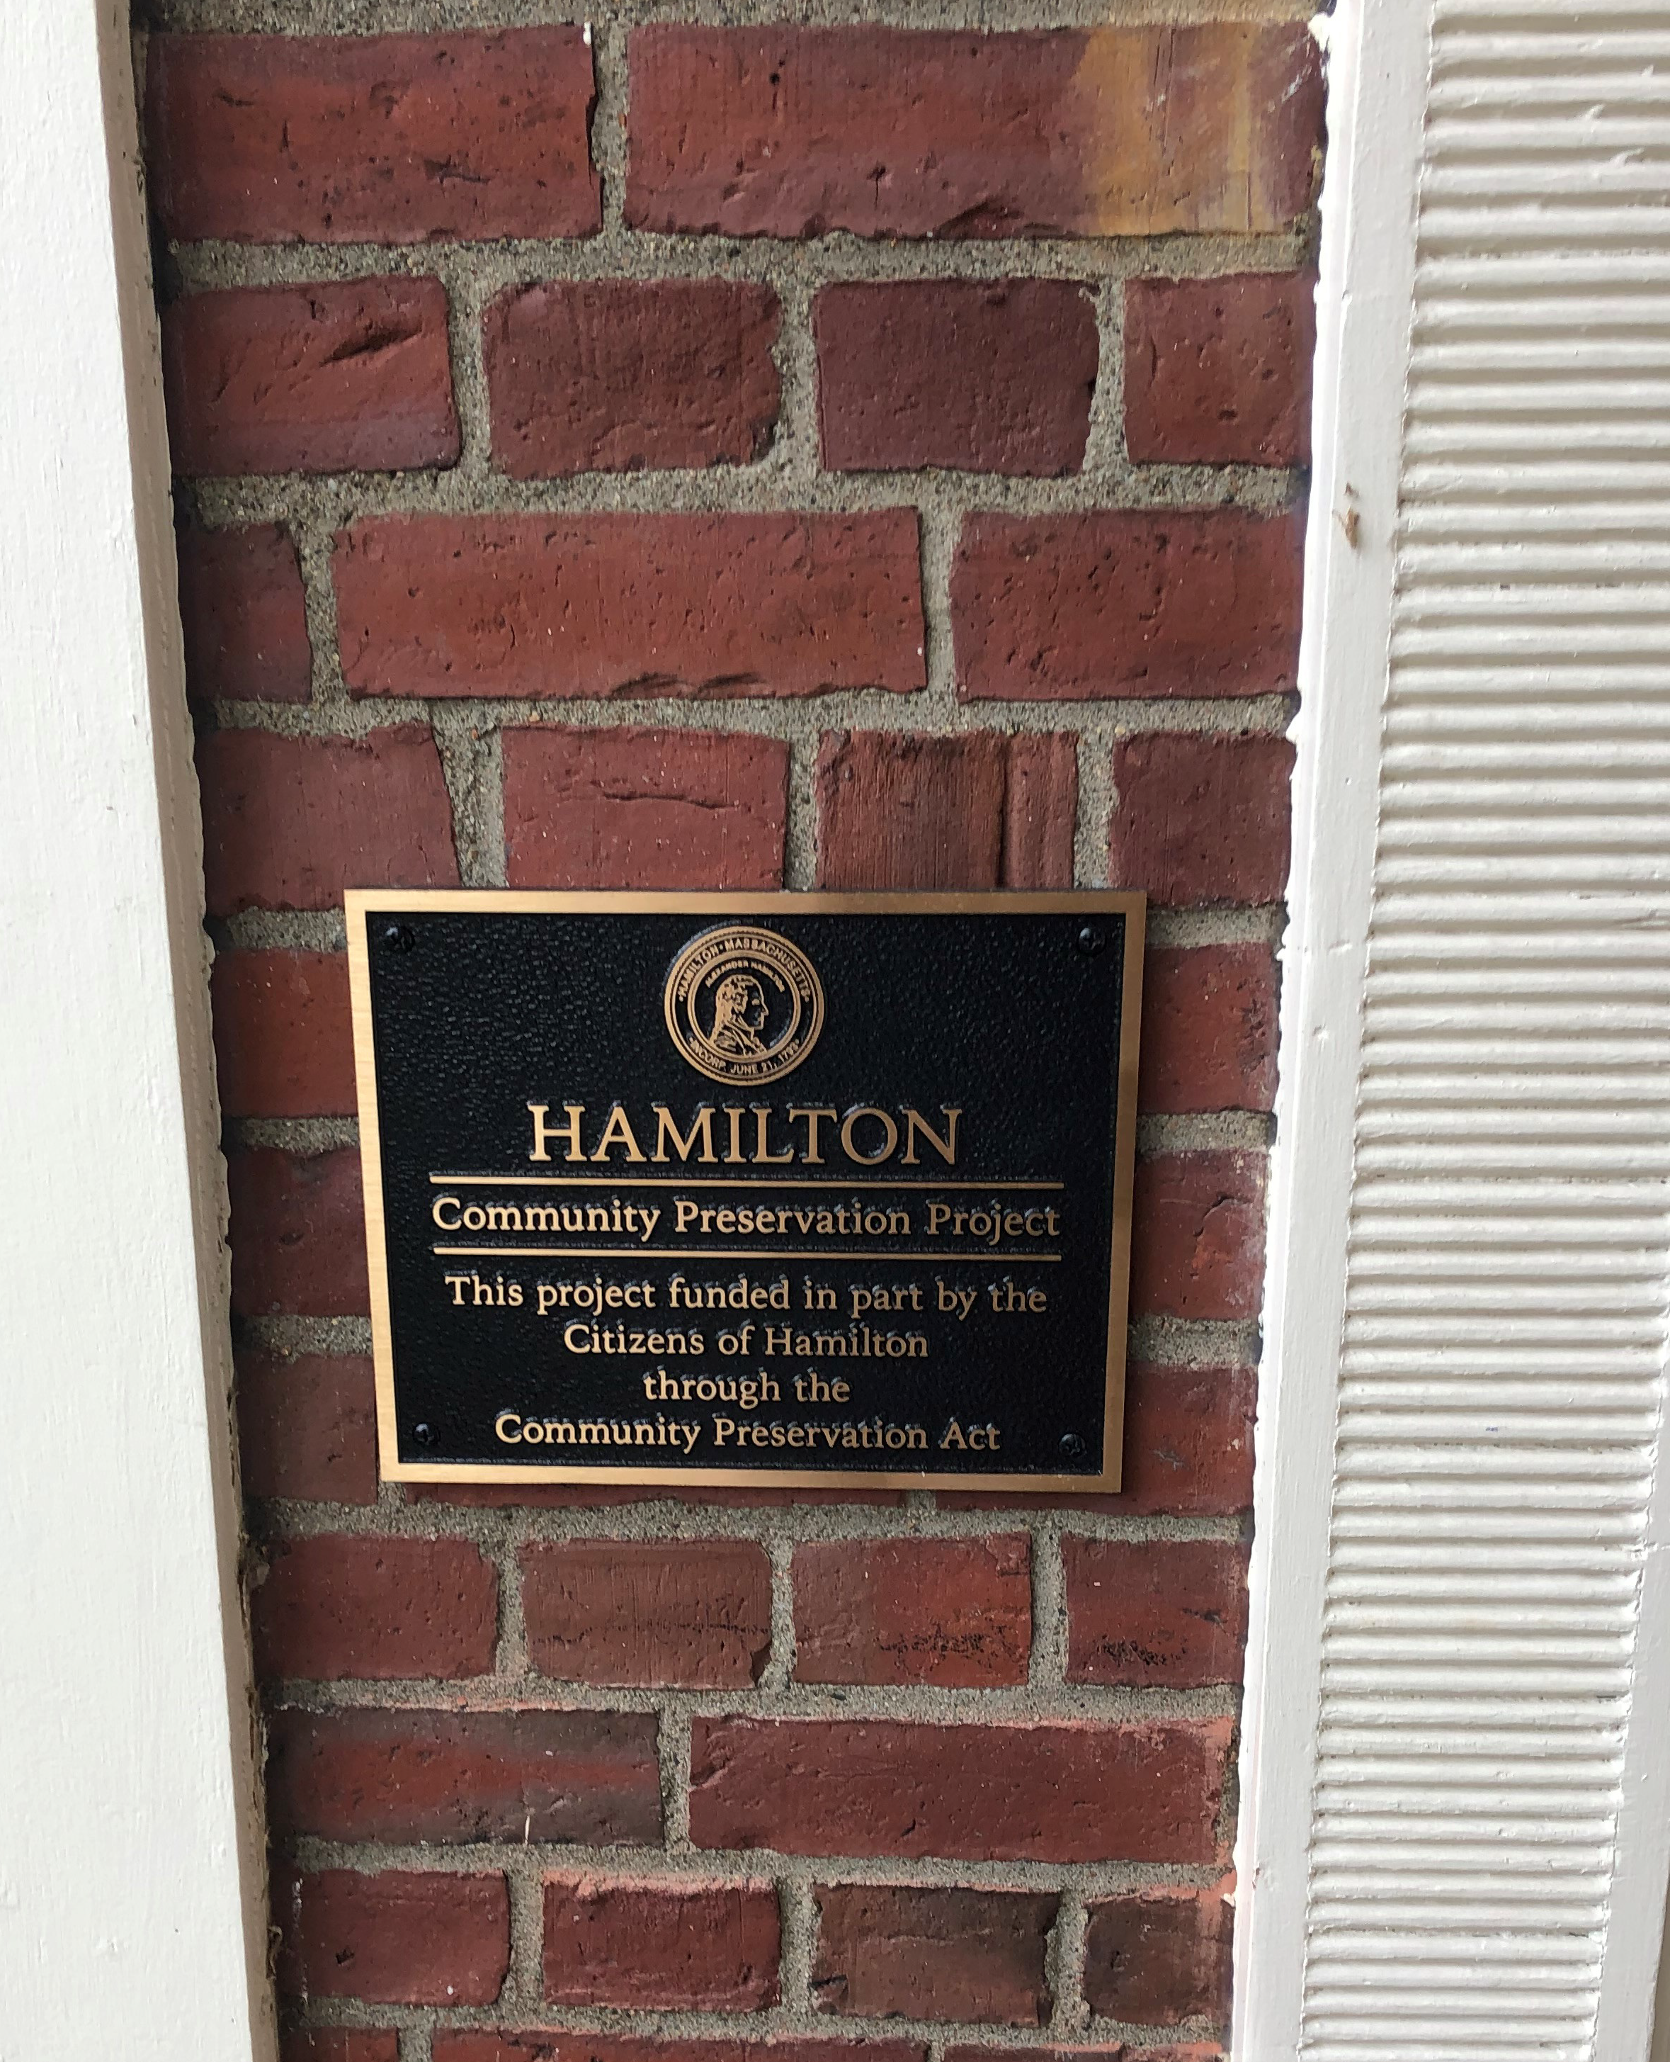
Hamilton CPC 2026 Annual Meeting
CPA Signage
Temp sign is 24” x 36”
Bronze plaque is 8” x 10”
Notes:
Temp signs installed at Hamilton Town Hall, HWRSD Middle School/High School Athletic Facilities, Habitat for Humanity 434-436 Asbury Street affordable housing, and at Hamilton Public Safety Building. Bronze plaques installed at The Community House, Hamilton Housing Authority, Hamilton Council on Aging Senior Center, First Congregational Church of Hamilton, Donovan Field, Patton Homestead, Sagamore Hill entrance, and Hamilton A.P. Gardner Post 194 American Legion. Other custom signage is at the Patton Park Memorial Pool and Firehouse Place, and soon at the Athletic Facilities behind the high school/middle school.

Slide 19
Hamilton CPC 2026 Annual Meeting
Historical Distribution of CPC Grants Since 2006
CPA Category | Total Number of Grants | Per Cent of Total Number | Dollars of Grants | Per Cent of Total Dollars
Open Space and Recreation | 32 | 33% | $5.5M | 35%
Historic Preservation | 50 | 51% | $8.1M | 51%
Community Housing | 16 | 16% | $2.2M | 14%
Total | 98 | 100% | $15.8M | 100%
Notes:
The imbalance of historic preservation and open space and recreation vs. community housing is noted and the CPC looks to better balance both the number of grants and associated dollars. The CPC has only voted no on one grant request for community housing, i.e., Longmeadow Way, which was voted down at Town meeting by a near unanimous vote. The CPC voted only $500k vs. a $1M ask for the Asbury Commons ask due to lack of funds, although the HAHT approved $250k. Community Housing grants are channeled through the Hamilton Affordable Housing Trust.

Slide 20
Hamilton CPC 2026 Annual Meeting
Grants approved this past Fiscal Year FY26:
One grant approved at the 2025 December STM
Project | CPA Category | Amount
Town Hall Renovation, Addition, and Preservation Project | Historical Preservation | $250,000

Slide 21
Hamilton CPC 2026 Annual Meeting
Current Open CPA Grants
Project | Amount
Hamilton Town Hall Renovation, Addition, and Preservation | $6.725M: Total of 8 grants = $75k, $150k, $250k – Design $3M, $1M, $1.5M – Bonds $500k, $250k
Asbury Common | $500K
Housing Production Plan Update | $40K
Notes:
These projects are all now eligible to receive funds if they send in invoices.

Slide 22
Hamilton CPC 2026 Annual Meeting
CPC Outstanding Bonds:
Sagamore Hill Conservation Project
  FY 2027 Premium = $99,550k
  Matures in 2032.
  Original 2015 CPA Grant was a $1.25M bond for 15 years plus $500k in cash

Slide 23
Hamilton CPC 2026 Annual Meeting
CPC Outstanding Bonds:
Hamilton Town Hall Renovation, Addition, and Preservation Project (two 20-year bonds)
  #1 - $4M - FY 2027 Premium = $331,400
    Consists of a $3M grant (2020 STM) and
    $1M grant (2021 ATM) = $4M.
  #2 - $1.5M - FY 2027 Premium = $140,025
    $1.5M grant (2024 STM)
  Total of 8 CPA grants for project = $75k (2017) +
  $150k (2019) + $250k (2019) + $3M (2020) + $1M (2021) + $500k (2023) + $1.5M (2024) + $250k (2025) = $6,725,000

Slide 24
Hamilton CPC 2026 Annual Meeting
Annual Bond Repayment Status FY27
Sagamore Hill @ $1.25M = $99.5k in FY27
  15 yr. bond matures in 2032 with $82.4k final payment
Hamilton Town Hall #1 @ $4M = $331.4k in FY27
  20 yr. bond matures in 2044 with $187.2k final payment
Hamilton Town Hall #2 @ $1.5M = $140k in FY27
  20 yr. bond matures in 2045 with $71.4k final payment
Total FY27 Bond Repayments = $570.9k
Total Projected FY27 2% Surcharge Revenue = $621k
No room for any new bonds in the near term

Slide 25
Hamilton CPC 2026 Annual Meeting
Estimated FY26 CPA Reserves on June 30, 2026
Unreserved = $ 549,070
Historic Preservation = $ 1
Open Space and Recreation = $ 336,000
Community Housing = $ 142,000
Total Reserves = $1,027,071
Notes:
(1) Unreserved funds can be used to fund grants in other categories if those category funds are not sufficient.
(2) Total Reserves will only grow by ~ $100k each year, near term, due to current state match amounts.

Slide 26
Hamilton CPC 2026 Annual Meeting
Future Anticipated Potential CPA Grants
Category A
Eligible Project, Good Cost Estimate, Strong Support
Category | Requestor | Project | Cost Estimate | Year
 |  | None

Slide 27
Hamilton CPC 2026 Annual Meeting
Future Anticipated Potential CPA Grants
Category B
Some Question on Eligibility, Cost Guesstimate, Project Needs More Definition
Category | Requestor | Project | Cost Guesstimate | Year

Slide 28
Hamilton CPC 2026 Annual Meeting
Future Anticipated Potential CPA Grants
Category C
No Project, Costs Unclear, Project Support in Question
Open Space and Recreation
HW Recreation Department
Rec Project on Pingree Park Tennis Courts
$50,000
2025
Open Space and Recreation
HW Recreation Department
Rec Project on Pingree Park Tennis Courts
$Oopen
2025
50,000
Open Space and Recreation
HW Recreation Department
Rec Project on Pingree Park Tennis Courts
$50,000
2025
Category | Requestor | Project | Cost Guesstimate | Year
Open Space and Recreation | HW Recreation Department | Rec Project on Pingree Park Tennis Courts | $50k | 2027
Open Space and Recreation | HW Recreation Department | Patton Park Improvements | $50k | 2027
Open Space and Recreation | Chebacco Lake & Watershed Association | Preservation of Chebacco Lake Watershed | $50k | 2027

Slide 29
Hamilton CPC 2026 Annual Meeting
2024 Hamilton Master Plan - Implementation Program
Cultural and Historic Resources Goal
Protect Hamilton’s historic structures and sites, especially in the Hamilton Historic District….
Create a grant program for the maintenance and restoration of privately owned historic structures….
Based on the priorities identified in the Comprehensive Cultural Resources Inventory, potentially using CPA funds.
Notes:
This is the only requirement for the CPC in the new Master Plan. The May 2005, Hamilton Renaissance Report, Essex County Landscape Inventory Program, prepared by the MA Department of Conservation and Recreation and the Essex National Heritage Commission may need updating to pursue this task. The MA Historical Commission has info on historic properties in Hamilton.
The preservation of privately owned historic structure is eligible for CPA grants, after meeting certain requirements, including historical importance determination by the Historical Society or the Hamilton Historic District Commission.

Slide 30
Hamilton CPC 2026 Annual Meeting
Final Comments
The CPC typically meets the second Thursday of the month and welcomes the public to attend and comment.
The CPC would appreciate more advance information from organizations considering applying for CPA grants. We are happy to meet with you and discuss your ideas in advance.
The next deadline for application for CPA grants is January 4, 2027 for the 2027 ATM. For more info, contact the CPC Coordinator, Laurie Wilson, lwilson@hamiltonma.gov.
The CPC will continue to communicate with the Wenham CPC for projects requested by the HW Recreation Department, the HW Library, and the HW Regional School District.
More detailed information on the CPA and CPC activities is available in the 2026 Annual CPC Report, available on the CPC web page.
Thank you,
Robert Preston, Chair, CPC

